Slide 1


Empowering Teachers for All Learners To Succeed
Presentation at Educaid Webinar
Quentin Wodon, September 2026

Slide 2
Structure of presentation
Background on IICBA & what’s in it for you
Teacher policies: Careers, standards, CPD
Diagnostic tool: Scorecard
Surveys: Teacher well-being, school leadership, etc.
Example of (light) evaluation: Ethiopia summer training
IICBA research: Selected outputs

Slide 3
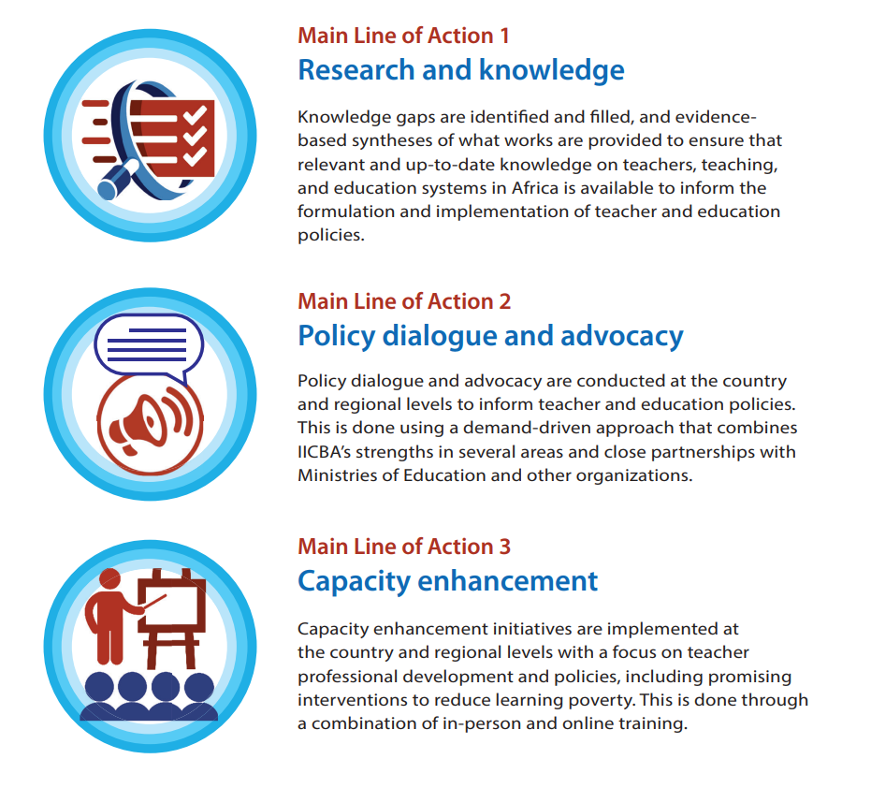

IICBA Progress Report and Strategy Update
More emphasis in 2026-28: Higher Ed & TTIs, eLearning and digital, OOSC, STEM/labor markets/skills, intersectoral work

Slide 4
Great team
Team (85% Africans): 25 staff & a dozen LT consultants
Strong Performance
Annual revenue x4
Financial reserves x11
Program beneficiaries x15
Website users x32
Research x50
… but still a small Institute.

Slide 5
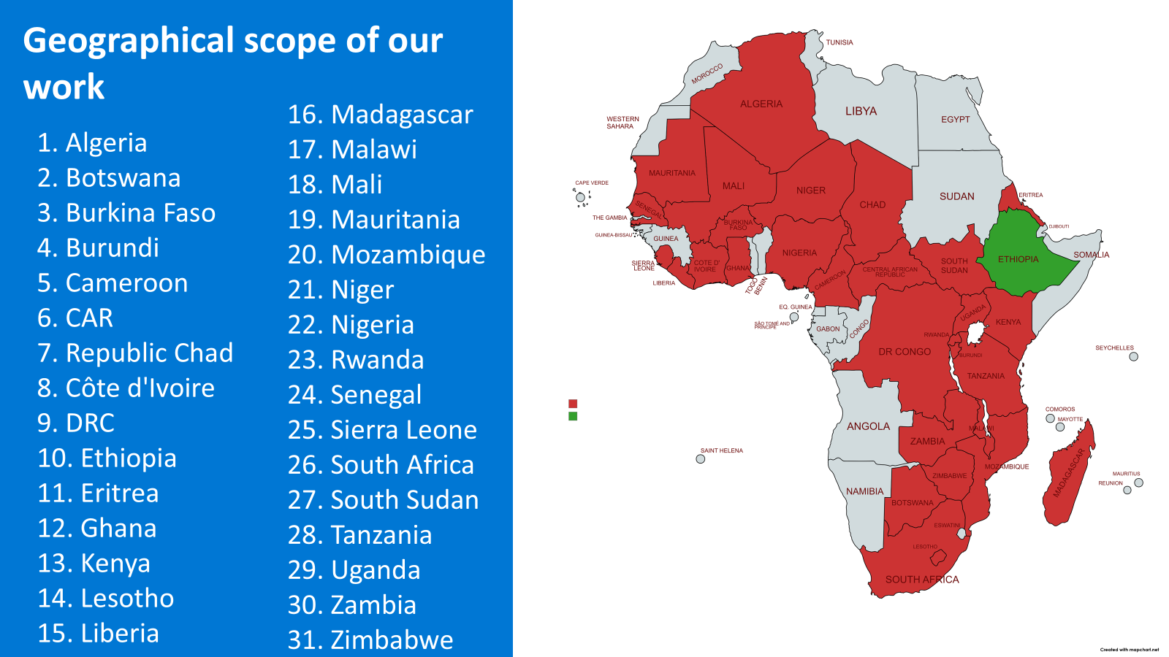

Slide 6



Support to the African Union: CESA 26-35 & MHPSS Strategy

Slide 7

What’s in it for you? Example of study
Research – Studies, DPs, KBs, DBs
Africa Teachers Webinar Series
Africa Education Knowledge Platform
Online Communities of Practice eLearning Courses
Training Manuals
Journal of Teaching & Learning in Africa
Interviews, Magazine with AU, etc.
Workshops & Conferences

Slide 8




IICBA eLearning and Digital Focus
Digital Competence (6)
Teacher Preventing Violence (1)
Gender Responsive Pedagogy (2)
Mental Health and Psychosocial Support (3)
Safe Learning Environment (3)
School leadership (1)
Digital Inclusion and Equality: Designing Equitable Digital Futures (1)
Practical AI Literacy and Classroom Integration (1)
© UNESCO IICBA
footer

Slide 9
Program: On-going Projects
Knowledge & Innovation eXchange (KIX) Africa 19 (until 2027)
EU Regional Teachers Initiative for Africa (until 2029)
Capacity-building for Girls’ Ed in West Africa (until 2027)
Professionalization of Teaching in Asia-Pacific/Africa (until 2026)
→ Situational analyses, reviews of policies, scorecards
Support to GPE Grants incl. Chad & Cote d’Ivoire (until 2028)
Empowering Female Teachers/Leaders w/ eLearning (until 2026)
Innovative Teacher PD through eLearning in Ethiopia (until 2026)

Slide 10
Program: New Projects
Enabling OOSC to Join Formal Education w/ ALP (until 2029)
GPE Grants Burundi, Cameroon, Madagascar, Mali (until 2028)
Country Support Mechanism under KIX Africa 19 (until 2027)
Secondary School Youth for Workforce Readiness (until 2027)
Education Systems in Crisis Cameroon, DRC, Uganda (until 2027)
Others:
Research grants (Fates, Mastercard Foundation & AfECN)
CapED and O3 – support to HQ-led programs
Other work – example of Deans Forum

Slide 11
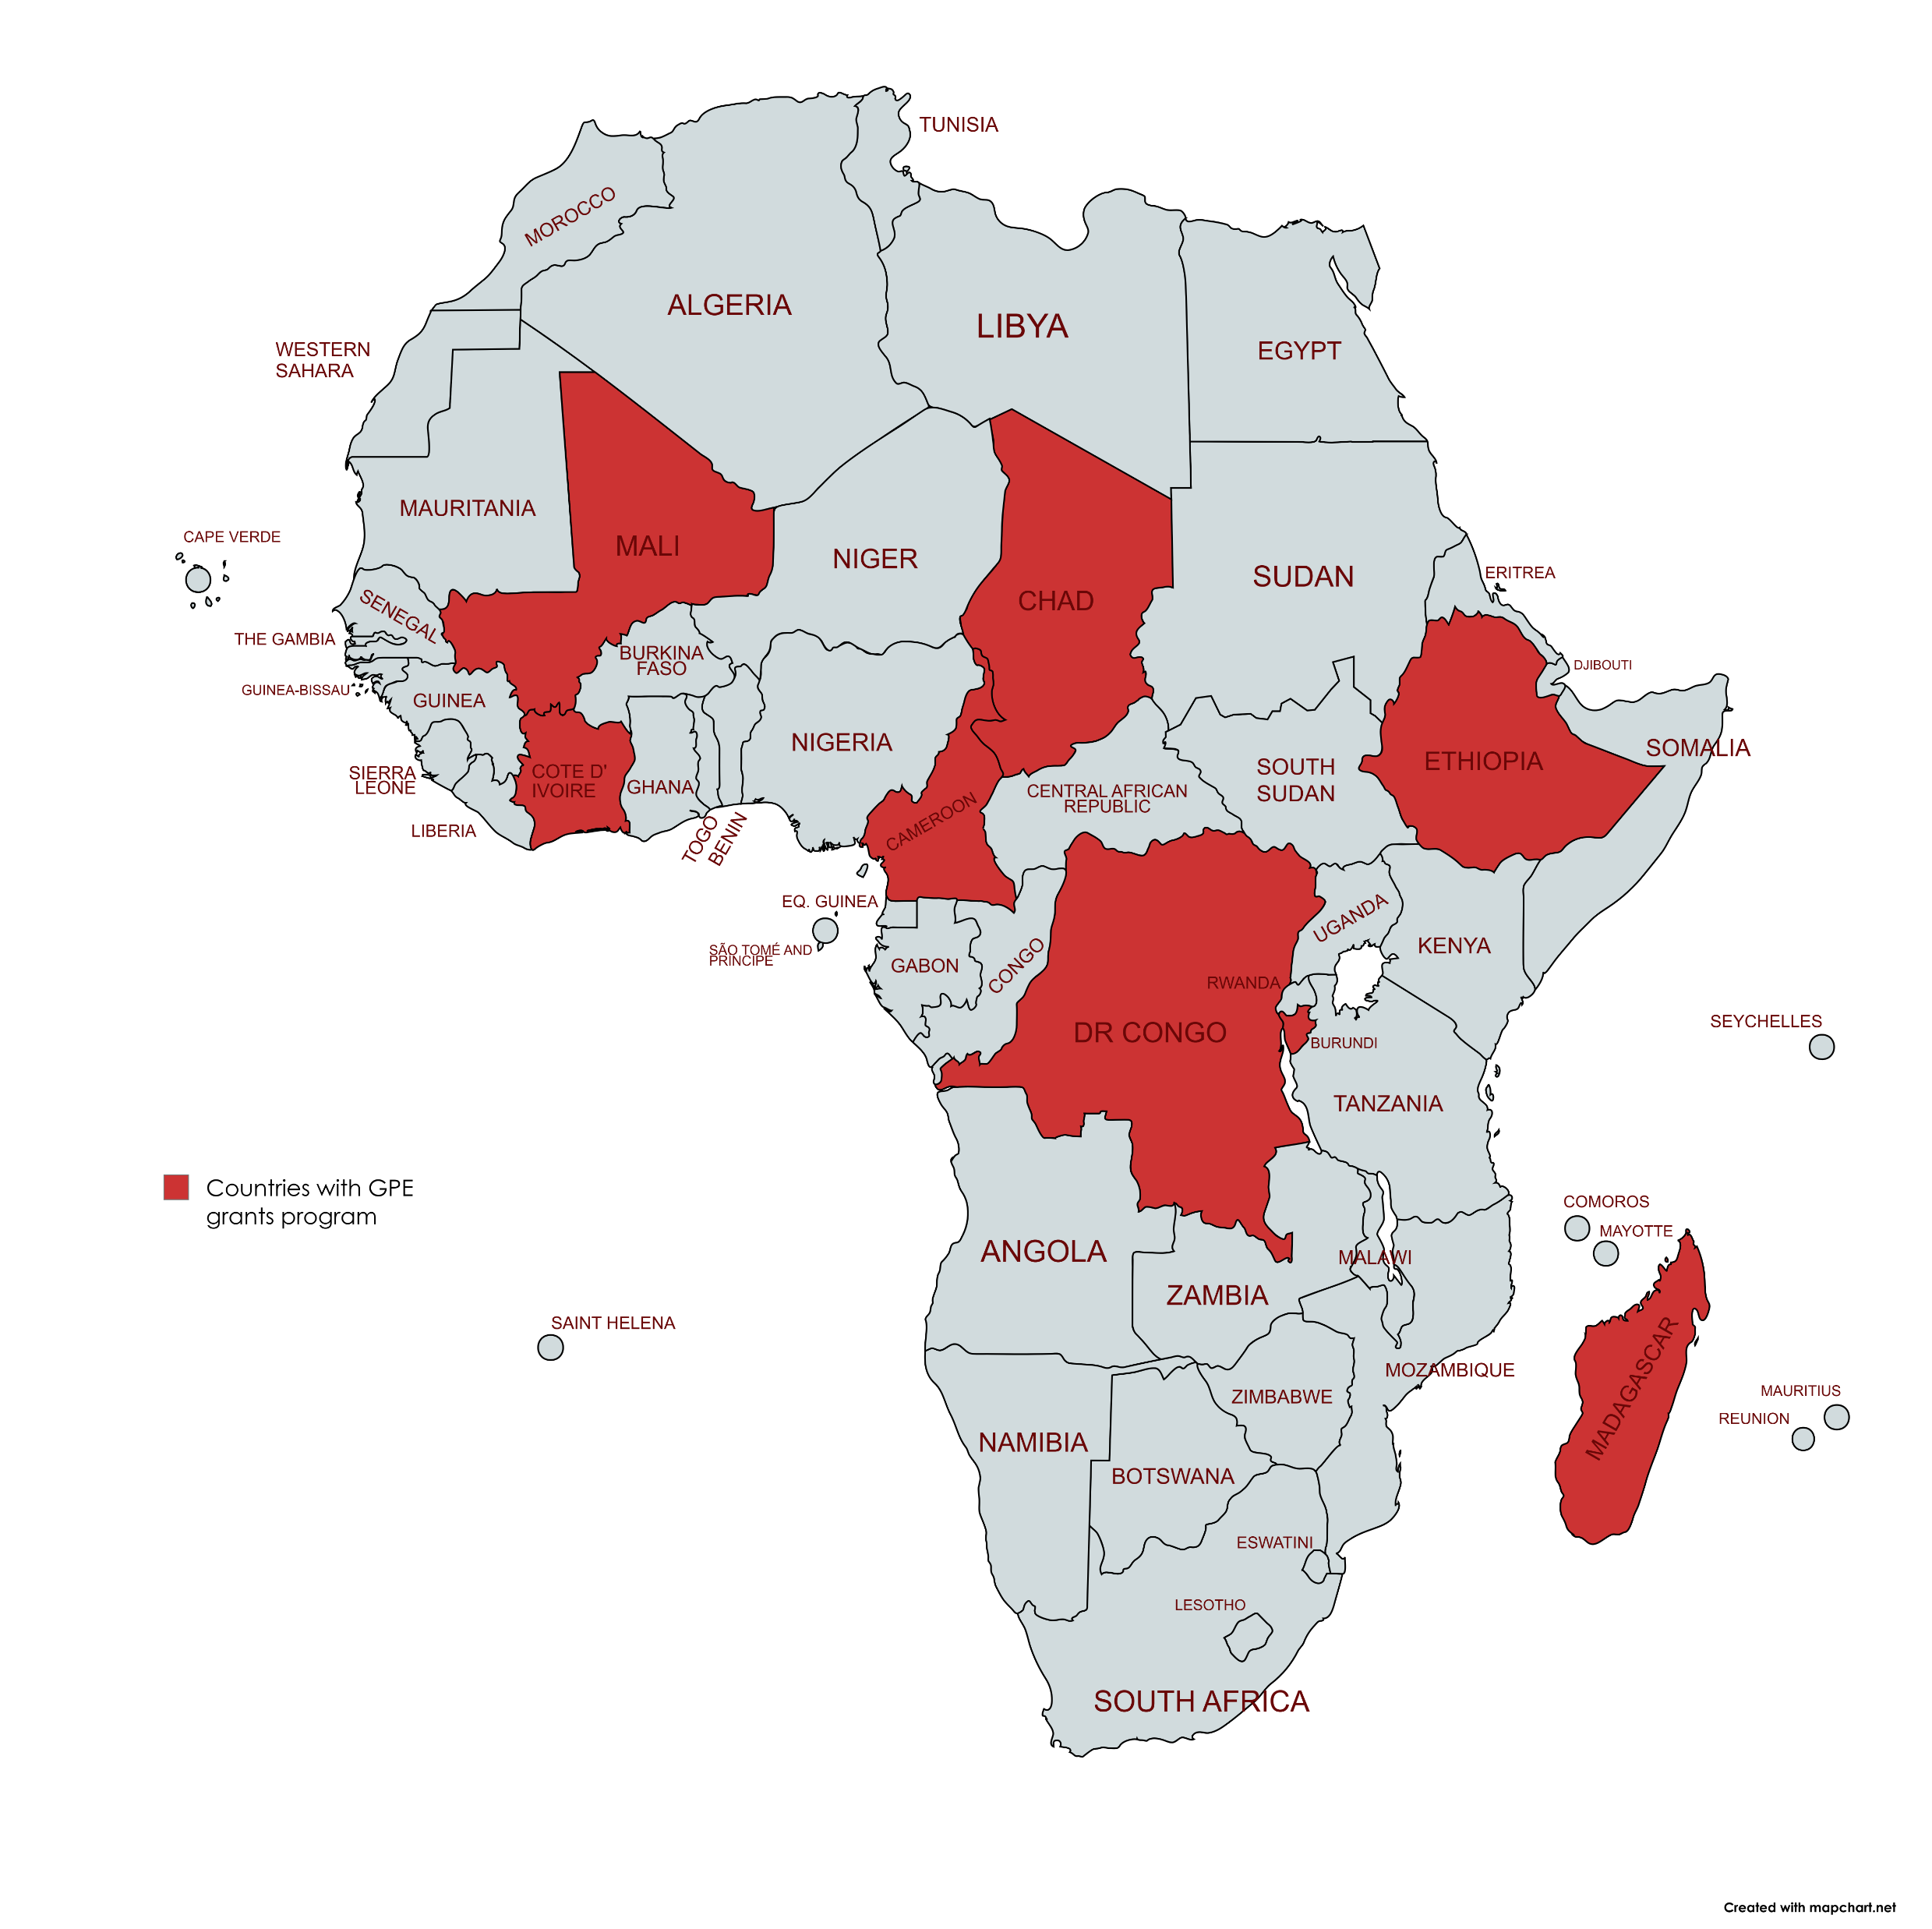
GPE grants - Overview
Funding: GPE grants managed by UNESCO
Aim: IICBA support national teacher education reforms in Côte d'Ivoire, Cameroon, Chad, Burundi, Mali, DRC, Madagascar, Ethiopia
Focus: Professional development for teachers (pre-primary, primary and lower and upper secondary)
💰 GPE → 🏛️ UNESCO IICBA → 📚 Ministries → 👩‍🏫 Teachers → 🎓 Learners
Empowering Teachers for All Learners To Thrive

Slide 12
Structure of presentation
Background on IICBA & what’s in it for you
Teacher policies: Careers, standards, CPD
Diagnostic tool: Scorecard
Surveys: Teacher well-being, school leadership, etc.
Example of (light) evaluation: Ethiopia summer training
IICBA research: Selected outputs

Slide 13
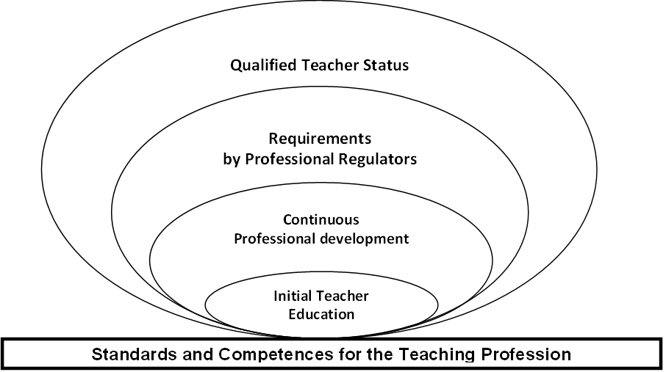
AU Frameworks including African Continental Teacher Qualification Framework

Slide 14
Familiarity with AU Frameworks
(21 countries, 33 responses)

Slide 15
Alignment of National Frameworks with the Domains of the AU Standards for Teachers

Slide 16
Alignment of National Frameworks with the Domains of the AU Standards for School Leaders

Slide 17
Career Stages for Teachers and School Leaders

Slide 18
CPD Frameworks + Link with Career Stages (%)

Slide 19
Teachers Benefitting from CPD, Last 3 Years (%)

Slide 20
Teacher salaries & working conditions West Africa

Slide 21
Teacher salaries & working conditions - Burkina
 | Public schools |  |  | Private school
 | Primary | Secondary | All | Primary | Secondary | All
 | Burkina Faso
Salary (FCFA. 1000) | 1 995 | 2 416 | 2 139 | 893 | 1 367 | 1 188
Second job (%) | 19.4 | 27.6 | 22.1 | 17.0 | 13.2 | 14.6
Days worked/month | 20.9 | 21.5 | 21.1 | 20.8 | 19.1 | 19.7
Hours worked/day | 7.9 | 7.2 | 7.7 | 7.8 | 5.8 | 6.5
Annual leave (%) | 99.8 | 100.0 | 99.9 | 30.9 | 4.6 | 14.4
Sick leave (%) | 64.9 | 65.2 | 65.0 | 29.4 | 9.8 | 17.1
Pension (%) | 83.8 | 87.9 | 85.1 | 31.0 | 7.4 | 16.2
Maternity leave (%) | 70.9 | 57.4 | 66.5 | 24.3 | 3.7 | 11.4
Bonus (%) | 2.7 | 2.5 | 2.7 | 4.5 | 3.0 | 3.5
Other benefits (%) | 24.9 | 23.9 | 24.6 | 0.3 | 2.5 | 1.7
Food received (%) | 0.2 | 0.0 | 0.1 | 3.2 | 0.0 | 1.2

Slide 22
Teacher salaries & working conditions - Burkina
 | Public schools |  |  | Private school
 | Primary | Secondary | All | Primary | Secondary | All
 | Burkina Faso
Household Poverty | 0.6 | 0.0 | 0.4 | 6.3 | 0.0 | 2.4
Quintile of well-being
Bottom quintile | 0.0 | 0.0 | 0.0 | 6.2 | 0.0 | 2.3
Second quintile | 0.6 | 0.0 | 0.4 | 0.1 | 0.0 | 0.1
Middle quintile | 2.4 | 0.0 | 1.6 | 5.9 | 0.0 | 2.2
Fourth quintile | 12.1 | 7.7 | 10.7 | 41.3 | 2.9 | 17.2
Top quintile | 84.9 | 92.3 | 87.3 | 46.5 | 97.1 | 78.2
Total | 100.0 | 100.0 | 100.0 | 100.0 | 100.0 | 100.0

Slide 23
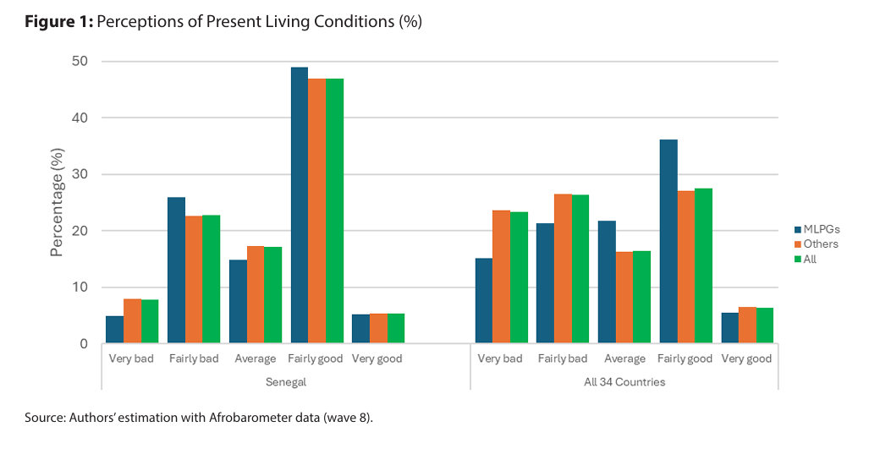
Afrobarometer - MLPGs

Slide 24
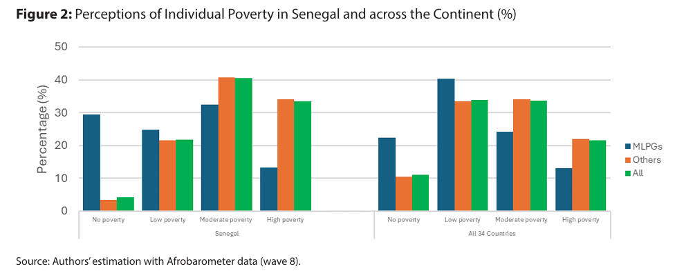
2 – Afrobarometer - MLPGs

Slide 25
Structure of presentation
Background on IICBA & what’s in it for you
Teacher policies: Careers, standards, CPD
Diagnostic tool: Scorecard
Surveys: Teacher well-being, school leadership, etc.
Example of (light) evaluation: Ethiopia summer training
IICBA research: Selected outputs

Slide 26
Technical Guidelines: Evaluation Criteria
Legal standing
International frameworks
Pre-service teacher education
Teacher CPD
Teacher working conditions
15
11
Is the framework aligned with international frameworks (e.g., UNESCO, AU)
Is there a law to professionalize teaching?
(i.e., Implementation of AU Continental Guidelines on the Teaching Profession; registration and licensing of Teachers? School leaders?)
13
15
Has CPD been aligned with the AU Continental Teacher Qualification Framework?
Has a national CPD framework been developed and implemented? Career pathways?
Has pre-service teacher education been aligned with the AU Continental Teacher Qualification Framework?
Have the necessary reforms been implemented to raise the quality of pre-service teacher education to match international standards?
13
How conducive are the teacher working conditions to ensure the achievement of the national framework of teaching standards and competencies?
Has the country implemented AU (2017) teacher working conditions and UNESCO-IICBA (2017) teacher support motivation framework recommendations?

Slide 27
Criterion 1:
Overarching international frameworks of teaching standards and related policy documents
Examples
0=Not started;
1=Concept stage;
2=Preliminary stage (1st draft);
3=Advanced (final draft);
4=Completed (published)
At what stage is the development of the national framework of teaching standards and competencies?
At what stage is the development of the national framework of standards for school leadership?
Is the national framework aligned with the African Teacher Qualification Framework, ATQF (African Union, 2019)?
Does the national framework have the same (or contextualized) professional domains as ATQF?
0=Not at all/No framework;
1=Less partially, <25%;
2=Partially, about 25-50%;
3=Mostly, about 50-75%;
4=Almost or completely, >75%
Does the national framework have the same (or contextualized) career stages for teachers as the ATQF?

Slide 28
Criterion 2:
Legal standing of the teaching profession
0=Bill not yet drafted;
1=Bill being drafted;
2=Bill in parliament);
3=Bill enacted by parliament;
4=Bill signed into law)
Examples
Has the country enacted a law that recognizes teaching as a profession to be practiced only by individuals with acceptable teaching qualifications, and who are registered and licensed?
0=Entry qualification not specified
1=Much below ATQF (e.g., Certificate in Education);
2=Below ATQF (e.g., Diploma in Education)
3=Slightly below ATQF (e.g., bachelor’s degree with no qualification in education);
4=Same or above ATQF (i.e., Bachelor of Education or Bachelor’s degree with Post Graduate Diploma in Education)
Has the country established a statutory National Teaching Council (or any other form of statutory teaching authority) which regulates teaching as a profession, registers and licenses teachers and school leaders?
Has the country enacted a law on teacher registration and licensing in accordance with ATQF?
Does the country's minimum entry qualification for teaching comply with the ATQF?

Slide 29
Criterion 3:
Pre-service teacher education
0=Entry qualification not specified;
1=Much below ATQF (e.g., ISCED Level 2);
2=Below ATQF (e.g., ISCED Level 3 with no requirements for passes at credit level);
3=Slightly below ATQF (e.g., ISCED Level 3 with credit in at least four subjects);
4=Same or above ATQF (i.e., ISCED Level 3 with passes at credit level in at least five subjects including mathematics and any of the major languages)
Examples
Does the country's minimum pass level (at Upper Secondary or ISCED Level 3) for entry into various education programs comply with the ATQF?
Is the country's national teacher education curriculum framework aligned with the ATQF?
Is the ECD and primary school teacher education program aligned with the primary school curriculum?
ISCED =The International Standard Classification of Education
What proportion of teacher educators have at a master’s degree as specified by the ATQF?

Slide 30
Criterion 4:
Teacher CPD
Examples
0=Not at all/No framework;
1=Less partially, <25%;
2=Partially, about 25-50%;
3=Mostly, about 50-75%;
4=Almost or completely, >75%
Is the country's national CPD framework aligned with ATQF?
Are there CPD credit units; and if yes, do they count towards the advancement of the teachers and school leaders along the career path?
What proportion of the available CPD programs can be classified as of best quality and relevant to teachers and school leaders?
What proportional of school leaders have taken a mandatory training in school management?

Slide 31
Criterion 5:
Teacher working conditions
Examples
What proportion of teachers are highly or very highly satisfied with their renumerations?
What proportion of teachers are highly or very highly satisfied with their teaching jobs?
0=Very low, <10%;
1=Low, 10-25%;
2=Moderate, 26-75%;
3=High, 76-95%;
4=Very high, >95%
What proportion of teachers would still choose teaching as a career given another opportunity
What proportional of school leaders have taken a mandatory training in school management?

Slide 32
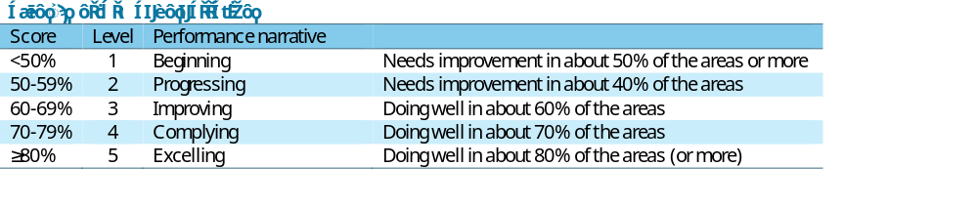


Evaluating Progress in the Implementation of National Standards and Competencies for Teachers and School Leaders: A Case Study of Liberia, Sierra Leone and The Gambia
Objective: To evaluate the progress in the implementation of national standards and competencies for teachers and school leaders.
Criteria for Evaluation: Five key criteria were assessed, covering (a) alignment with international frameworks, (b) legal standing of the teaching profession, (c) pre-service teacher education, (d) continuous professional development, and (e) teacher working conditions
Method: The evaluation process utilized a self-rating strategy through national stakeholder roundtable discussions to reach consensus on scores for each of the 105 selected indicator of progress.
• Stakeholders awarded scores on a scale of 0-4 for the105 indicators.
• For each of the five evaluation criteria, scores from the various indicators were converted to percentage scores.
• The performance narrative categorizes scores into five levels, from "Beginning" (<50%) to “Excelling" (≥80%) (see Table 1)
Shanghai FIT Project

Slide 33
Criterion 6:
Teacher & FLN – what would make sense (not tested yet)?
Examples
Teacher training: Science of learning, TaRL, Structured pedagogy
Outcomes data: Student assessments and role of teachers
0=Very low, <10%;
1=Low, 10-25%;
2=Moderate, 26-75%;
3=High, 76-95%;
4=Very high, >95%
Materials for teachers and learners
What proportional of school leaders have taken a mandatory training in pedagogy targeting FLN?

Slide 34
Structure of presentation
Background on IICBA & what’s in it for you
Teacher policies: Careers, standards, CPD
Diagnostic tool: Scorecard
Surveys: Teacher well-being, school leadership, etc.
Example of (light) evaluation: Ethiopia summer training
IICBA research: Selected outputs

Slide 35
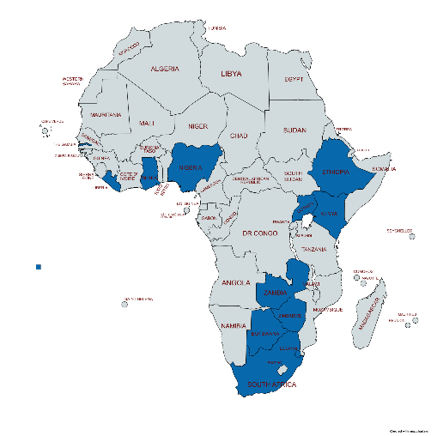
Key Findings on Teacher Well-being
Teacher well-being surveys completed in a dozen countries (twice in two countries). Two parts in the surveys:
Common core - satisfaction
Special theme - MHPSS
→ Fourth Africa Teachers Report on teacher well-being to be shared at AFTRA annual conference in Botswana.

Slide 36
What best describes your career plans for the next five years?
Encouragingly, for both countries, a vast majority of the teachers (>75%) interviewed plan to stay on the job either as teachers or as school leaders

Slide 37
Teacher perceptions on their job satisfaction
For both countries, only a small proportion of the teachers interviewed are happy with their job compensation…
… Nevertheless, many of the teachers agree or strongly agree to be highly satisfied with their jobs
… thus, apart from the renumeration, there are other factors involved in teacher job-satisfaction

Slide 38
Please rate the level of importance of the following factors that influences a teacher’s decision to stay in the job …
Nigeria (n=1,192)
Ghana (n=1,456)
Rank
Rank
1
1
2
2
3
3
Topmost factors influencing a teacher decision to stay on the job …
4
4
5
5
6
6
School leadership
7
7
8
8
Manageable workload
9
9
10
10
11
11
Opportunities for career development
12
12
13
13
Job security
14
14
15
15

Slide 39
Level of participation in-service courses in the last 3 years
Apart from ICT issues, the levels CPD levels on these issues are generally low or very low, and more so on MHPSS issues

Slide 40
Support to learner mental health issues
Less than one-half of these teachers reported availability of appropriate support for mental issues for learners in their schools

Slide 41


Liberia Case Study
[Conducted in July-August 2025]

Slide 42
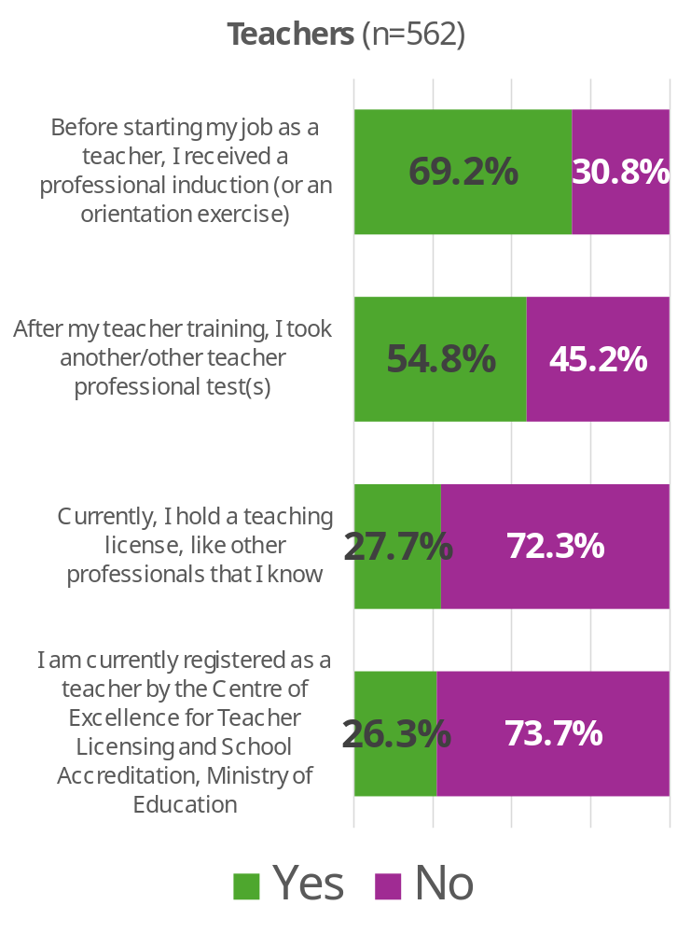
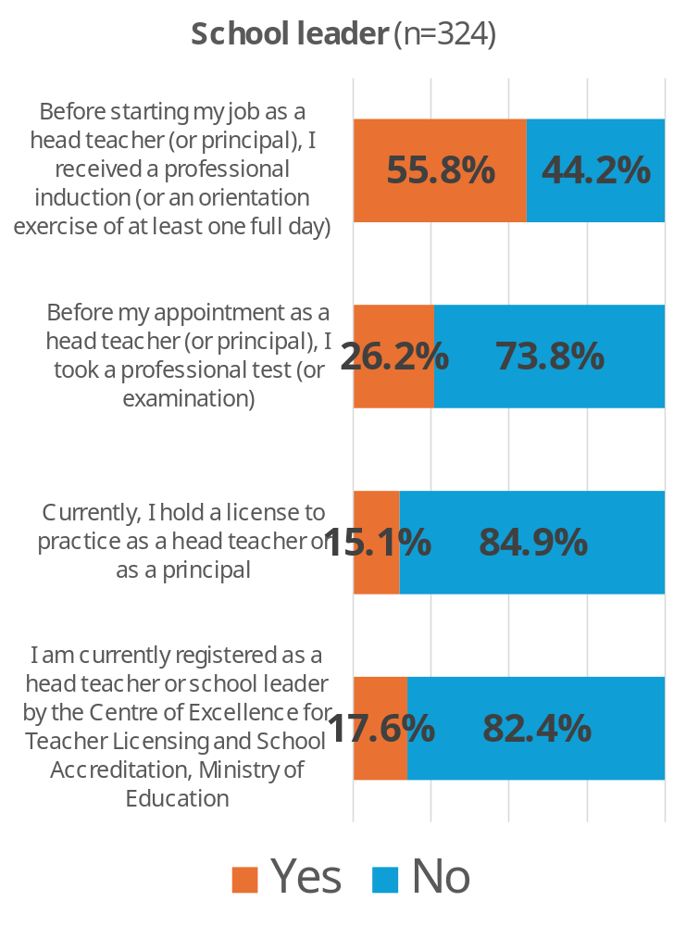
Levels of entry exam, registration, licensing and induction
Levels of registration and licensing are low, and more so among school leaders

Slide 43
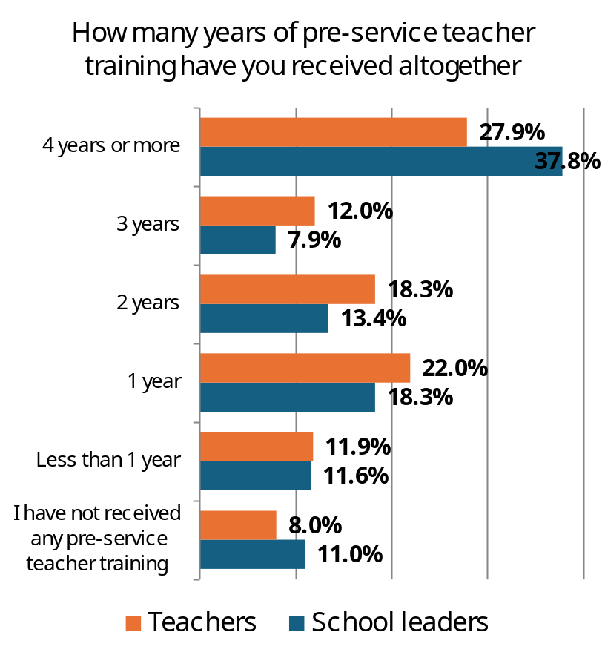
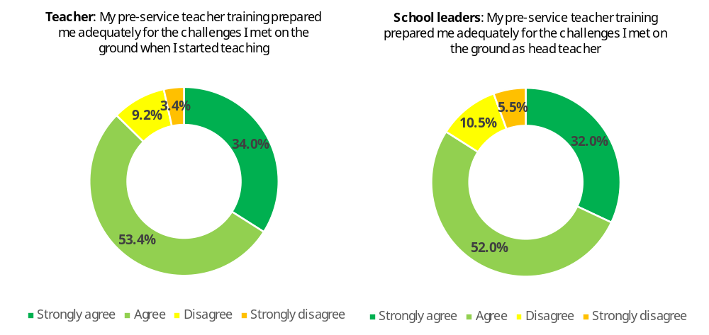
Levels and adequacy of pre-service teacher training
88%
84%
Around four in every ten (40%) of the teachers reported receiving at least 3 years of pre-service training
A vast majority of the teachers (88%) and school leaders (84%) “agreed” or “strongly agreed” that their pre-service training prepared them adequately for the challenges they met on the ground as teachers or head teachers

Slide 44
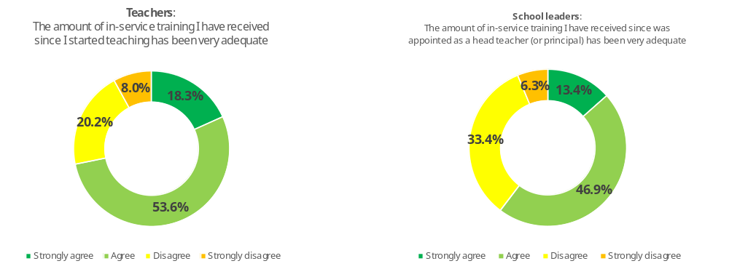
Adequacy of CPD received since becoming a teacher or leader
72%
60%
The levels of adequacy of CPD received are notably higher among teachers (72%) than among school leaders (60%)

Slide 45
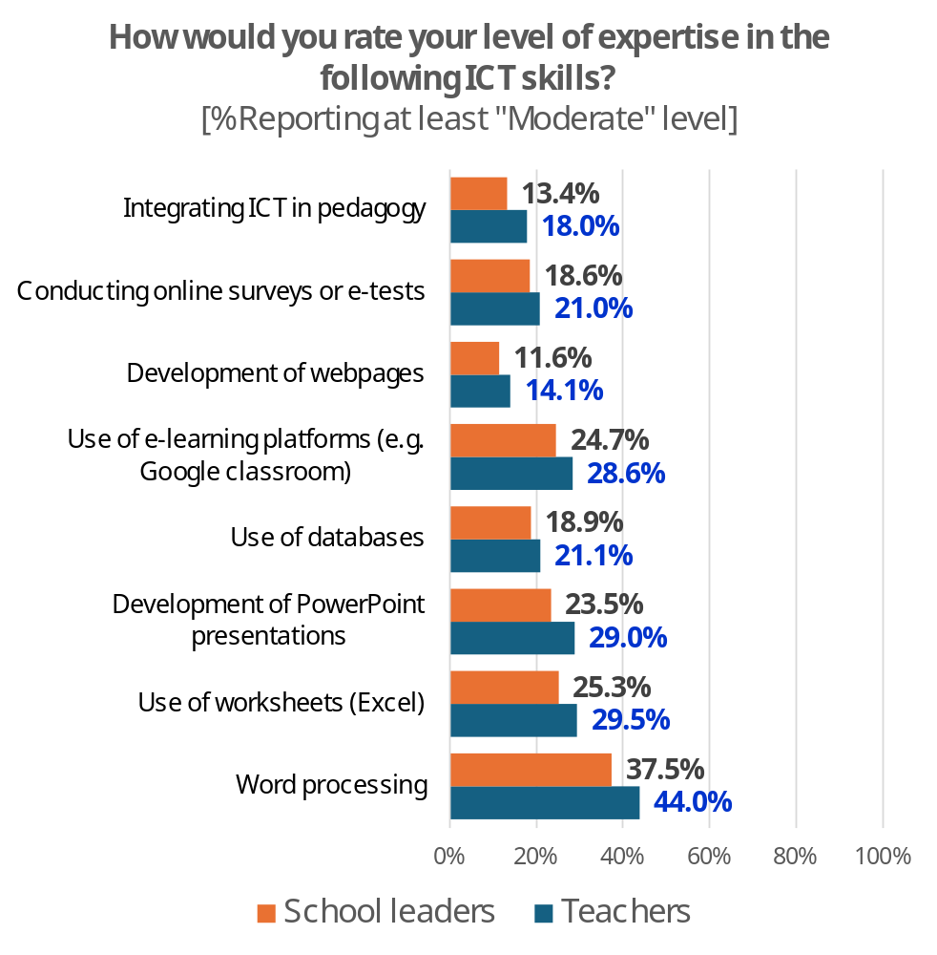
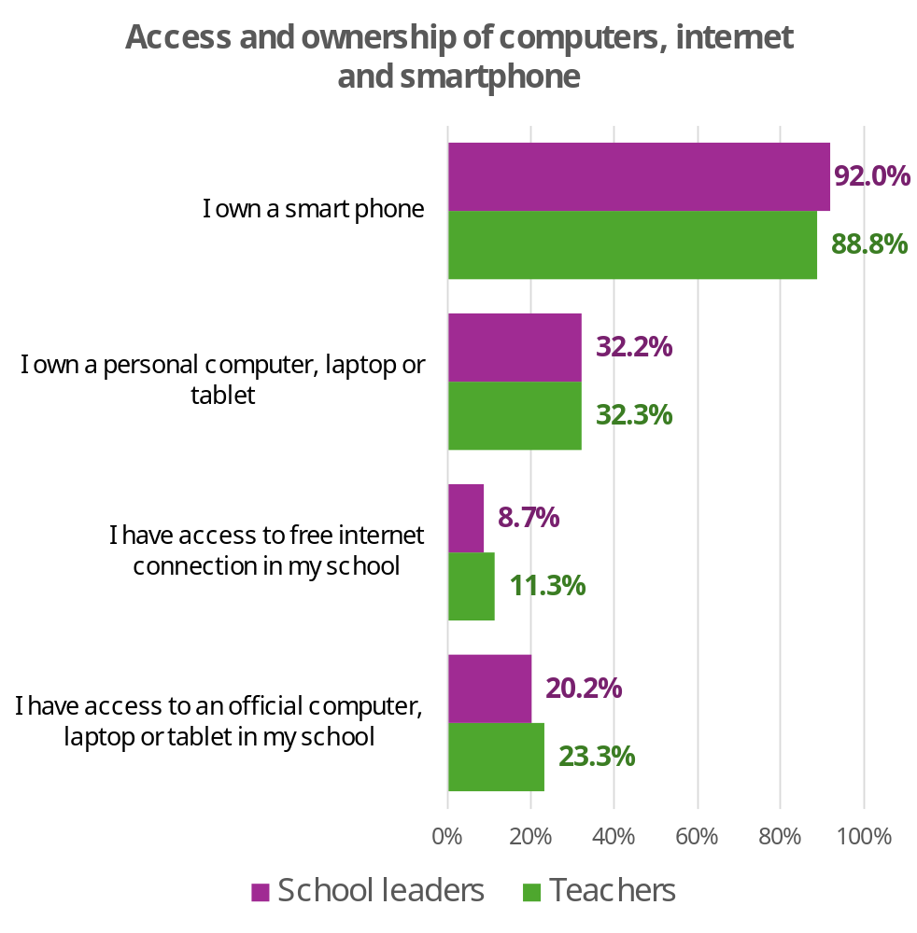
Level of expertise in ICT skills and access to ICT facilities
In general, the levels of expertise in basic ICT skills are low or very low
Very few teachers (11.3%) and school leaders (8.7%) have access to free internet connection in their school

Slide 46
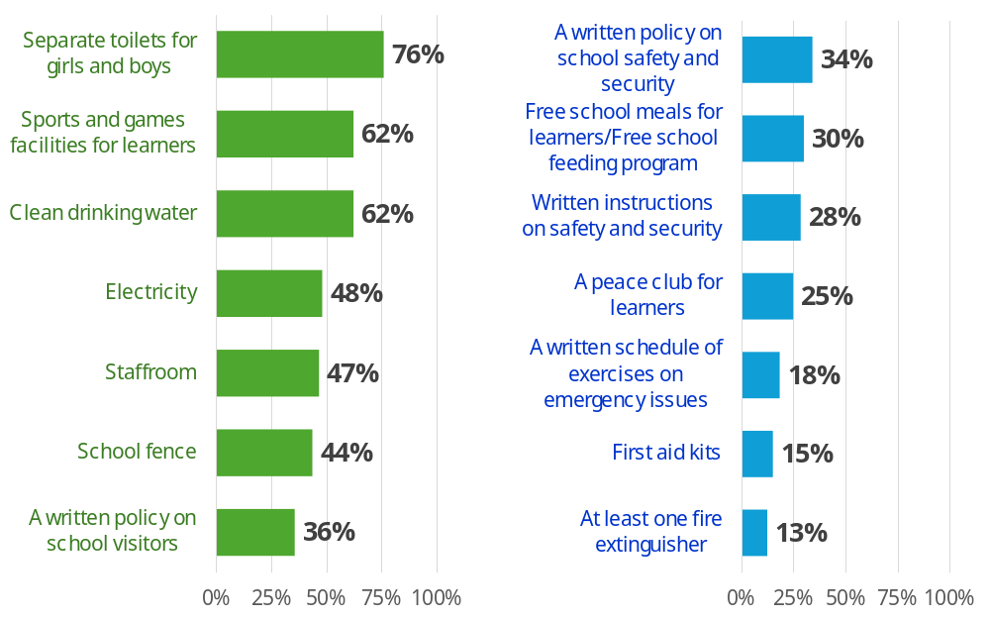
Levels of availability of selected school resources
In general, the levels of some basic school resources (such as fire extinguishers & first aid kits) are low or very low

Slide 47
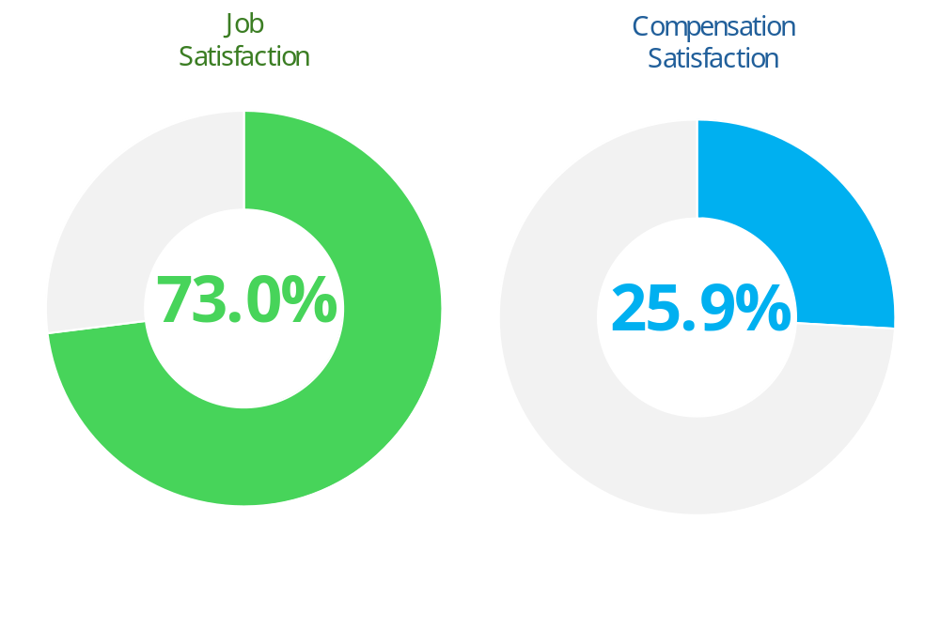
Levels of teacher job and compensation satisfaction
Only about one-quarter of the teachers interviewed are happy with their job compensation…
…. but nearly three times as many are happy with their jobs

Slide 48
Structure of presentation
Background on IICBA & what’s in it for you
Teacher policies: Careers, standards, CPD
Diagnostic tool: Scorecard
Surveys: Teacher well-being, school leadership, etc.
Example of (light) evaluation: Ethiopia summer training
IICBA research: Selected outputs

Slide 49


ETHIOPIA: 2025 Summer Teacher Training Program Survey
Preliminary Results [Not for citation]

Slide 50
Satisfaction, usefulness and possible level of use
About three out of every four of the teachers interviewed were…
… satisfied or very satisfied with the training program (75%)
… and about the same proportion (77%) found the content of the training program useful to their daily teaching work
Additionally, about two-thirds (66%) of the teachers expected to be able to use or apply over 60% of the training content in their classrooms

Slide 51
How much has the summer training program improved your competencies in the following areas?
At least 6 in every 10 of the teachers interviewed thought that the training program improved their competencies “Much” or “Very Much” in each of the seven identified areas …
… Nevertheless, the levels of perceived improvement varied across competencies areas - ranging from 59% for “Creating & maintaining supportive & safe learning environments” to 70% “Engaging in self-directed professional learning”

Slide 52
How much do you think the training improved your knowledge of the following topics?
More than one-half of the teachers interviewed thought that the training program improved their knowledge “Significantly” or “Extremely” in each of the four identified topics …
… the levels of perceived improvement were slightly better in the topics of Activity-based, project-based & student-centred teaching – learning (69%), and Competency-based curriculum (66%)

Slide 53
Did the format and duration of the training work well for you?
A vast majority (81%) of the teachers felt that the format and duration of the training work well for them ...
… and more so for those in the leadership training program (90%)

Slide 54
What additional support would help you apply what you learned? [Select all that apply]
The most popular additional support that would help the teachers apply what learned is Online resources (50%), followed by provision of classroom materials (36%), and participation in peer learning communities (34%)

Slide 55
Structure of presentation
Background on IICBA & what’s in it for you
Teacher policies: Careers, standards, CPD
Diagnostic tool: Scorecard
Surveys: Teacher well-being, school leadership, etc.
Example of (light) evaluation: Ethiopia summer training
IICBA research: Selected outputs

Slide 56
Empowering Teachers for All Learners To Succeed

