Slide 1
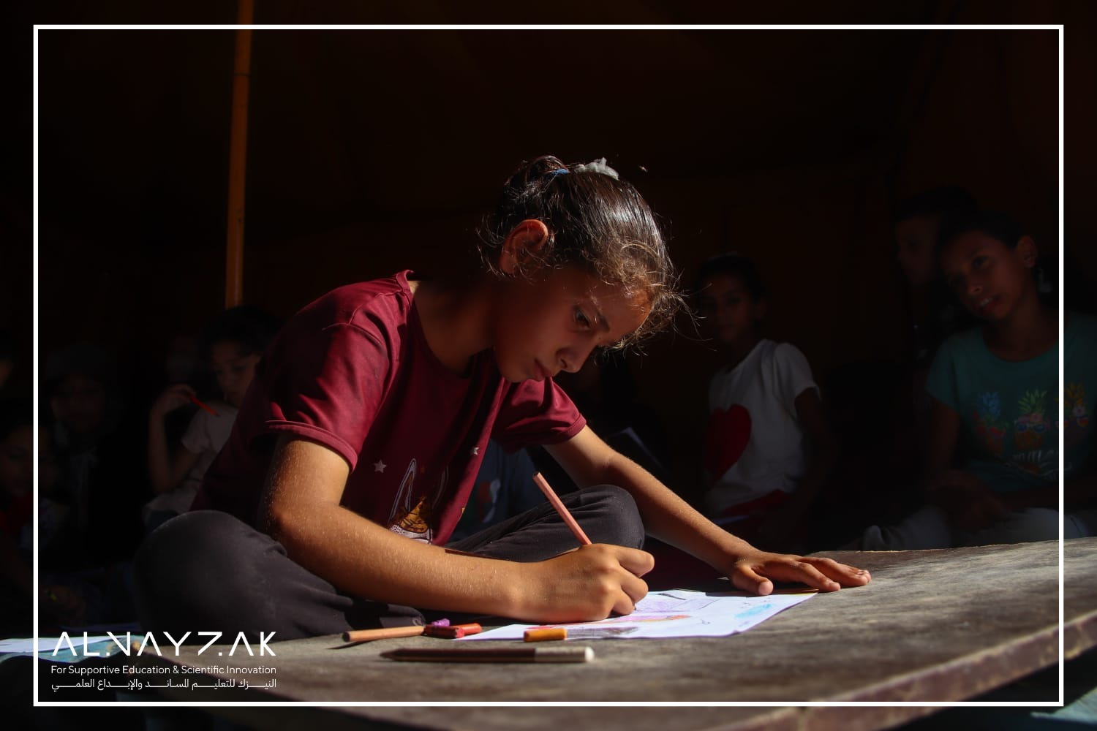



Resuming Education During War in Gaza
Methodologies Applied and Lessons Learned

Slide 2
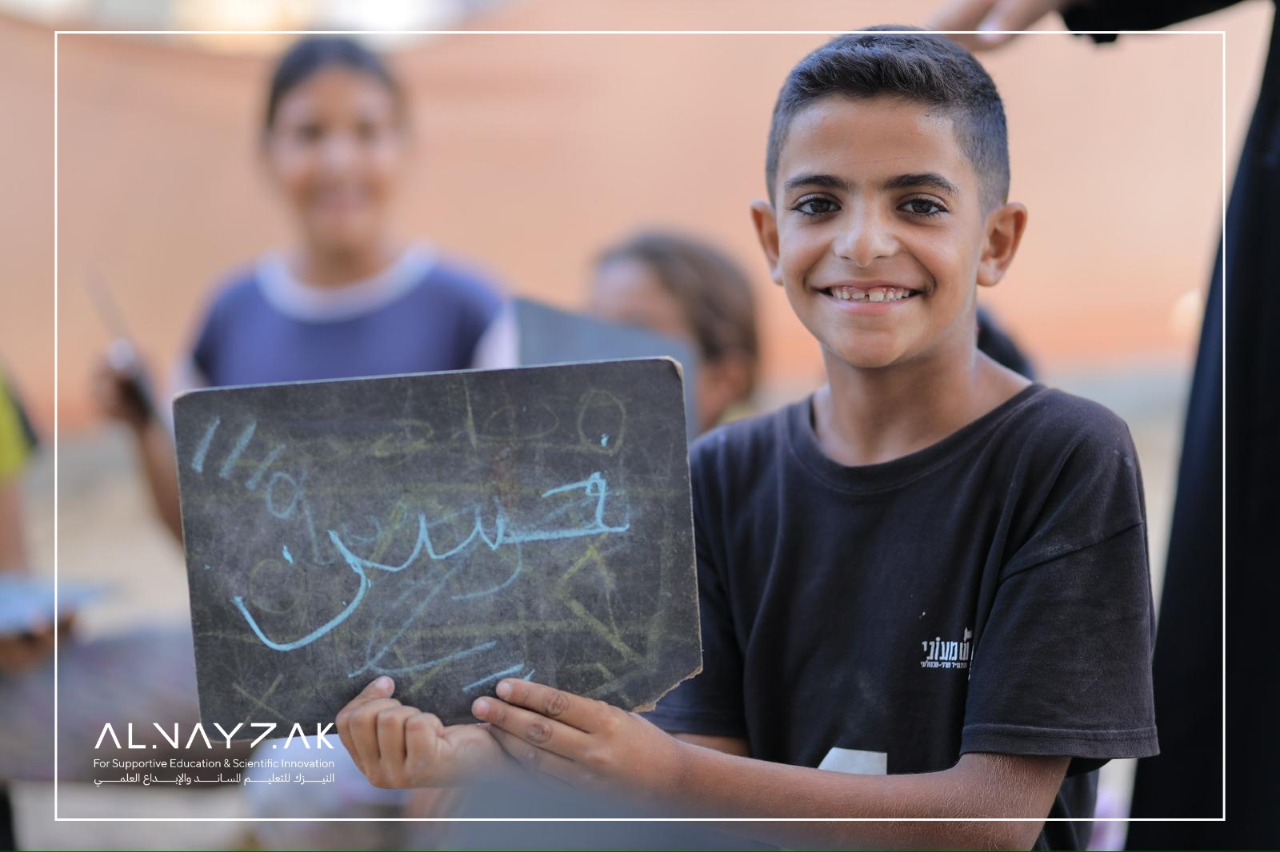
MAP
Beginning in April 2024, AlNayzak has steadily worked with facilitators and opened learning spaces to reach about 30,000+ students grades 4-10.
With 60+ TLSs (Temporary Learning Spaces) and 400+ facilitators/teachers.

Slide 3
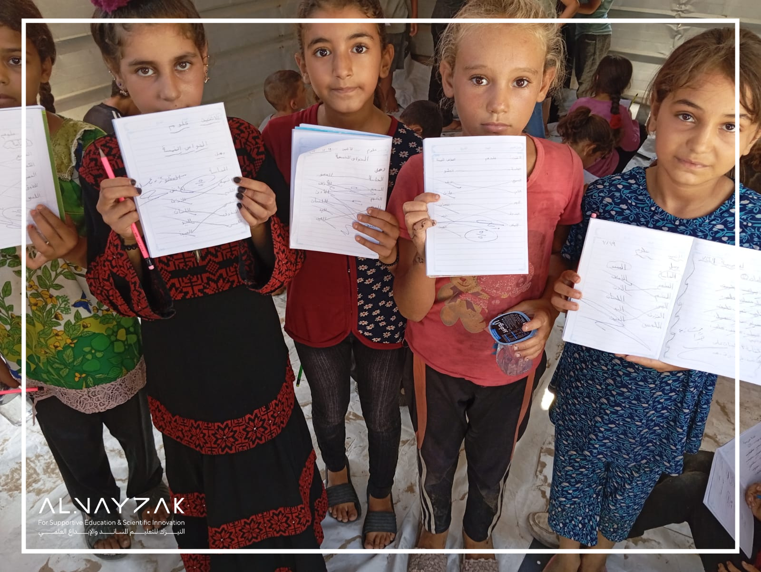
MAP
The first step in implementation was to ensure that the chosen locations were not close to the "red zone", were near students' homes/tents, and had no war hazards or debris in the vicinity.
Despite these precautions, pausing and/or relocating learning spaces remained very common.

Slide 4
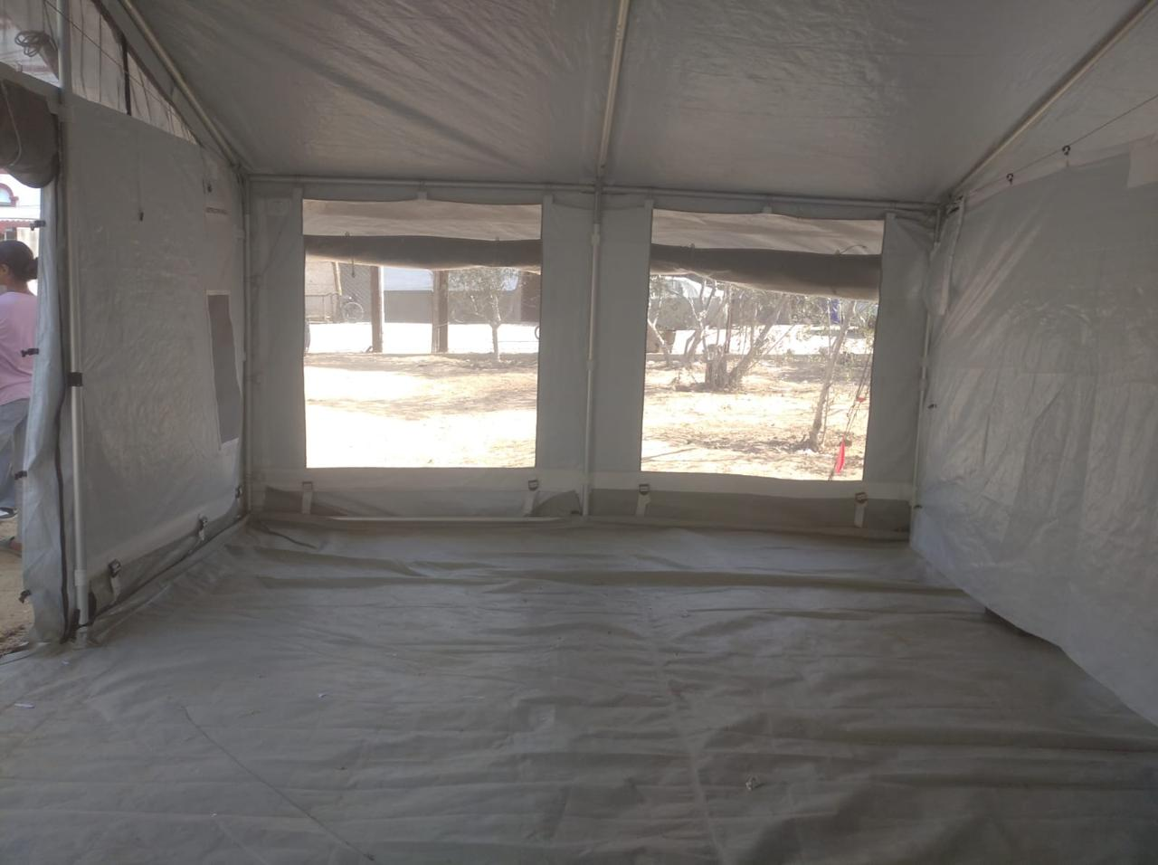
We began by conducting several visits to the proposed learning space locations and speaking with the community. Locations were chosen based on student density, safety, and inclusion, with the aim of covering all parts of Gaza.
Tents were set up at each location, provided by UN organizations or, in some cases, built from scratch, or ad-hoc classrooms were established within still-standing buildings.

Slide 5
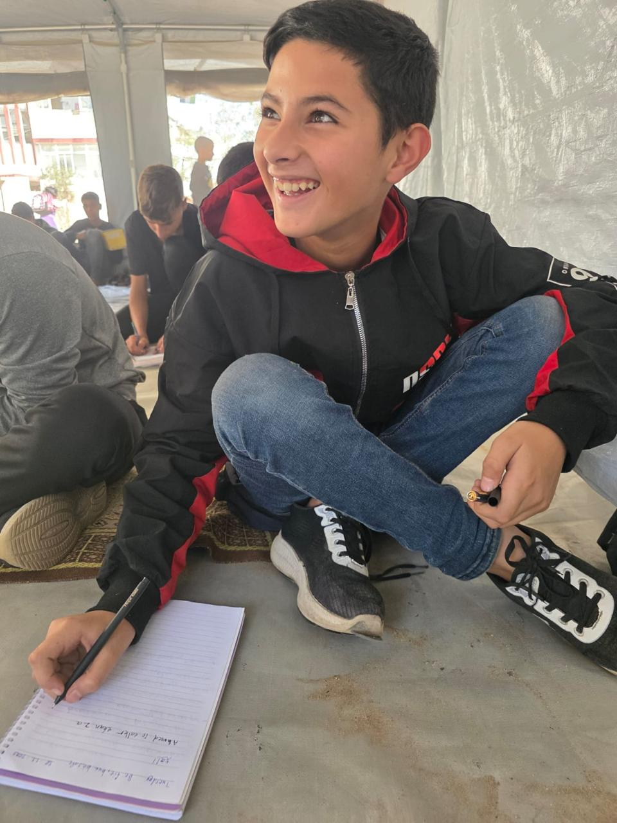
A model of 3 hours x 3 sessions per week was implemented.
The educational content was project-based integrated with SEL (Social-Emotional Learning) taking into consideration the effect of war on children.
Students were organized into groups of 20-25.
Each facilitator/teacher was responsible for up to 3 groups of students.
Specialized field facilitators for each learning space/centre were required (in addition to teachers) for coordination and ensuring the program is implemented per log frame.

Slide 6
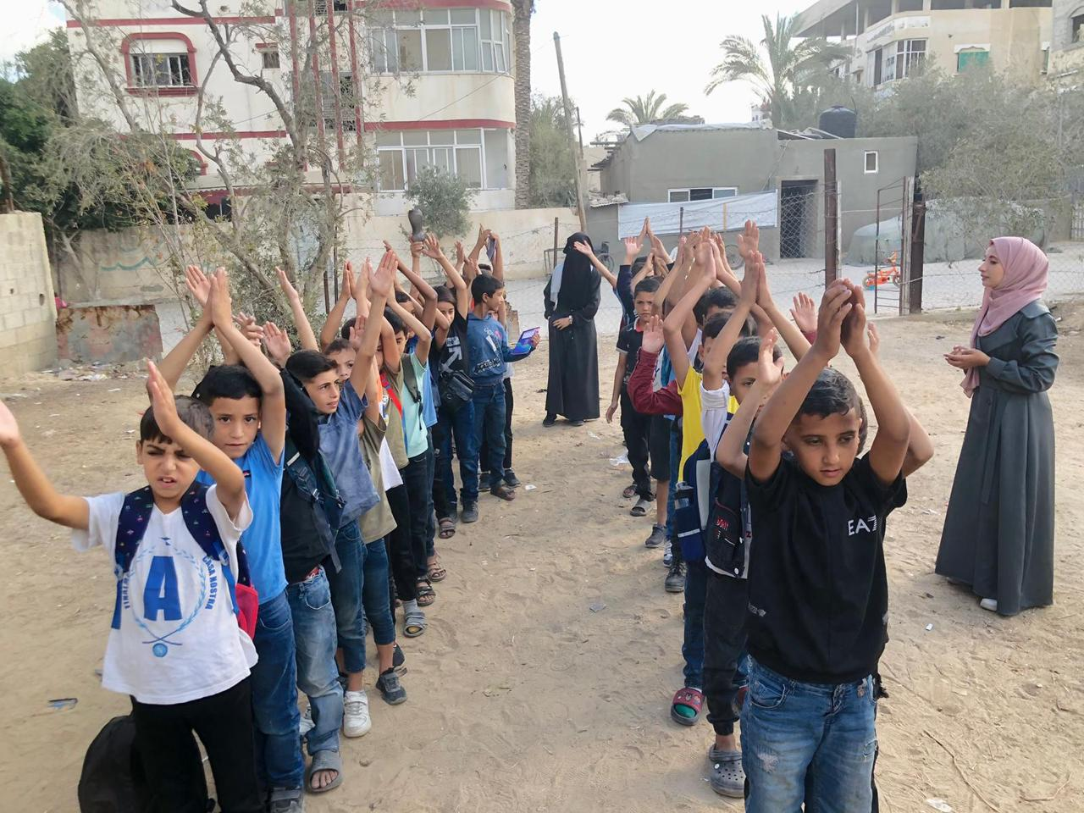
Teachers were trained on student management during emergency as well as on war hazards (this involved students as well).
When sudden evacuation was necessary, every teacher inside the learning space must know their role in the evacuation plan (each teacher is responsible for their assigned students, reassuring them and keeping them calm and free from panic).

Slide 7
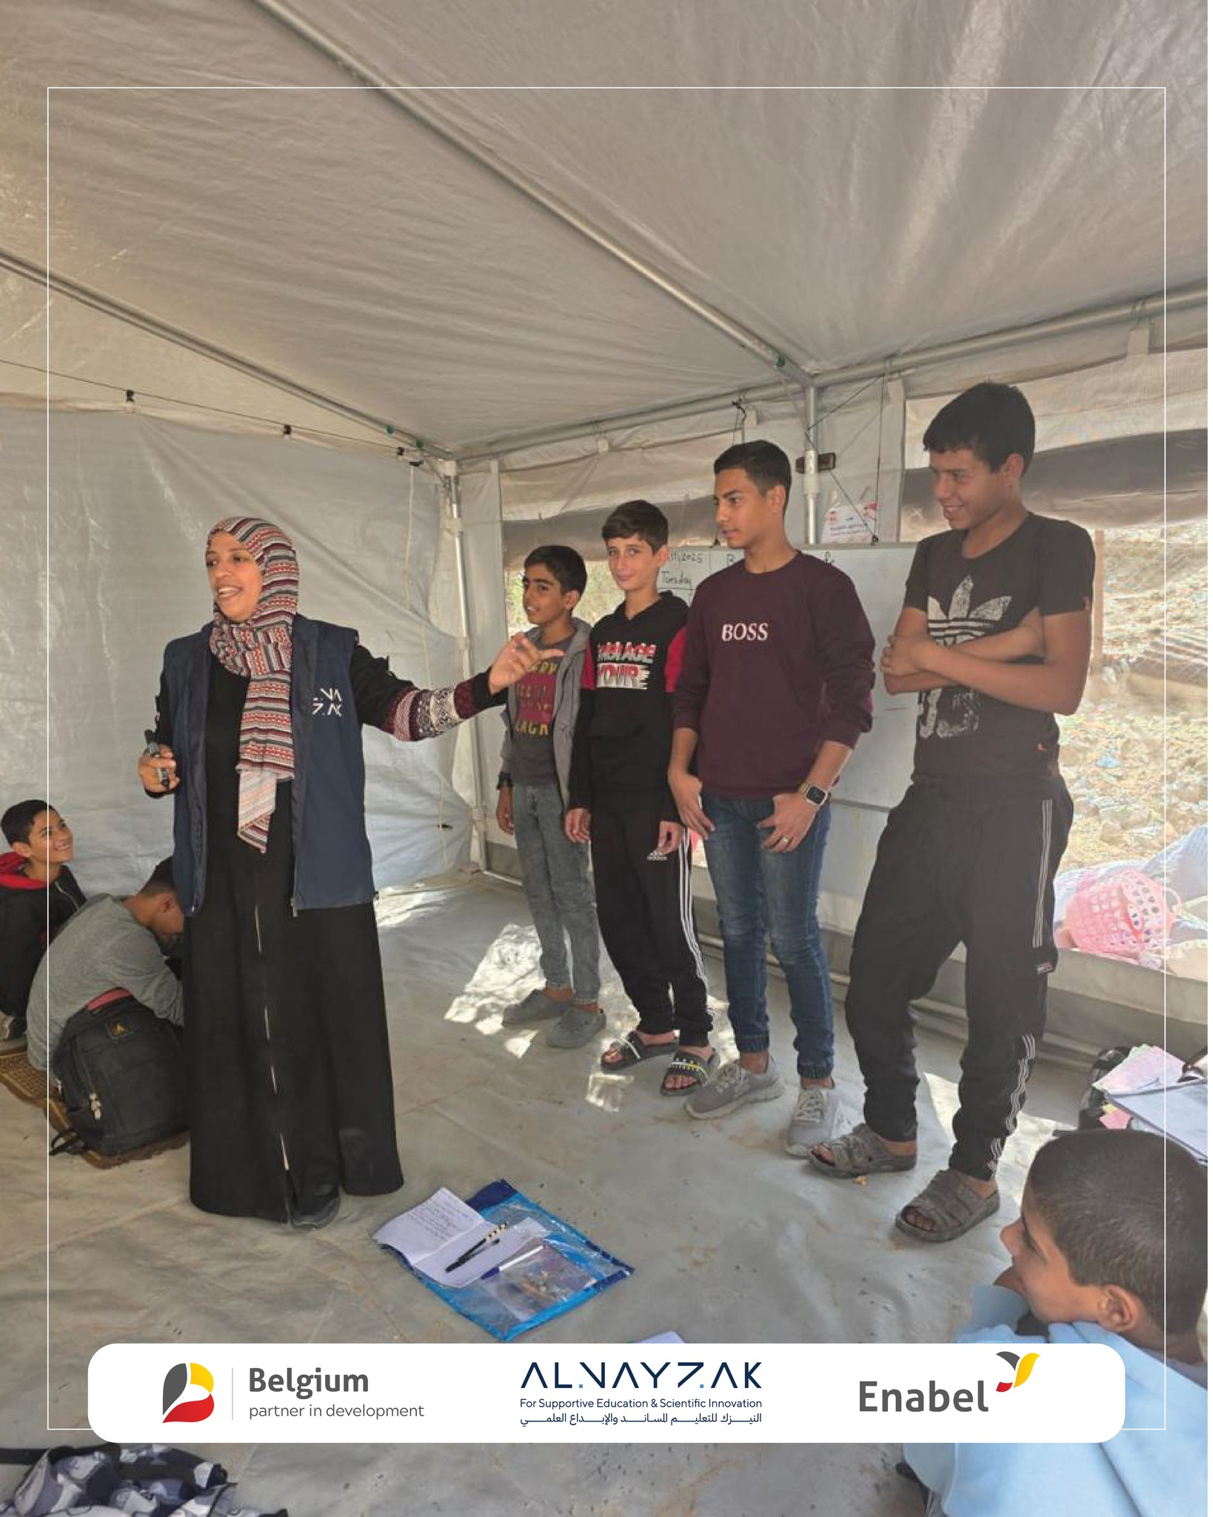
The steps are as follows:
Teachers are informed/knowledgeable about the designated safe areas.
2.Each teacher organized the group of students they are responsible for as parents are communicated with.
3.Parents are informed in advance of the nearest safe location to the learning space; in case of any danger, their children will be there.
4.The teacher and students follow the pre-designated safe route.
5. Parents proceed to pick up their children after identifying the safest routes and paths.

Slide 8
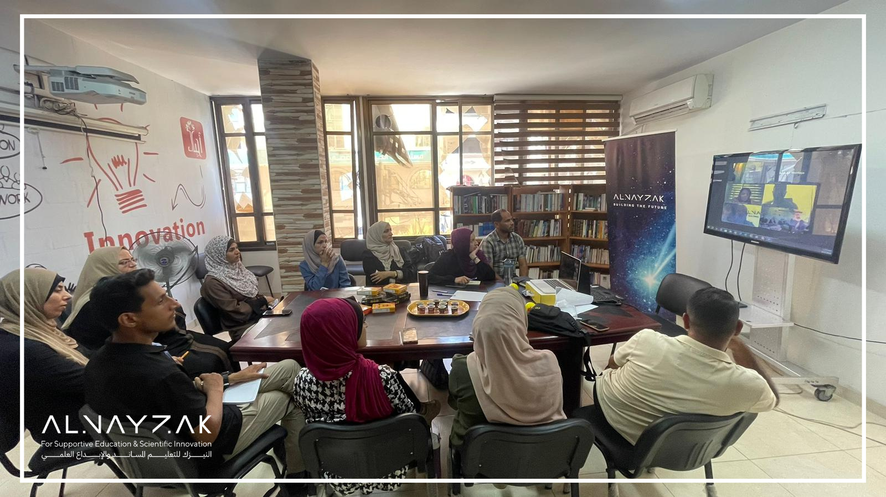
Follow-up on ToTs several times per year was required to ensure effective implementation of teaching methodologies.

Slide 9
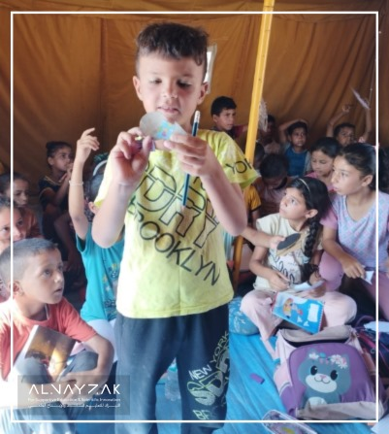
Key Elements for Success:
Community and Networking.
Procurement planning and smart inventory management for when prices inflate/supplies are short.
Consistent communication with parents, teachers, facilitators.

