Slide 1
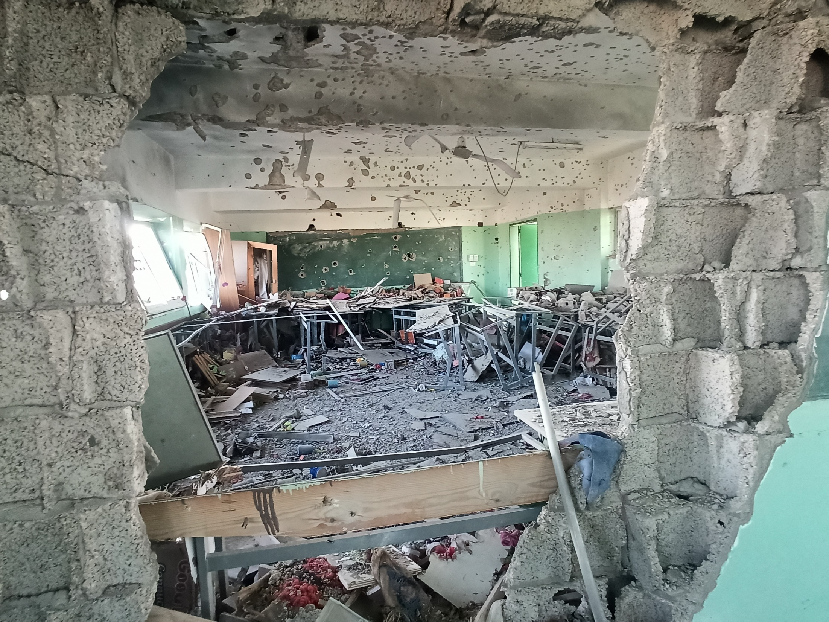

International Conference 2026
Education in Times of Turmoil
Ensuring the continuity and protection of
learning for stability, development, and peace
Education in Gaza
Brussels 28 May 2026

Slide 2

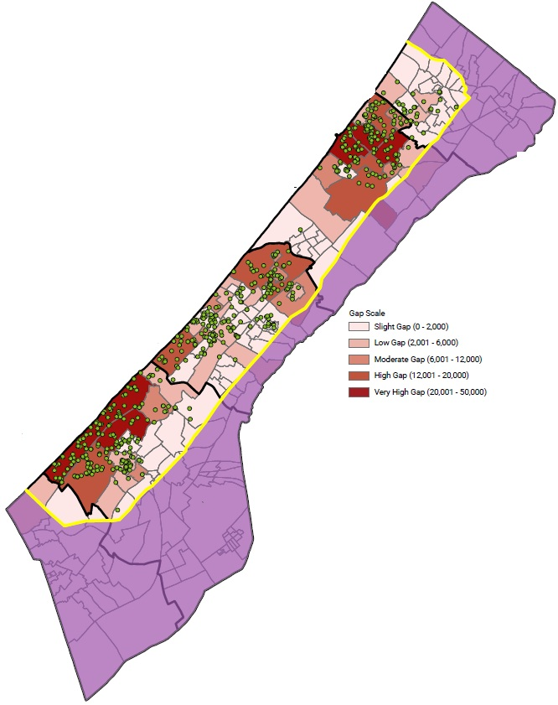

Gaza Strip: EDUACTION SITUATION AND CLUSTER Response
EDUCATION SITUATION
Cluster partners response:
Operational TLS Across Gaza Strip
Before the 2023 war, Gaza’s education system was heavily affected by prolonged occupation & repeated escalations, yet literacy rates remained high.
Coordination: Mobilize 69 partners (UN, INGOs, NNGOs) to respond to children learning needs aligned with the cluster 3-phase response, winterization and ceasefire plans.
Catastrophic Collapse: The education system in Gaza has experienced unprecedented levels of destruction and disruption. All 700k+ KG and School-aged children have no access to formal education & exposed to violence leading to psychosocial distress.
624 operating TLSs, providing access to learning opportunities for 395,553
learners including 18,942 pre-primary (KG) (only 51.7% of school-aged and KG-aged children.
During the escalation, education supplies were restricted. After the ceasefire, UNICEF managed to slowly enter supplies and tents supporting partners to scale up.
10,641 teachers deployed in the operating TLS. (70.7% female)
55,600 provided with access to MHPSS.
Funding significantly low. Lack of teacher incentives is a growing concern
Massive Displacement: Schools in use as shelter. Limiting access to learning or potential rehabilitation where planned
Support access to distance learning through supporting MoEHE and UNRWA.
Education is a fundamental right.

Slide 3
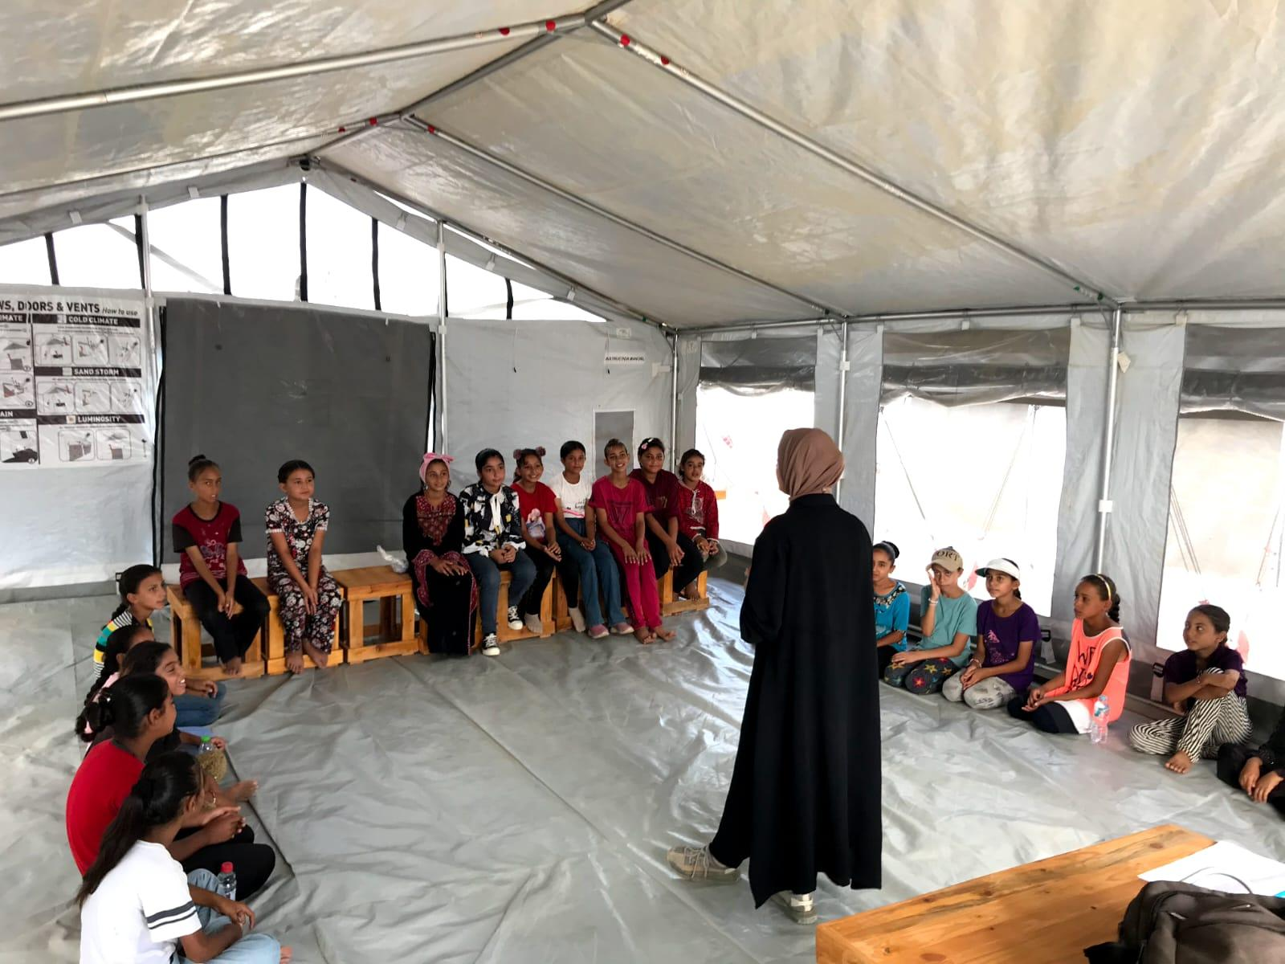

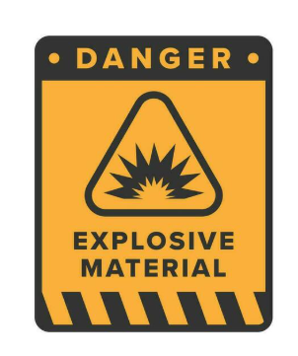
Gaza Strip: EDUACTION SITUATION AND CLUSTER Response
Cluster partners response:
Conducted physical school damage assessments using satellite imagery, field assessment with UNICEF, & RDNA and published evidence of the impact of the war on education, with damages ranging from direct hits to partial or likely
Successfully finalized the 2023/24 and 2024/25 academic years, in alignment with MoE and UNRWA standards, and provided support for the administration of the Tawjihi 2023/24 and 2024/25 cohorts.
UNICEF has played a leading role in supporting education in Gaza by establishing 172 learning centers and providing in-person non-formal education to 260K children during the escalation and after the ceasefire, alongside the Back to Learning campaign.
Developed guidelines to strengthen the education response, ensuring alignment among all partners with MoE , UNRWA, & UNICEF standards and benchmarks.
Refer at-risk children to specialized services
Raise awareness on risks of damaged buildings and UXOs
Education is a fundamental right.

Slide 4
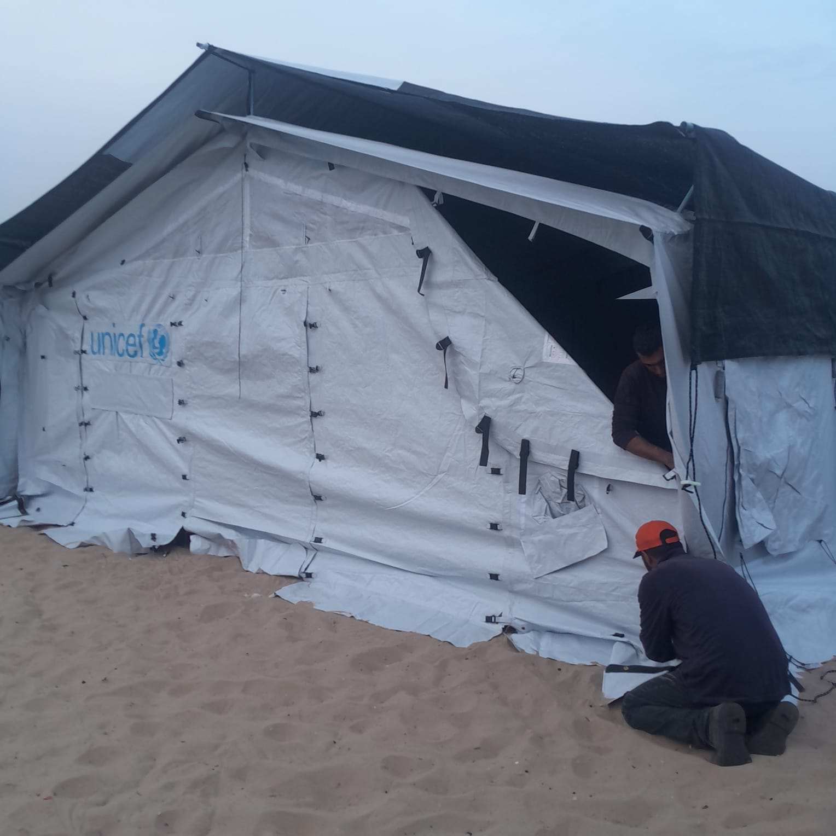
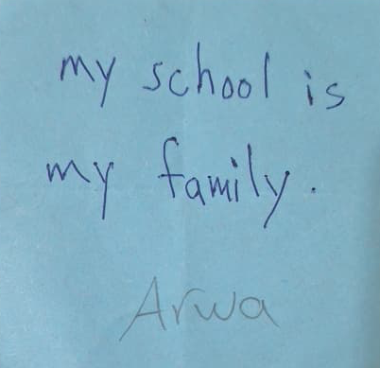
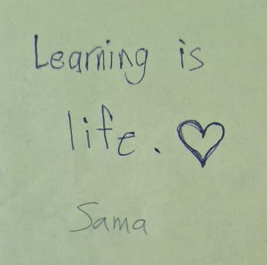
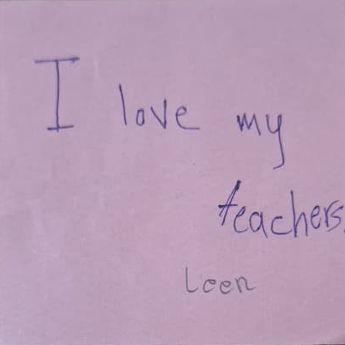
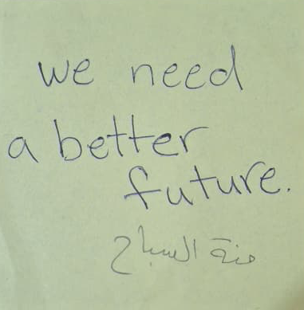
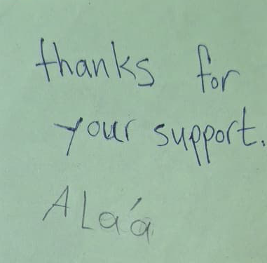
“For Palestinians, education is not only a right, it is resilience, dignity, and continuity”

Slide 5
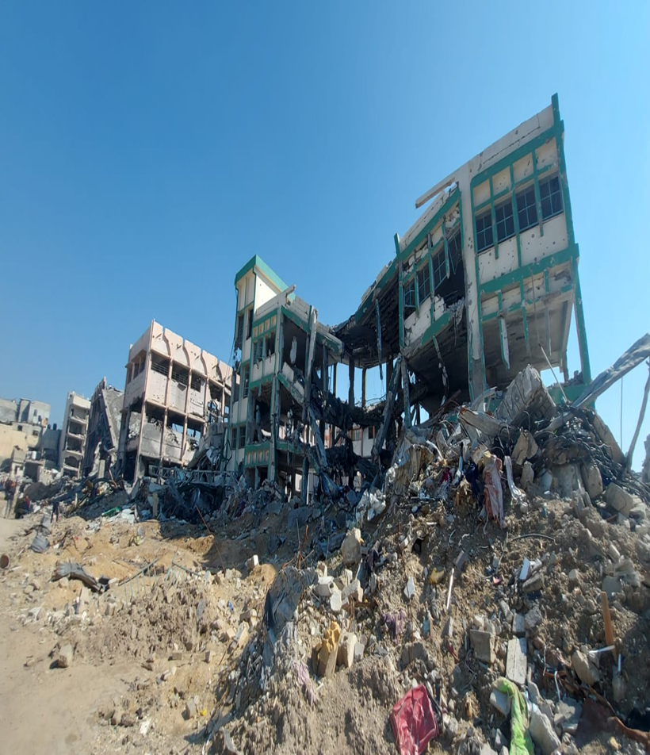
Damages to schools in Gaza since 7 OCT
Based on the Satellite-derived Damage Assessment conducted by the Education Cluster (UN body) using data collected on 11 October 2025:
97.5% of schools sustained some level of damage to their buildings, this includes Direct hit, Damaged, and Likely damaged.
At least 93.3% of schools in Gaza will either need full reconstruction or major rehabilitation work to be functional again.
One-third of Directly hit and Damaged schools are UN-run schools through UNRWA.
77% of school buildings that have been used by IDP as shelters are Directly hit.
The satellite-derived images provide further evidence for the military use of schools by Israeli Security Forces (ISF)

Slide 6
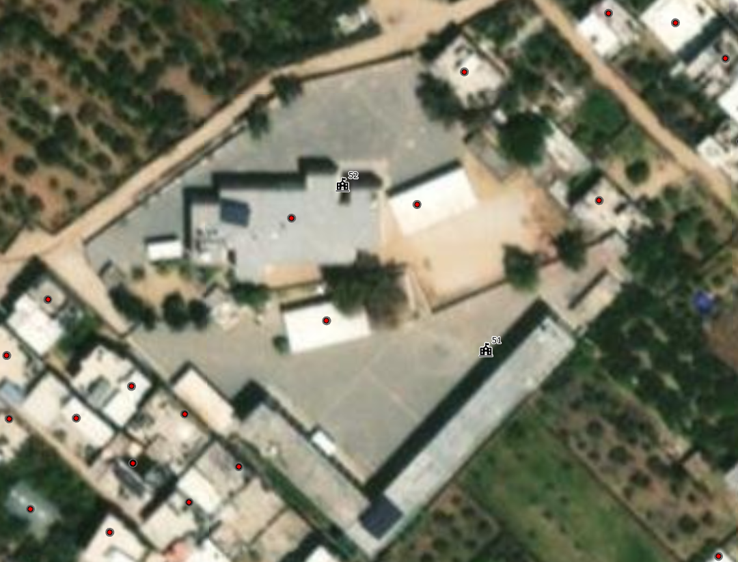
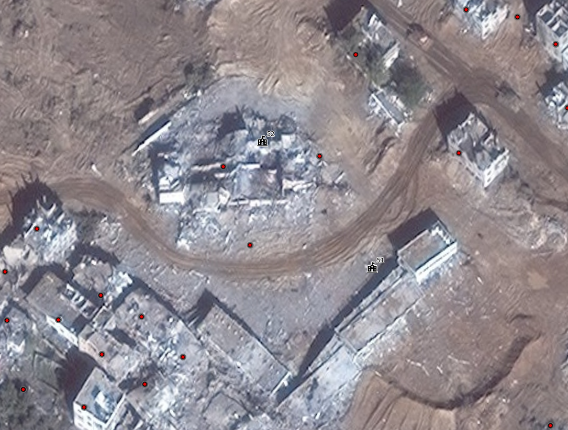
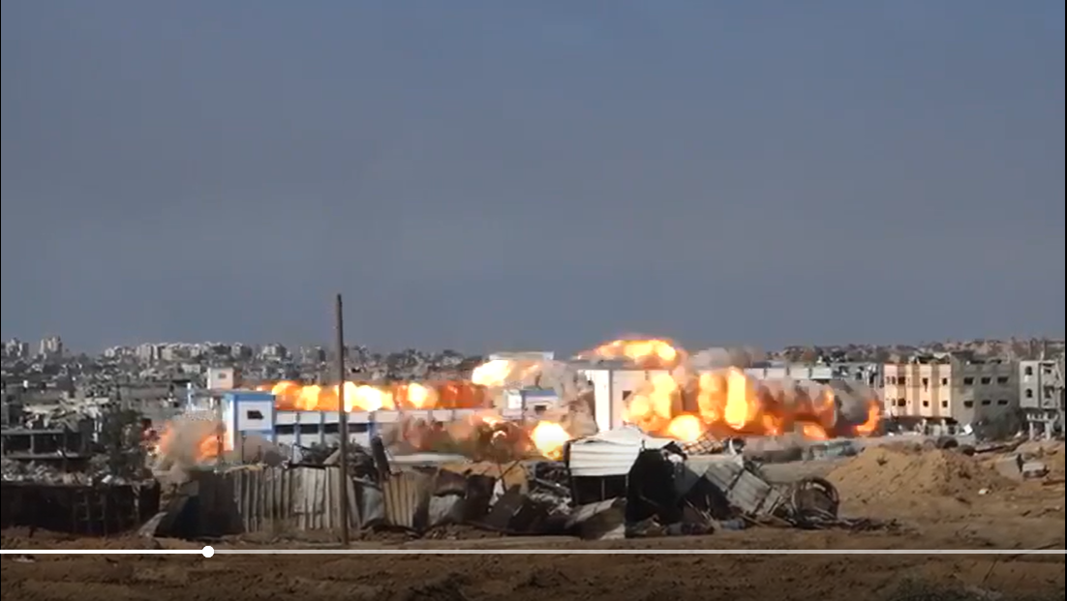
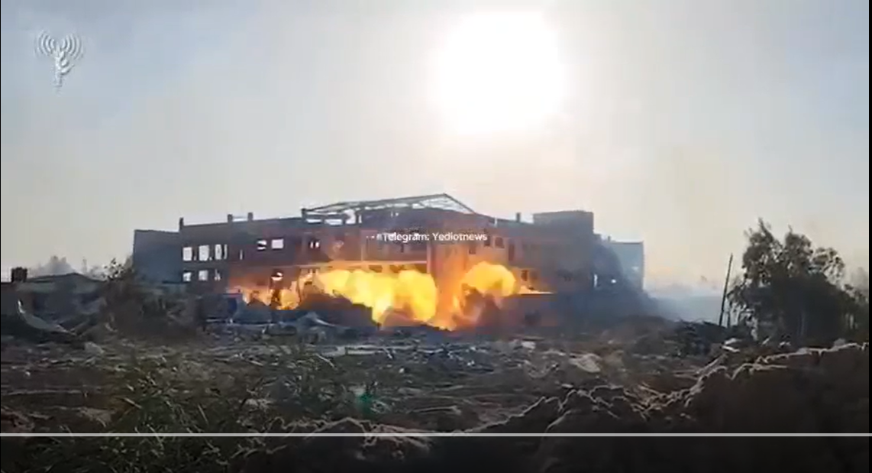
Snapshots & Videos
Before
After
VID-20231212-WA0006.mp4
VID-20231122-WA0022.mp4

Slide 7
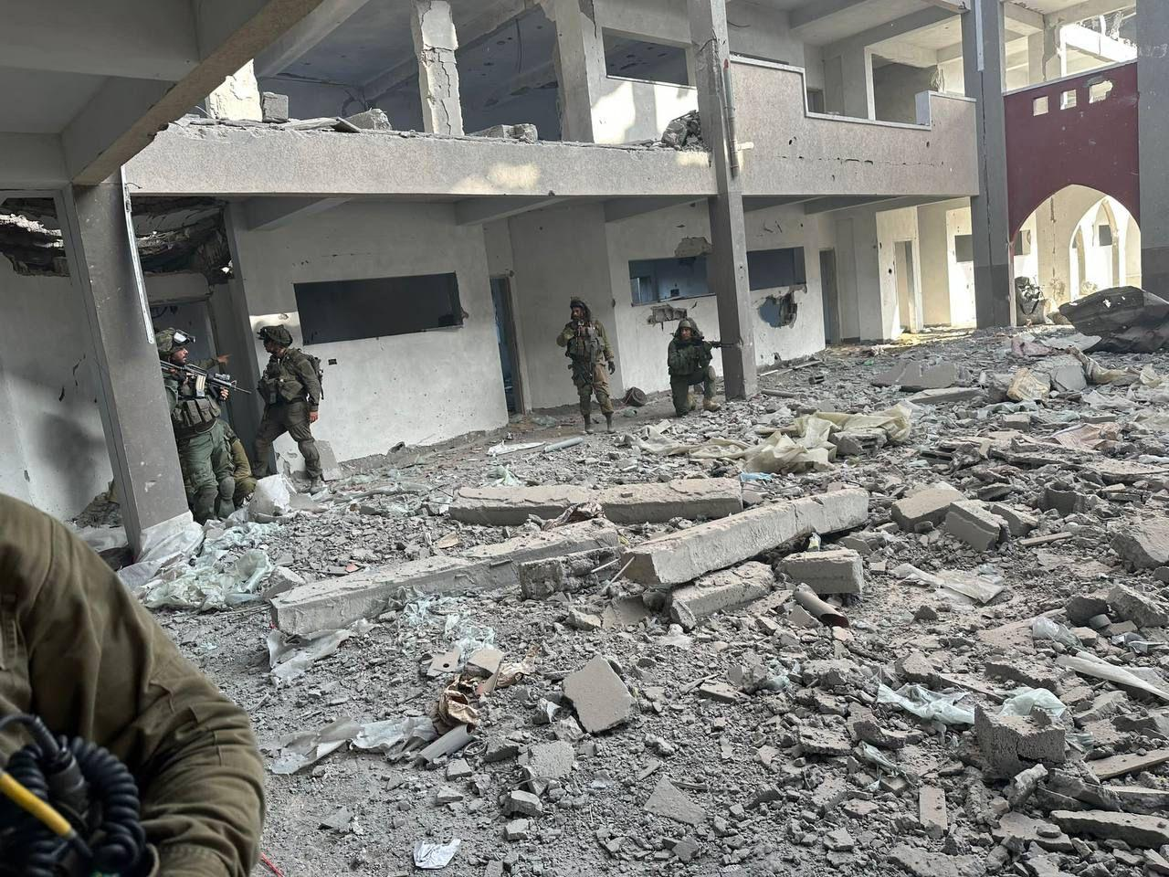
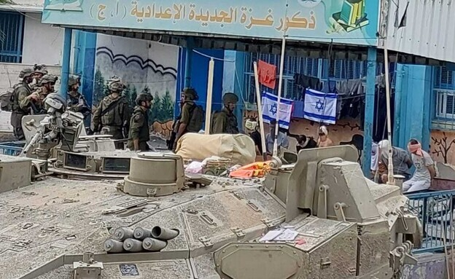
Military use of school premises
Several concerning reports, pictures, and videos, show that schools are being used for military operations by Israeli Security Forces (ISF) including used as detention and interrogation centers, and military bases.

Slide 8
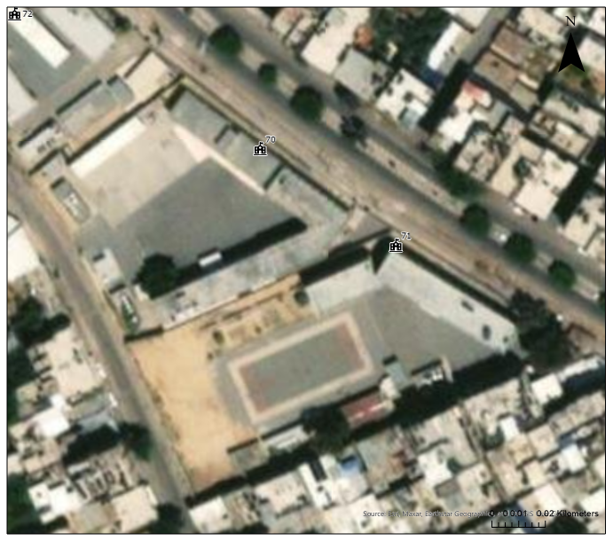
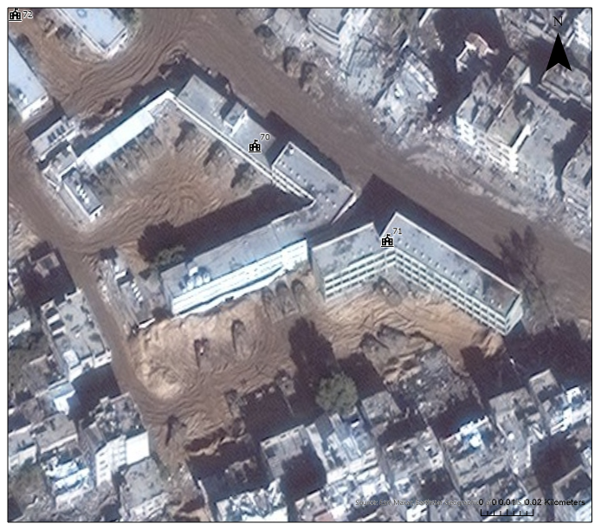
Findings: Military use of school premises
Before
After
Military tanks present inside the school

Slide 9

Cluster Response Plan and Learning Strategy
Phased Response Plan
Key Strategies & How Learning is Happening?
Phase 1: Provide recreational activities & PSS for affected children’s well-being
Phase 2: Affected children access formal and non-formal education in safe, inclusive settings.
Phase 3: Affected children access safe, inclusive, quality education during reconstruction
Through establishing Temporary Learning Spaces (TLS)
In limited school buildings – lightly renovated by UNICEF.
Shifts & Rotations: Maximize limited classroom space (≈3 hours/day, 3 days/week per child).
Re-use Materials: Recycle school supplies and resources.
Community Initiatives: Support local education programs and volunteers. Some partner-supported.
Shared Spaces: Collaborate with CP AoR and other partners for learning spaces.
PSS & Catch-Up: Integrated psycho-social support and recreational activities and key messages in open spaces support well-being and learning readiness

Slide 10
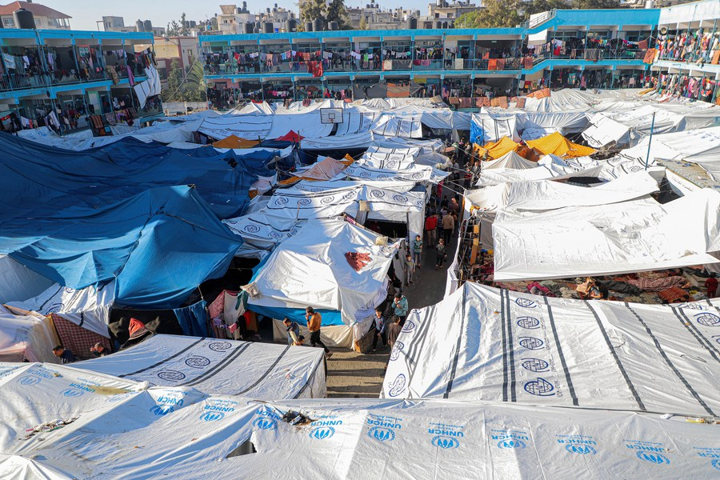
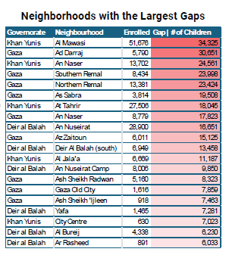
Key Challenges
Sustained hostilities are damaging schools and harming students and teachers.
Funding shortages and INGO deregistration are limiting education response capacity.
Fuel shortages are disrupting deployment, supervision, and learning continuity.
Poor internet, electricity cuts, and lack of devices restrict access to e-learning.
Education remains under-prioritized in humanitarian funding and response efforts.
High displacement and population density are increasing demand for learning spaces, teachers, and supplies.

Slide 11
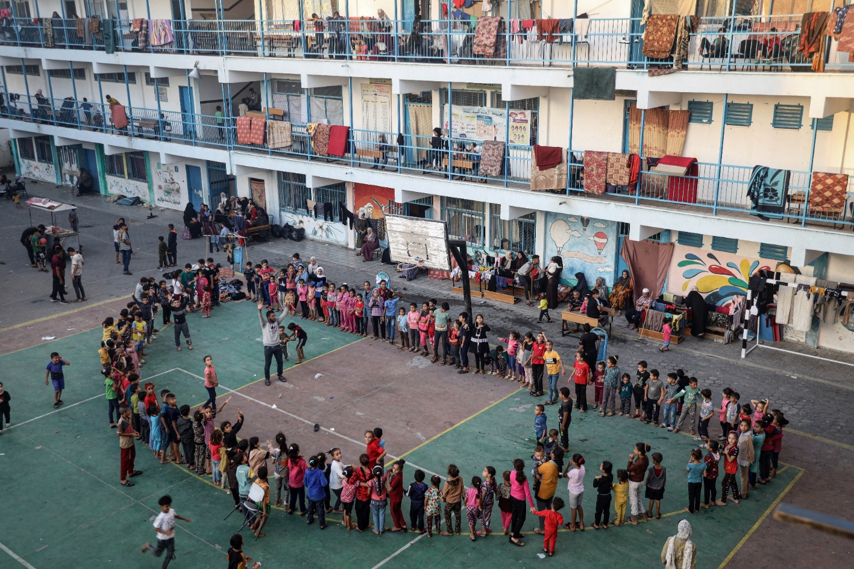
Recommendations & Way Forward
Increase flexible funding for education in emergencies, teacher salaries, and psychosocial support.
Rebuild and repair damaged schools, kindergartens, and universities.
Establish temporary learning spaces and expand non-formal, accelerated, and remedial education programs for every child, particularly for out-of-school children.
Provide learning materials, school supplies, and digital tools.
Develop remote learning and improve digital infrastructure, internet access, devices, and electricity for education.
Support teacher training, wellbeing, and trauma-informed education.
Strengthen local education authorities, NGOs, and community-led initiatives.
Invest in long-term recovery of education, including higher education and vocational training.
Advocate for protecting schools under international humanitarian law and promote schools as safe spaces for healing and resilience.

Slide 12
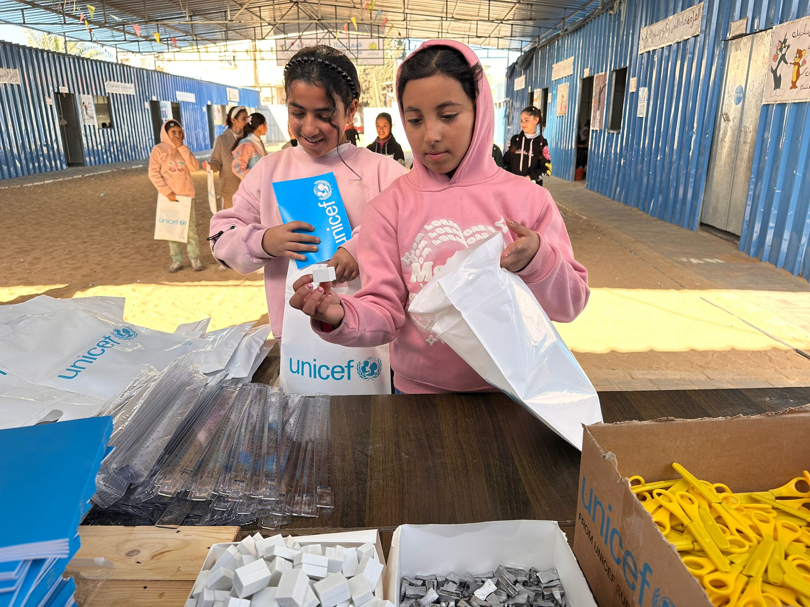
2026 Gaza Education Cluster Priorities
Requests (Us$) | People Targeted | Partners
$171M | 0.745M | 58
Establish, expand and equip TLS with WASH facilities in IDP shelters. Provide structured, age and gender-appropriate recreational and MHPSS activities. Provide teaching, learning materials & assistive devices for CwDs. Raise awareness on risks of damaged buildings and UXOs. Support access to distance learning in support of MOEHE and UNRWA. Offer NFE & SEL programs in TLS. Capacity building of teachers and facilitators on NFE, SEL, and MHPSS Identify and refer at-risk children to specialized services. Support rubble removal and school clearance
“We need a better future,” said a young girl during the distribution of learning materials supporting children’s return to learning.
Support sustaining the ceasefire for safe reconstruction and schooling.

Slide 13
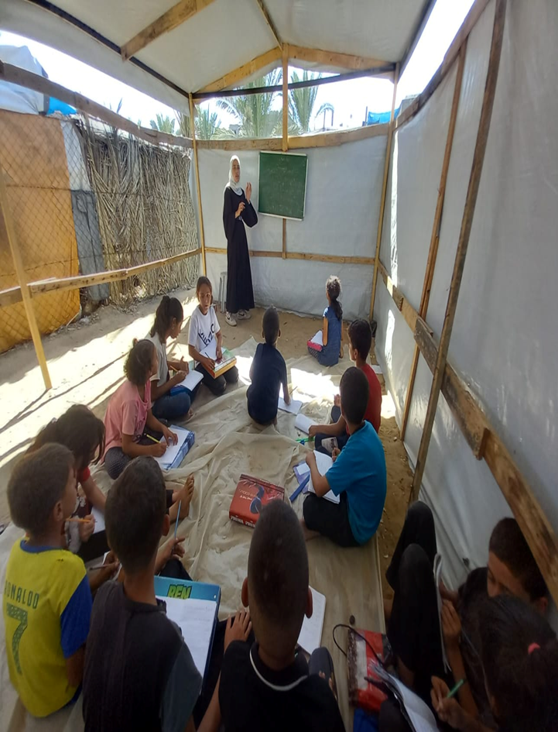
The Cost of Inaction is Permanent
▪ The war on the Gaza Strip has brought the education sector to a near halt, with devastating consequences for students, teachers, and families. The destruction of schools, displacement, and trauma have created a humanitarian crisis that demands urgent action. Rebuilding the education system, addressing the psychological needs of students, and ensuring access to learning are vital steps to mitigate the long-term impact of the conflict on Gaza's children and their future.
▪ The cost of inaction in supporting children's access to education is significant and far-reaching. Prolonged school closures lead to substantial educational losses, widening learning gaps that hinder future opportunities. The absence of education worsens anxiety and trauma, depriving children of crucial cognitive development and stability. Vulnerable children face increased protection risks, with the most disadvantaged likely to experience greater inequality and limited economic prospects due to a lack of skills. Without constructive engagement, young people are more likely to be drawn into violence as lawlessness rises. Neglecting education harms individual futures, undermines progress in Gaza’s education system, and destabilizes the region. Addressing these challenges through educational support is essential for building a healthier, more equitable society and a stable future for the region.
Every missed learning cycle compounds loss – leading to lost generation
Children cannot “wait for stability” to learn
Education today is Gaza’s recovery tomorrow
Recognize education as a lifesaving part of humanitarian response.
If we protect learning now, we protect OPT future

Slide 14

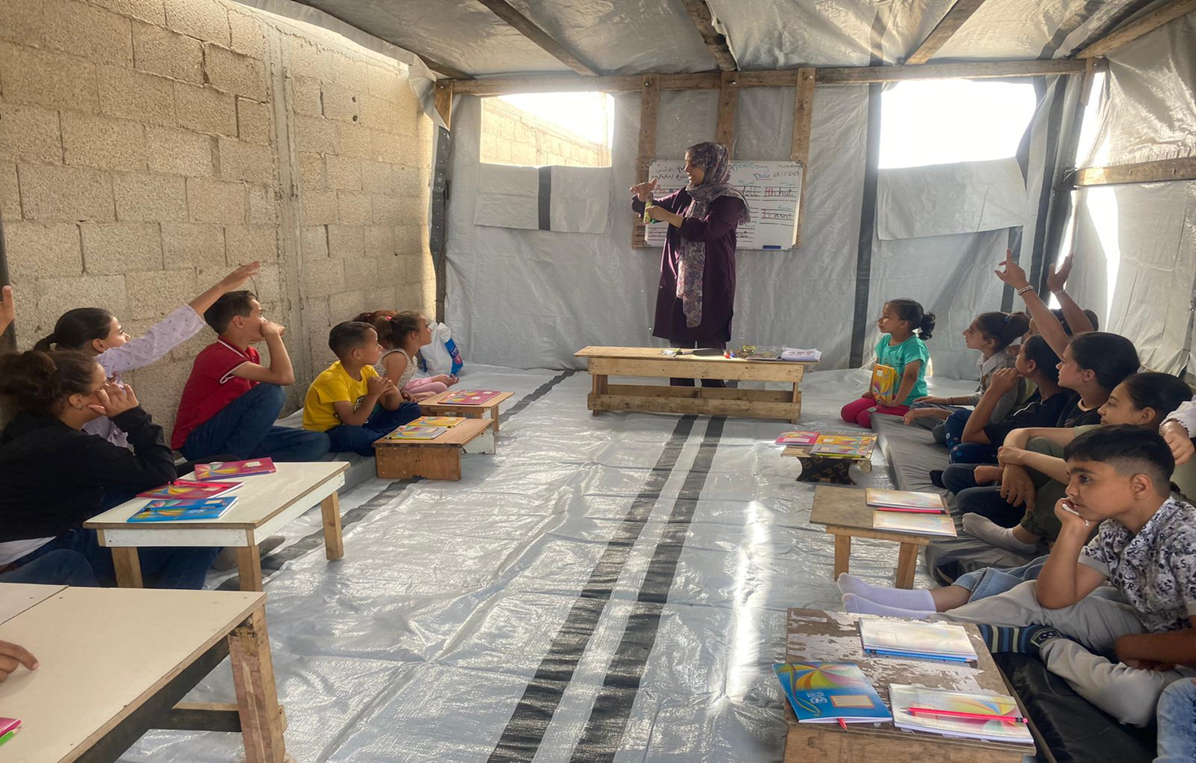
Affected people voices
"What I miss the most is wearing my school uniform. It was a comforting routine to come back from school and do my homework while still dressed in it. It made me feel focused and ready to learn. Now, not having that routine feels strange.”
"I miss school so much. I miss waking up early every morning, getting dressed, and preparing for the day. Maths classes were always my favourite; I loved solving problems and learning new concepts. Since the conflict started, I've been feeling really sad. I miss the routine, seeing my friends, and having teachers who helped me learn and grow. I hope things get better soon so we can go back to school."
Recent assessments have found that families are very concerned for the future and the well-being of their children. They Need our help to provide children with opportunities to play and learn safely

Slide 15

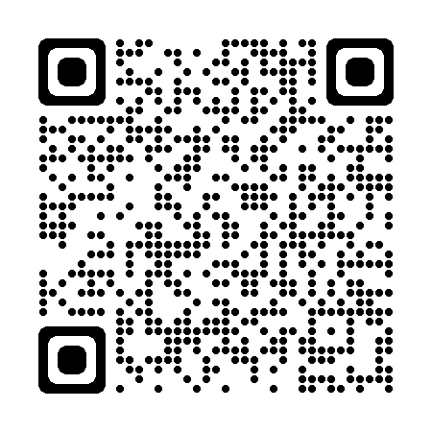
For more information on the oPt Education Cluster and other education resources please visit our Web page on Relief Web Occupied Palestinian Territory: Education | ReliefWeb Response

