Slide 1

International Conference 2026 | Education in Times of Turmoil
International Conference 2026 | Education in Times of Turmoil
Prof. dr. Sofie Cabus
Faculty of Psychology & Educational Sciences and Research Institute for Work and Society (HIVA), University of Leuven, Belgium

Slide 2
Learning Lab B | Advancing Foundational Learning to Build Resilience and Stability

Slide 3
Why are basic skills so important (to make societies more resilient)?
Human capital development
Adaptability to rapidly changing contexts
Active participation in society as a democratic citizen

Slide 4
Human Capital Development

Slide 5
A simple lecture on business economy
(Financial) Capital
Building, machinery, computers,…
+ Human Capital
People
= Production of goods and Services

Slide 6

Private Returns to Human Capital and Skills
Human capital is defined as the knowledge, attitudes, and skills that individuals acquire through formal, non-formal and informal education or training.
Firms pay wages to their employees. There is a direct, confirmed relationship in human capital theory between years of schooling and the wages employees earn.

Slide 7
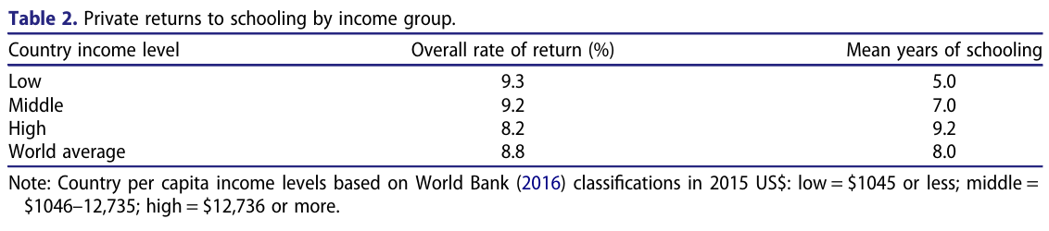
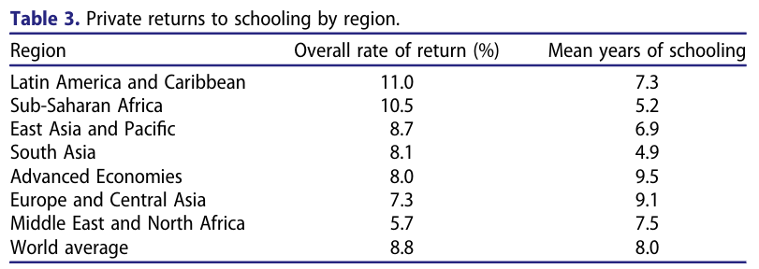
The ‘monetary value’ of education: a decennial review of the global literature
Source: Psacharopoulos & Patrinos (2018)
Notes:
George Psacharopoulos & Harry Anthony Patrinos (2018) Returns to investment in education: a decennial review of the global literature, Education Economics, 26:5, 445-458, DOI: 10.1080/09645292.2018.1484426

Slide 8
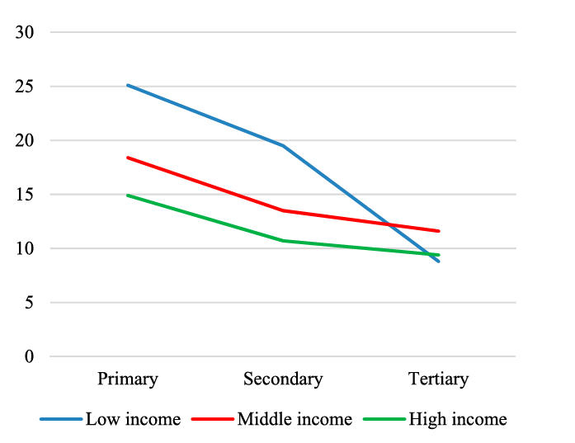
Social Returns to Human Capital and Skills
Macro-level perspective: education is subsidized, what are the (social) returns to education to the government and society?
Monetary: Registered firms and their employees pay taxes and social security contributions.
Non-monetary value of education to society? Active and democratic citizens, people able to adapt to changing contexts…
Structure of social returns
Source: Psacharopoulos & Patrinos (2018)

Slide 9

Caveat
Academic and policy discussion shifted from increasing “Enrollment Rates” (i.e. the more years, the better) to Quality Education for all children: those years in education should be good!
Notes:
Are the years spent in education also qualitatively good years in education? Do people learn → learning crisis.

Slide 10
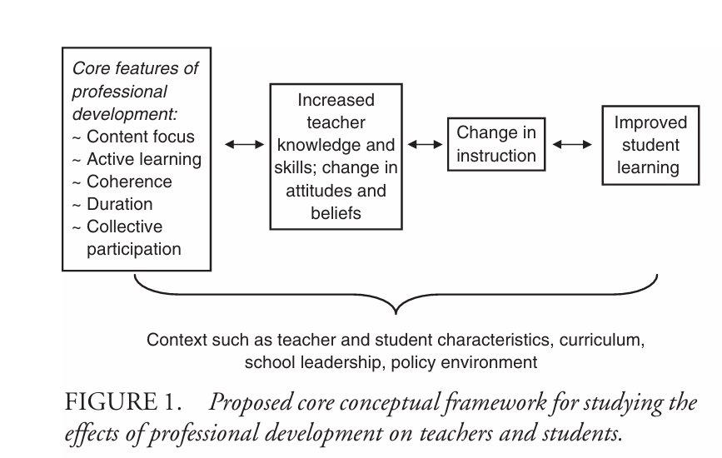
Caveat
This implies a shift in focus from years in education to…
  Teacher professional development
  Knowledge transfer from teachers to students
  Teacher value added
  Foundational learning gains in numeracy, literacy, digital literacy… (educational curricula)
Source: Desimone (2009)

Slide 11
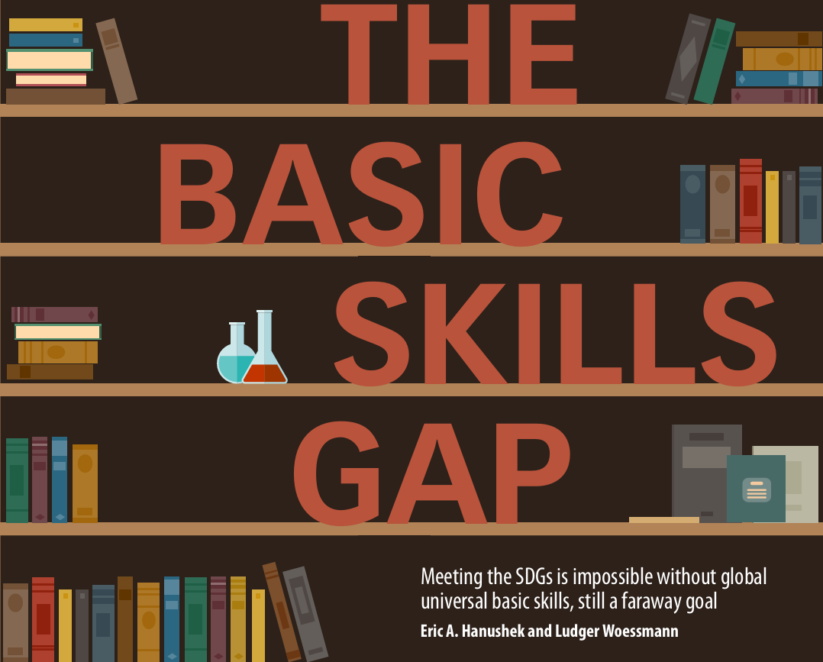
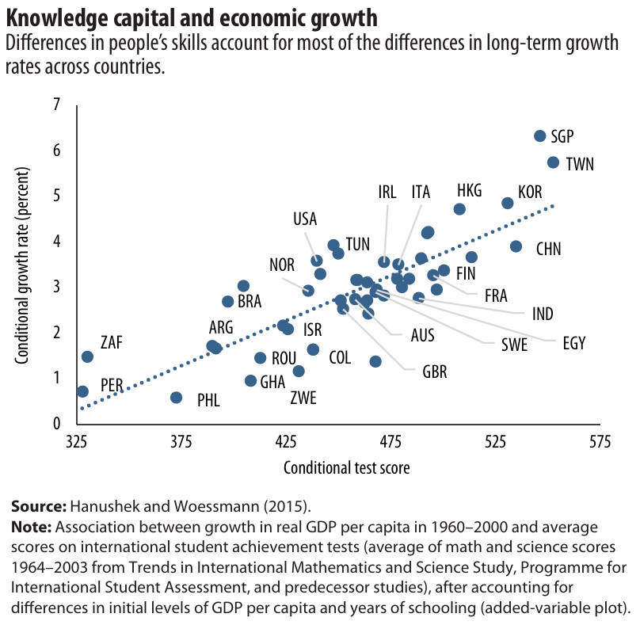

Slide 12
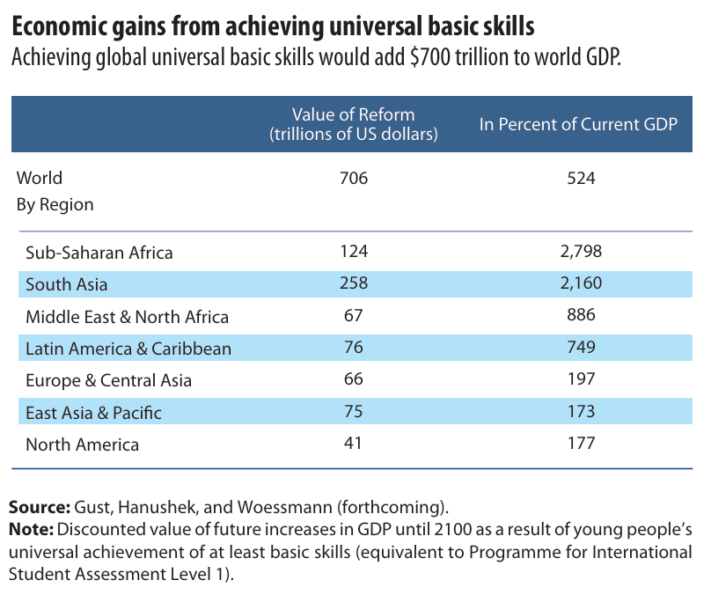
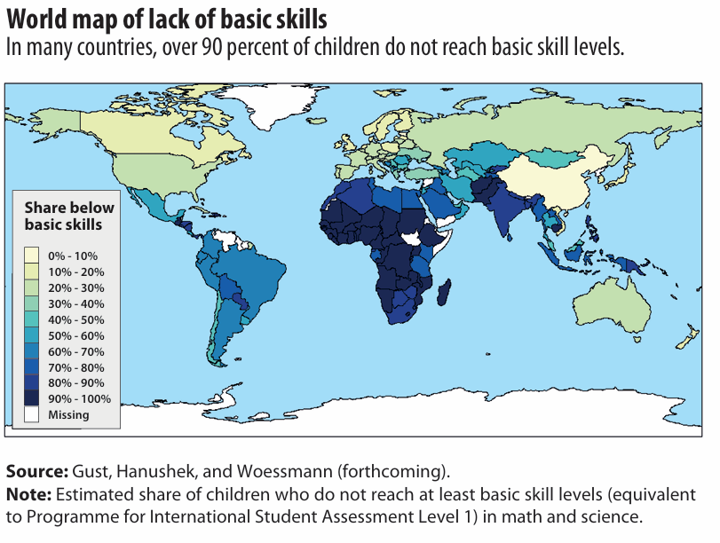
Basic Skills Gap

Slide 13
Adaptability to rapidly changing contexts

Slide 14

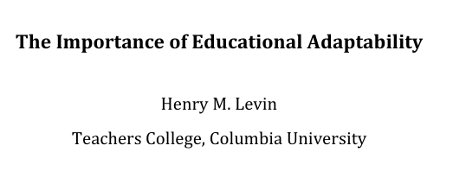

Slide 15
What’s educational adaptability?
Professor Levin (Teachers College, Colombia University) uses the term educational adaptability to describe the capacity of education systems to prepare learners for a future that cannot be predicted with any precision.
Rather than training pupils for specific jobs or technologies that may or may not exist in decades to come, he argues that schools should cultivate broad, transferable abilities - both cognitive and interpersonal/intrapersonal non-cognitive skills - that enable individuals to adjust to new circumstances, learn new skills, and respond effectively to change.
Notes:
Not always measured in an achievement test

Slide 16
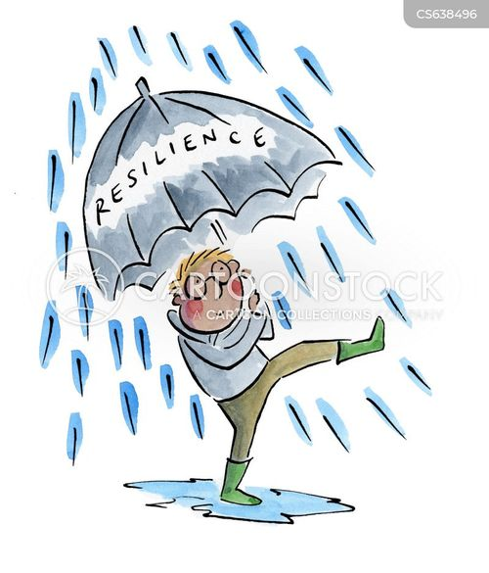
Educational adaptability and resilience to…
Argument: When individuals are more adaptable, entire economies and societies become more capable of absorbing shocks, adjusting to change, and sustaining productivity.

Slide 17
Active participation in society as a democratic citizen

Slide 18
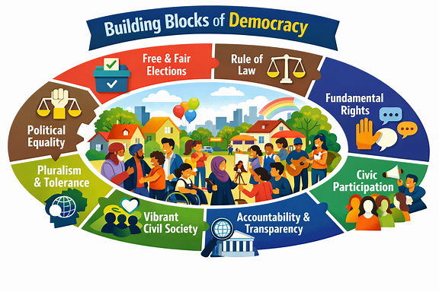
Democrative participation
Visual generated with Copilot (AI).

Slide 19
Democratic participation
The same skills that make workers adaptable, also make citizens capable of democratic participation.
Educational adaptability strengthens societal (collective) resilience: a society that can reorganize itself in response to crisis.
Educational adaptability requires from citizens active participation, deliberation, and judgement.
There is a clear connection between educational adaptability, democratic participation and societal resilience to shocks.
Notes:
skills=:
listening to others
negotiating differences
participating constructively in collective decision-making
taking initiative and responsibility
For example, during WWII, women entered the labour force and maintained productivity despite having little prior experience ().
This is a classic example of collective resilience: a society that can reorganise itself in response to crisis.
Democratic societies depend on this kind of resilience:
citizens must respond to rapid technological change
they must navigate misinformation
they must adapt to shifting social and economic conditions
they must participate in rethinking institutions when needed
Aanpassingsvermogen vereist participatie, overleg en oordeelsvermogen — democratische competenties.

Slide 20
Core message: Foundational learning is important, because…
Education, private and social returns, and economic growth, are closely linked. Foundational learning (in PE) → social returns + basic skills → growth rate, particularly in precarious contexts.
Shift in focus to quality education = shift in focus from years in education to what’s learned → TPD & knowledge transfer & educational curricula.
The demand for students’ and future workers’ adaptability challenges educational curricula today more than ever before..
Educated, adaptable inhabitants make societies more resilient to shocks and capable of collective problem‑solving.
Notes:
Social returns: also in terms of economic growth
How to integrate adaptability into curricula?
Climate change education, citizen education

Slide 21
Thank you! Questions? sofie.cabus@kuleuven.be

