Slide 1


The EU’s role in advancing foundational learning for stability and resilience
The example of the Regional Teachers’ Initiative for Africa
Katie Wade, Education and Skills Policy Officer, DG INTPA
1

Slide 2
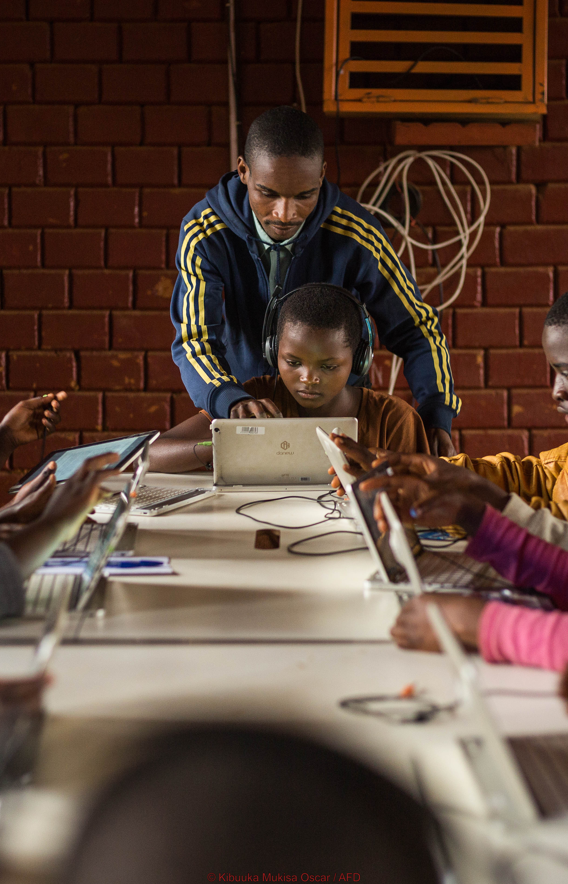

Why foundational learning matters in crises
Basic reading, writing, numeracy and socio‑emotional skills in early years.
Without these basics, later learning, jobs and societal participation become difficult.
In crises, protecting foundational learning gives children safety, routine and hope.
Supports social cohesion and reduces risks of exploitation.

Slide 3
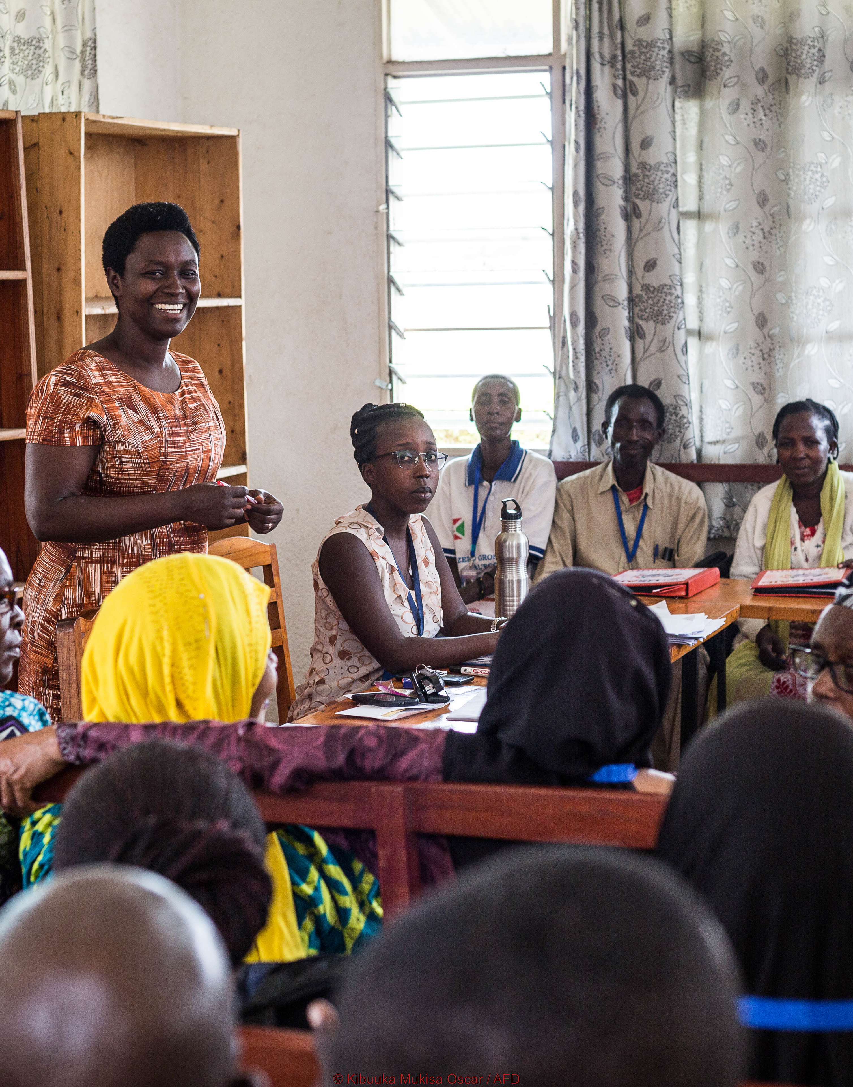
EU commitment to education, especially in fragile contexts
EU as a top donor for education.
12% of international partnerships budget (EUR 6bn in MFF 2021-2027).
Education is a fundamental right and key to tackling poverty and inequality.
Focus on learning outcomes and equity and inclusion.
About 44% of DG INTPA education funding in fragile and crisis‑affected contexts.
Aim to address root causes, whilst responding to immediate needs.

Slide 4
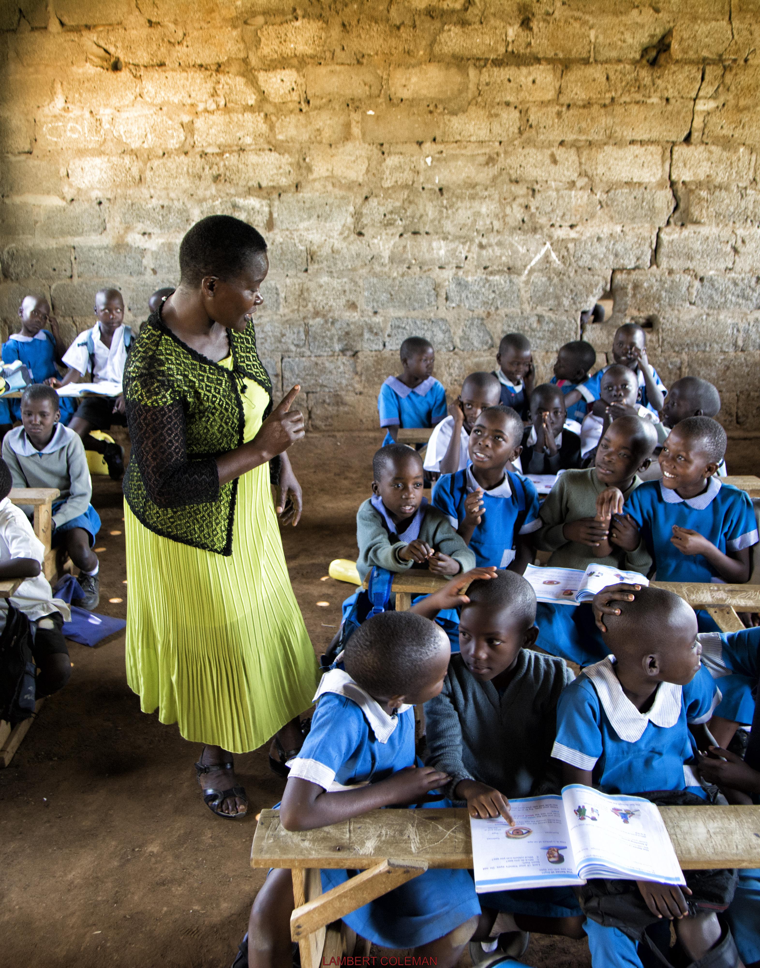
EU toolbox for education in fragile settings
EU engaged in highly fragile contexts using a broad toolbox.
Global Gateway is EU’s sustainable investment offer, matching partner needs and EU interests.
Education key within 360-degree approach.
Supports systems in ~80 countries, from foundational skills to VET and higher education.
Where investment logic is relevant, Global Gateway is context and conflict sensitive.
More flexible tools where investments are not feasible.

Slide 5
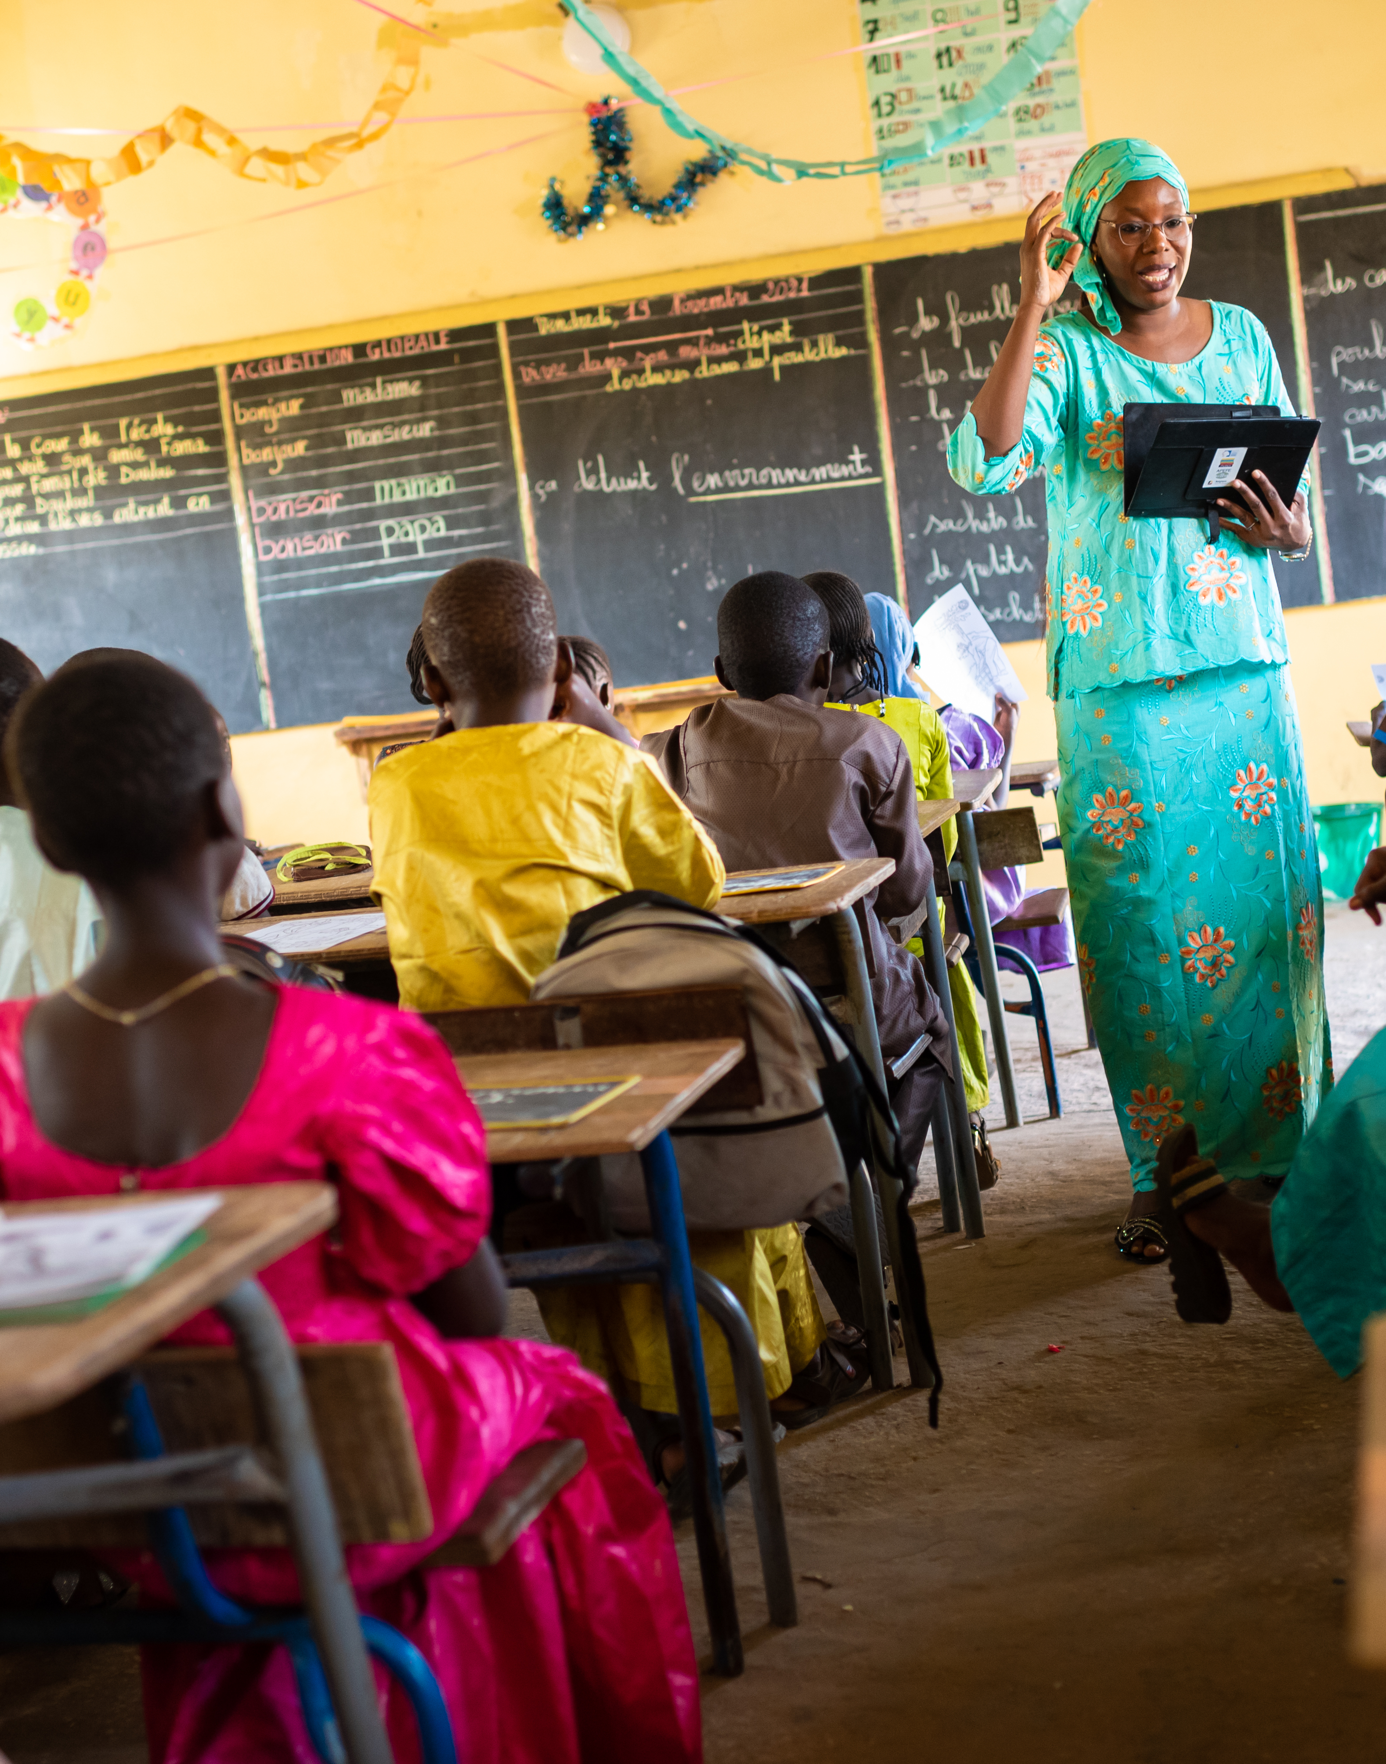
Why the EU is investing in teachers in Africa
250m children out of school globally and 70% of 10-year-olds in low/middle-income countries unable to read.
Huge teacher gap and many teachers lack minimum qualifications.
Difficult conditions undermine quality teaching.
Teachers at the heart of better foundational learning and improving learning outcomes.

Slide 6
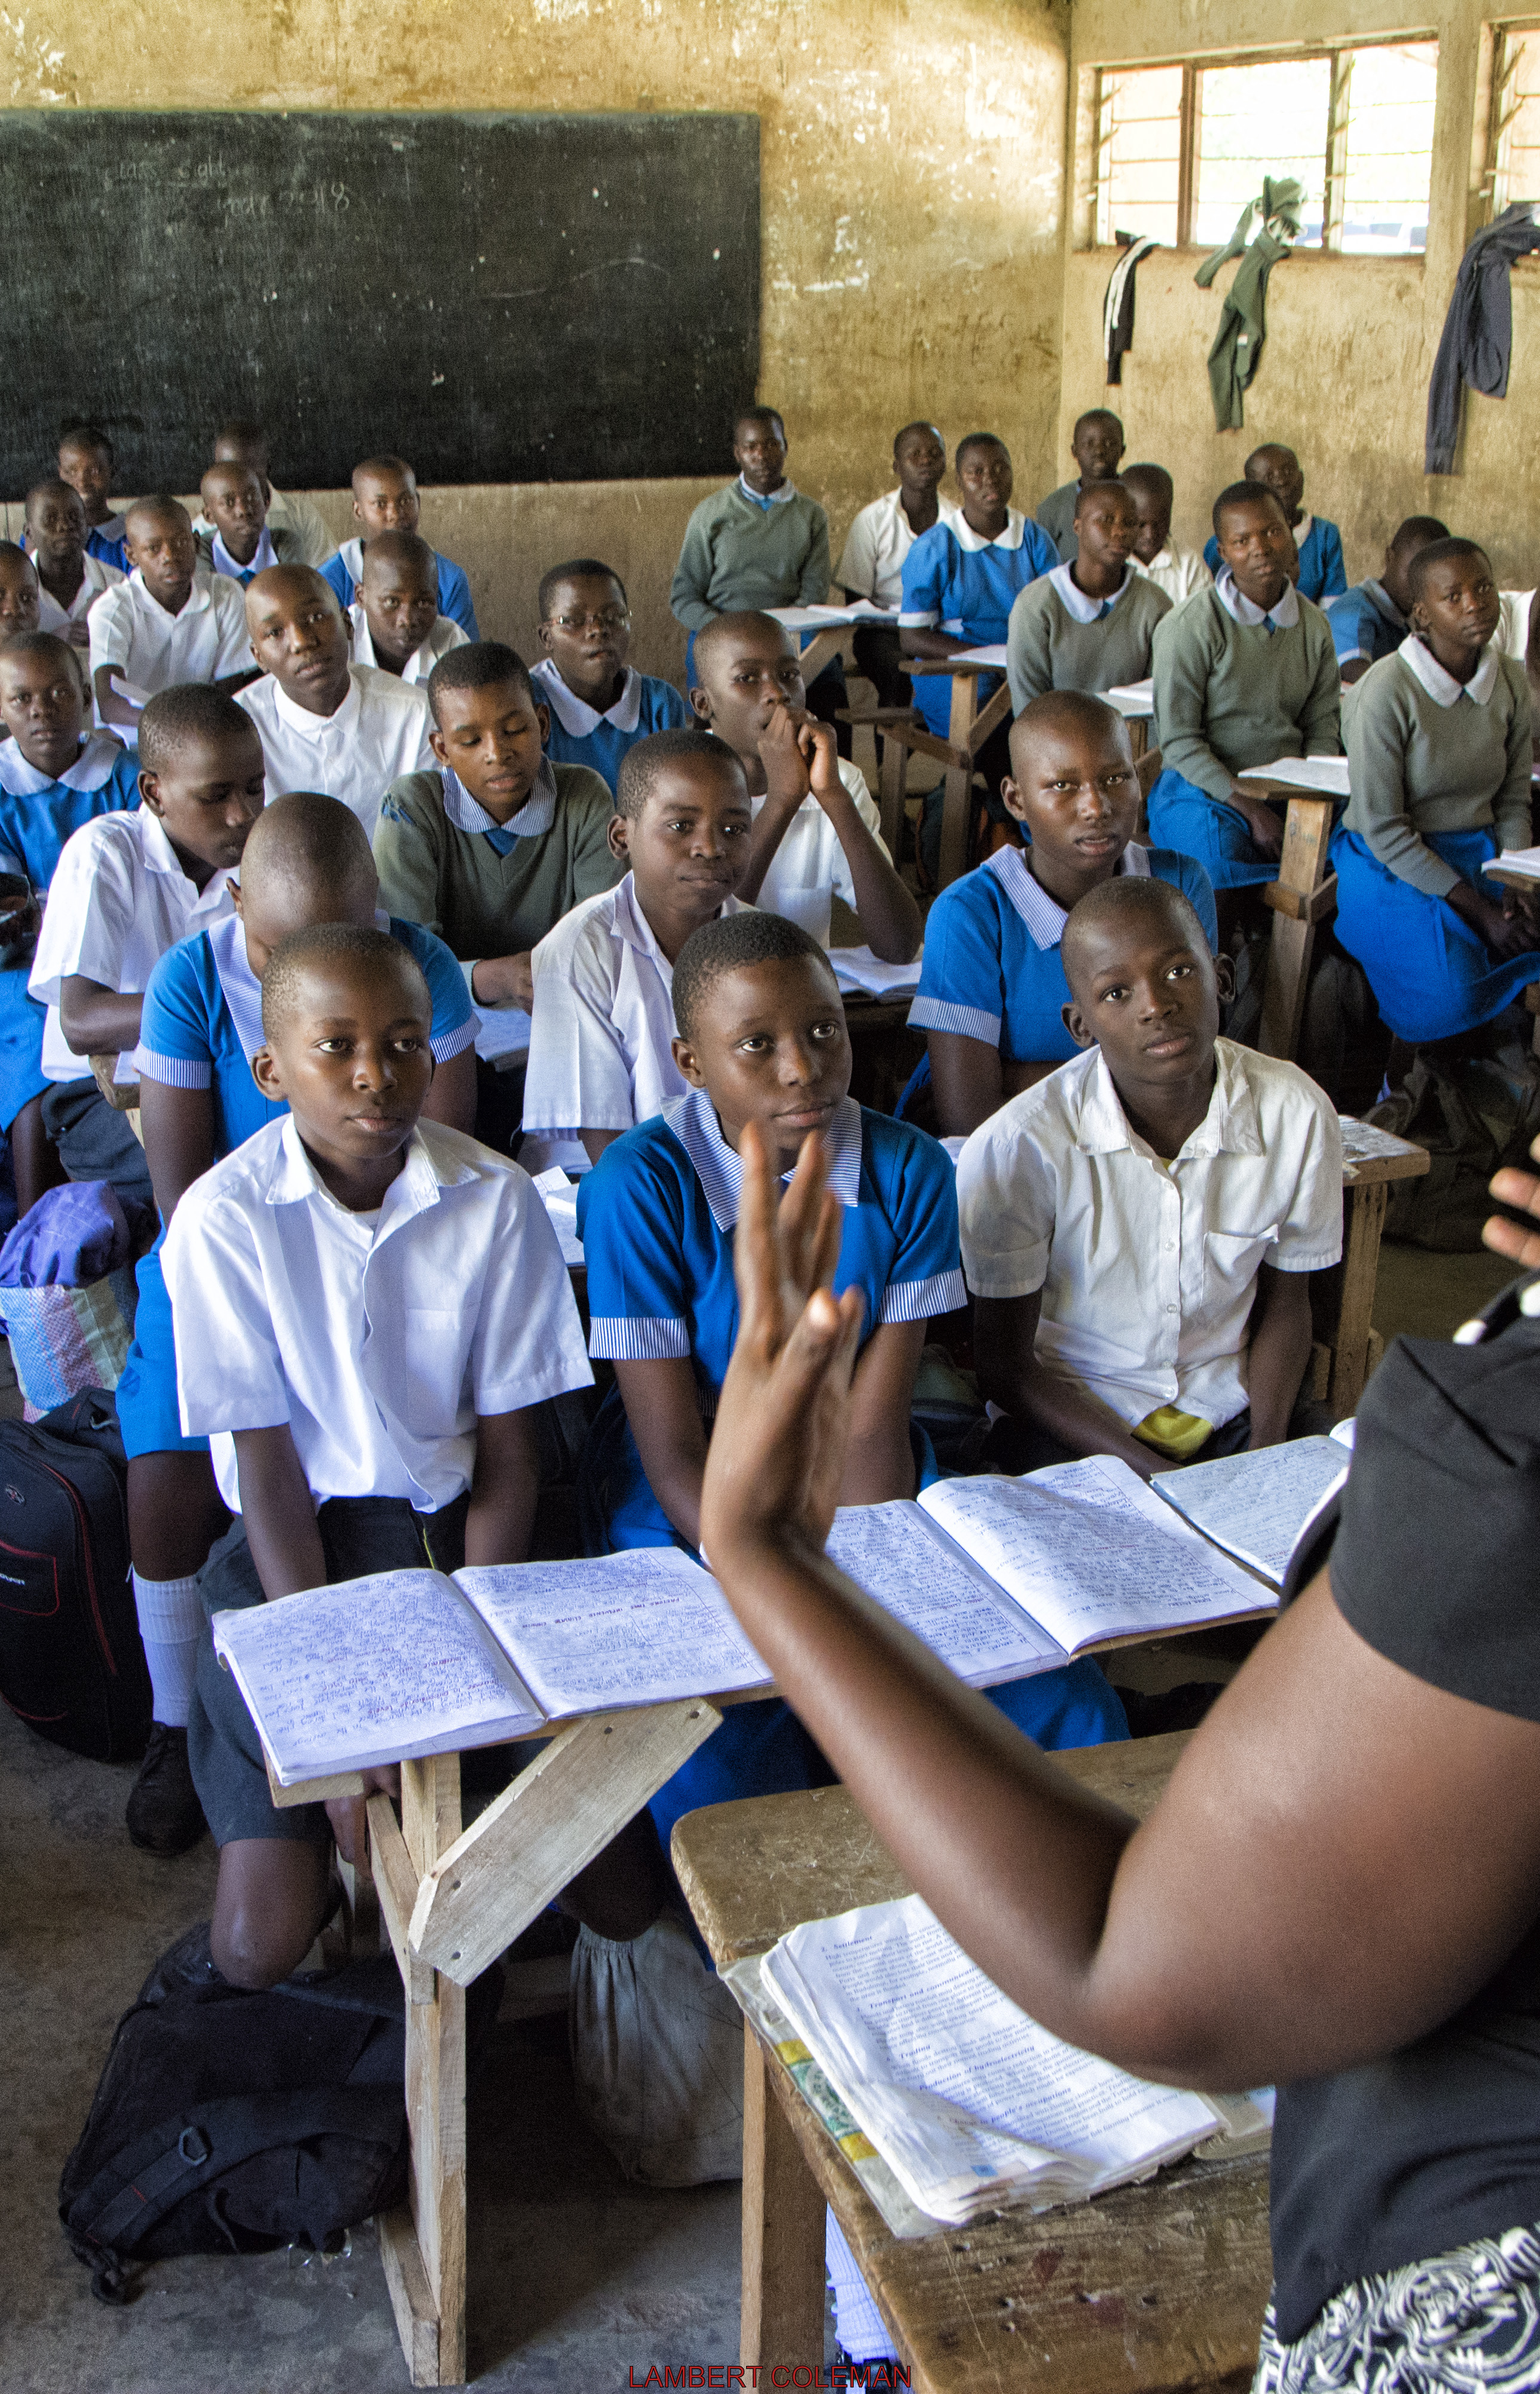
Regional Teachers’ Initiative for Africa
Global Gateway flagship financed by the European Commission (€100m), implemented from 2023–2030.
Joint EU-AU partnership and Team Europe approach (EU, Belgium, Estonia, Finland, France, AU, UNESCO, African countries).
Different contexts: relatively stable systems to highly fragile settings.
Aims to support the development of an inclusive, motivated, competent teacher workforce.
Aims to ensure high quality education for all.

Slide 7
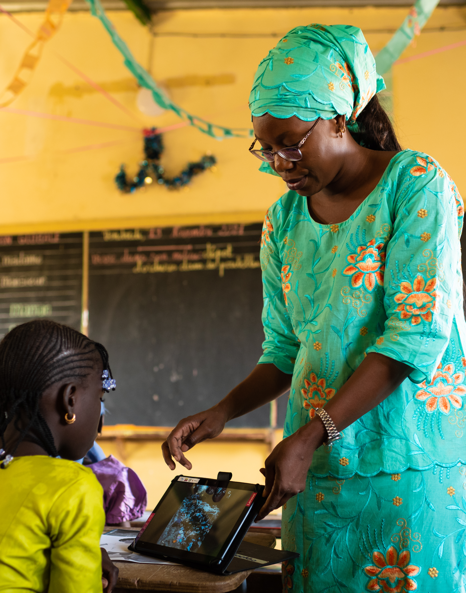
Teachers in crisis contexts: protecting foundational learning
Dedicated RTIA window for teachers in crisis contexts.
6 projects ongoing in conflict and disaster affected areas.
Focus on:
  Retaining and deploying teachers in hard-to-reach areas.
  CPD on crisis-responsive, conflict-sensitive and inclusive pedagogy.
  Psychosocial support and wellbeing for teachers.
Aim: to keep children in education and learning during and after crises.

Slide 8
Thank you
© European Union 2026
Unless otherwise noted the reuse of this presentation is authorised under the CC BY 4.0 license. For any use or reproduction of elements that are not owned by the EU, permission may need to be sought directly from the respective right holders.

