Slide 1
Advancing Foundational Learning to Build Resilience and Stability
Evidence from Refugee and Host-Community Education Systems in Ethiopia, Tanzania, and Uganda
Educaid.be International Conference 2026
Joseph Opondo
Regional Education in Emergency Advisor - PlayMatters
Plan International
Notes:
Lillian

Slide 2
Program context
This presentation draws on findings from the PlayMatters initiative, a six-year project implemented by IRC, Plan International, War Child Alliance, IPA and BIT in partnership with the LEGO Foundation.
The project works in Ethiopia, Tanzania, and Uganda to integrate Learning through Play (LtP) into education systems serving refugee and host community schools.
Key components of the project include:
Promoting play-based learning through teacher professional development.
Rallying parent/community participation in school activities.
Strengthening education systems to embed and support LtP
The project was intentionally designed not as a parallel intervention, but as a systems-strengthening approach embedded within government education structures.

Slide 3
Setting the Context
Evidence Base
Three complementary studies underpin
this presentation:
PlayMatters Evidence Brief: Learning through Play to Improve Teaching, Learning and Wellbeing in Conflict and Crisis (Ethiopia RCT) – This study was conducted in 35schools and with 3,060 learners
PlayMatters Community Engagement Sustainability Study – This multi-country study was conducted in 24 pre-primary and primary schools
PlayMatters Parent and Community Engagement Study Report – This multi-country study was conducted in 14 schools, with FGDs triangulated against classroom observation data
THE SUSTAINABILITY CHALLENGE
In fragile contexts, education programs collapse when donor funding ends
The key challenge is not only improving learning during crises, but sustaining gains beyond project cycles.
Activities stop
Teacher motivation declines
Community engagement weakens

Slide 4
  Key Findings: Ethiopia RCT
Teachers showed major gains in instructional practices, classroom management, and student engagement.
Children made large improvements in numeracy and social–emotional learning, and moderate gains in literacy and wellbeing.
Compared to education interventions in conflict affected settings, PlayMatters in Ethiopia achieved 4X the impact on children’s SEL outcomes, 2X the impact on numeracy, and similar impacts on literacy at one-sixth of the average cost of education interventions in conflict settings (US$38 per child compared to US$240 in the field).
Learning through Play can be integrated into national teacher professional development frameworks and curriculum reforms, offering a scalable, low-cost model to strengthen quality, equity, and resilience in education.
Notes:
This is the first RCT to demonstrate causal, cost-effective impacts of Learning through Play in a conflict-affected education system.
This is important because very few education interventions in crisis settings demonstrate causal learning outcomes at this scale and cost.

Slide 5
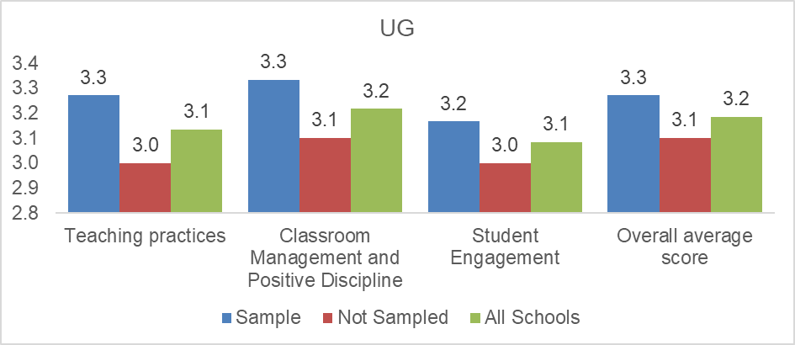
Key Findings: Parent and Community Engagement Study
Increased parental and community involvement in school affairs enhances teachers’ classroom practices, Classroom Management & Positive Discipline, and Student Engagement.
Positive feedback from parents motivates teachers to adopt and continue using LtP techniques.
Collaborative efforts have led to a more conducive learning environment, with creative use of play materials even in overcrowded classrooms.
Overall, community participation strengthens trust, shared responsibility, and continuity of learning during disruptions.

Slide 6
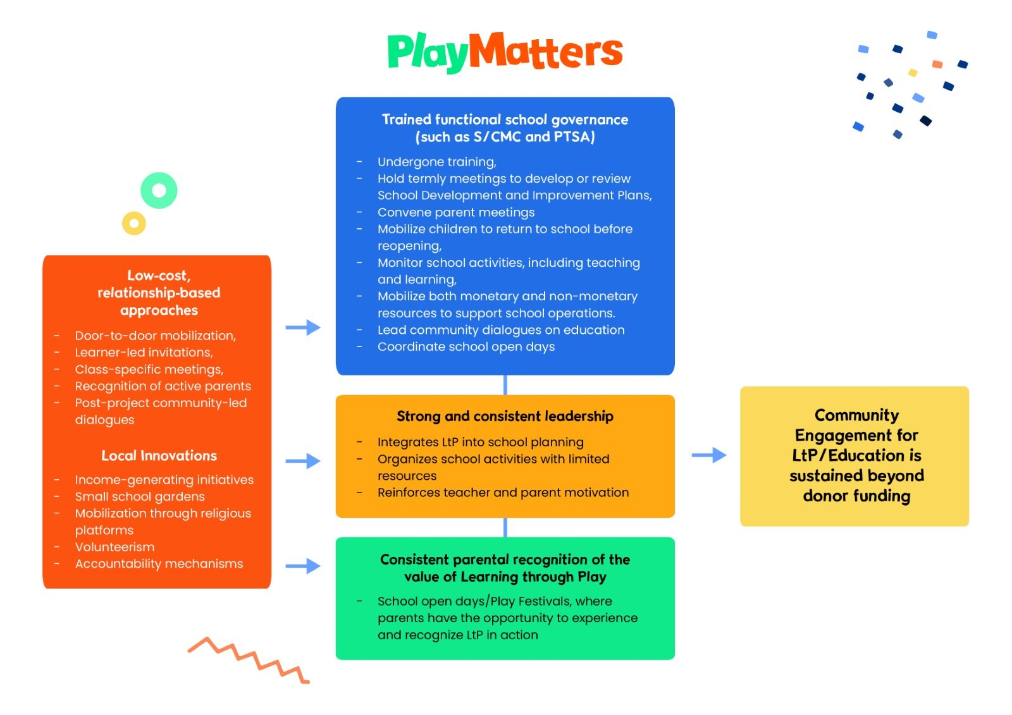
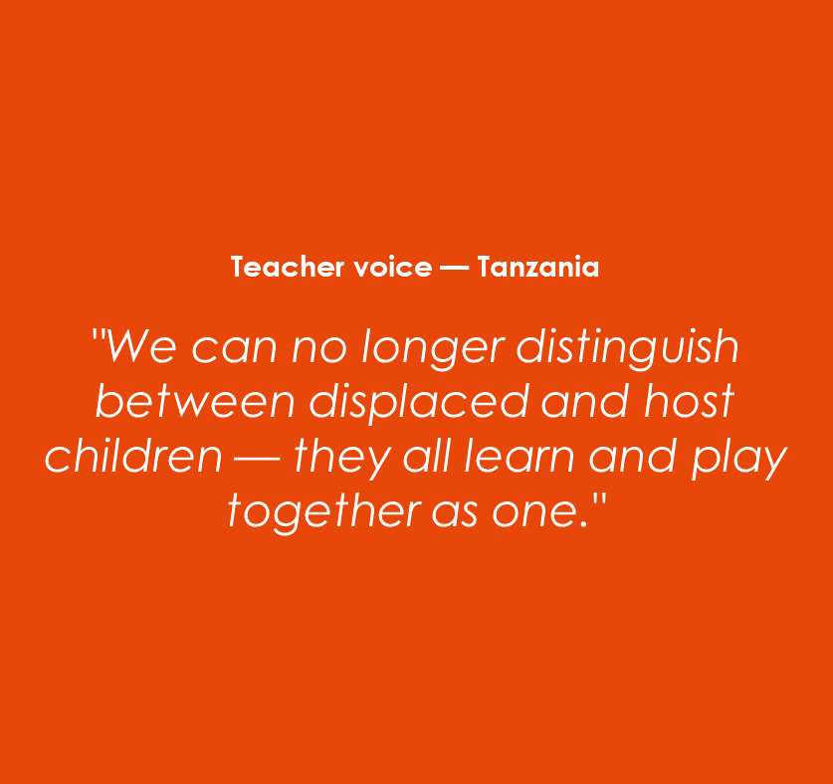
  Key Findings: Community Engagement Sustainability Study
Jjjjjjjjjjj
jjjjjjjj
In refugee-host schools, LtP created something beyond academic gains. It became a space for social cohesion, children from different communities played and learned together, parents interacted across ethnic and social divides, schools became shared spaces of cooperation and trust, play helped create shared spaces of trust, interaction, and belonging across refugee and host communities, and where division once existed.
Notes:
Drivers of community sustainability: strong school leadership, combined with a trained functional school governance (S/CMCs andPTSAs), and parental recognition of the value of LtP, when backed by low-cost, relationship-based approaches and local innovations ,collectively contribute to sustained community engagement beyond donor funding.

Slide 7
Why it Matters for Resilience & Stability
Human Capital
Foundational learning equips children with the literacy, numeracy, and social-emotional skills needed for lifelong learning, adaptability, and economic participation.
Social Cohesion
Play-based learning fosters empathy, collaboration, and positive interaction across divided communities and classrooms.
Stability
Community-owned and system-embedded approaches strengthen continuity, resilience, and stability beyond donor cycles.

Slide 8
Key Insights for Policymakers, Partners & Donors
1. Design for sustainability from the start
2. Invest in relational, low‑cost strategies
3. Integrate LtP into national teacher development & curricula.
4. Invest in schools as spaces for learning, protection, and social cohesion.
5. Provide flexible, multi-year funding that supports system integration rather than short-term parallel delivery
Foundational learning can be advanced in fragile contexts by embedding Learning through Play within community ownership and system structures. It matters because it equips children to thrive, fosters cohesion across divided communities, and provides a sustainable, cost‑effective pathway to resilience and stability.

Slide 9
Contacts and references
Joseph Opondo – Plan International
📧 joseph.opondo@plan-international.org
References
PlayMatters Evidence Brief: Learning through Play to Improve Teaching, Learning and Wellbeing in Conflict and Crisis (Ethiopia RCT, 2025)
PlayMatters Community Engagement Sustainability Study (Ethiopia, Tanzania, Uganda, 2026)
PlayMatters Parent and Community Engagement Study Report (Ethiopia, Tanzania, Uganda, 2024)
These and additional resources: www.playmatters.org

