Slide 1
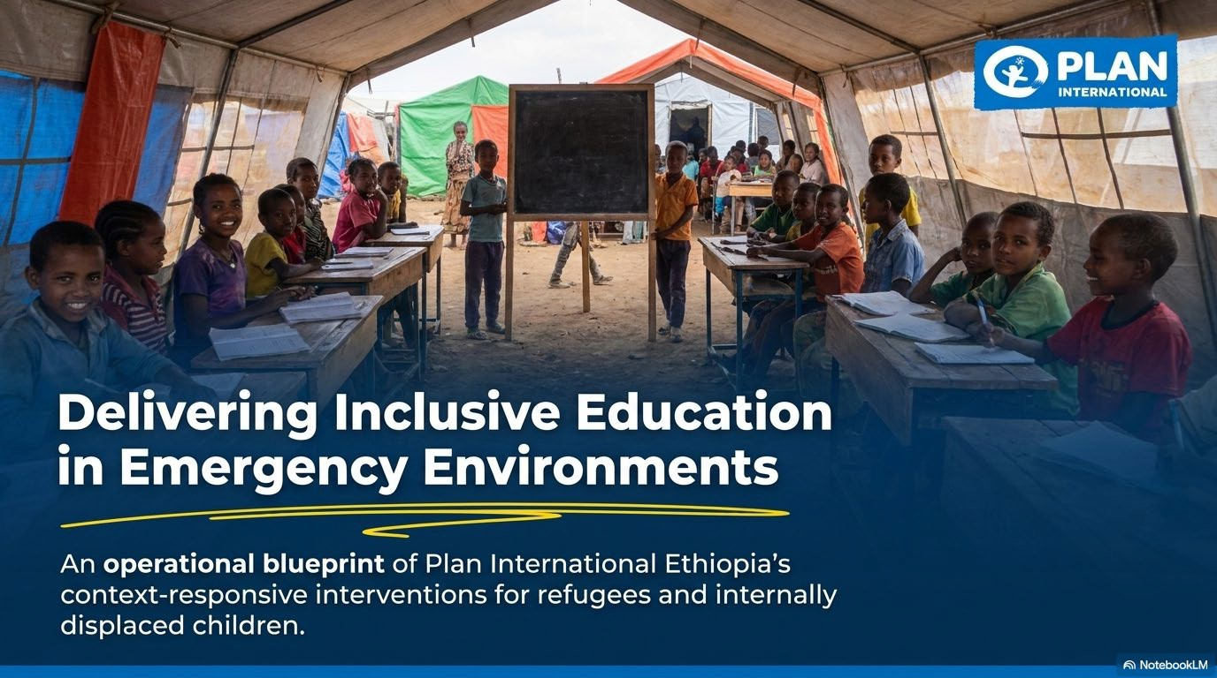

An operational blueprint of Plan International Ethiopia’s context-responsive interventions for refugees, conflict affected and internally displaced children

Slide 2
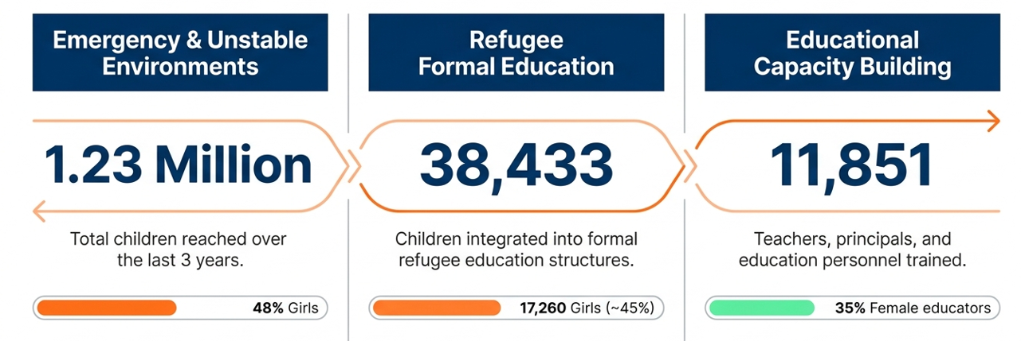
PIE’s EiE Achievement
65,943
44% girls
Notes:
This is past three years achievement.

Slide 3
PIE’s EIE Modalities: Refugees, Active Conflict areas, IDPs & Host communities
Modalities | Intervention | Duration | Target Context | Core Focus
Formal Learning | National curriculum | School academic year | Host communities, refugees, IDPs | General Education curriculum content
Informal Learning | Bridging Education | 3–6 months | Newly arrived refugees | Selected content from formal education curriculum
 | Catch-up Class | 3 months | Children needing formal education placement | Foundational Literacy and Numeracy (FLN).
Non-formal Learning | Accelerated School Readiness (ASR) | 2 months | Children aged 6 & 7 (Non-formal ECE) | Play-based emergent literacy, numeracy, and Social-Emotional Learning (SEL).
 | Accelerated Education Program (AEP) | 10 months | Emergency learning centers for displaced children aged 7+ years | 5 condescend subjects as one package (language (mother tongue and English), Maths, environmental science, aesthetics)
 | Home-Based Instruction (HBI) | 10 months | Active conflict areas where physical centers are unsafe. | Socialization and Foundational Literacy and Numeracy (FLN).
19/05/2026
4

Slide 4

Gambella Region Refugee education modalities
Gambella – Nguenyyiel
Refugee Camp
Gambella-LuakDong
Refugee Camp
Modality: Formal Education in Gambella refugees
Primary Reached yearly:
>18,000 children
Gender: 46% female
Pre-Primary Reached yearly:
>10,000 children
Gender: 36% girls
Modality:
Accelerated Education Program (AEP)
Total Reach
3,959 children
Gender: 1,745 girls
Modality:
Bridging Education
Reached:
8,441 children
Gender: 3,601 girls
19/05/2026
3
Notes:
The last 3 years achievement

Slide 5
Benishangul- Region Education modalities
Informal Education
Non-formal Education
Formal Education
Modality:
Catch up class
Total Reach:
1,672 children (678 girls)
Modality:
Bridging Education
Total Reach: 1,288 children (691 girls)
Modality:
Accelerated School Readiness (ASR)
Total Reach:
350 children (168 girls)
Modality:
Modality:
Accelerated Education
Program (AEP)
Total Reach:
640 children
(348 girls)
Modality:
Modality:
Formal Education
Pre-Primary
5756 children
(2946 girls)
Primary
22526 children
(10278 girls)
Secondary
4013 children
(1485 girls)
Ura refugee site
Tsore refugee site
Ura refugee site
Metekel IDP
19/05/2026
3
Notes:
Three years achievement

Slide 6
Amhara Region Education Modalities
East Gojjam, Active conflict areas
East Gojjam & Waghemra: relatively stable
Modality: Formal Education in Alemwach & Aftit refugees
Pre-Primary
258 children
(120 girls)
Primary
5005 children
(2222 girls)
Secondary
385 children
(130 girls)
Modality:
Home Based Instruction (HBI)
    Total Reach:
    2,647 children
    Gender Breakdown: 1,135 girls
Modality:
Accelerated Education Program (AEP)
Reached:
2,005 children
Gender breakdown: 758 girls
19/05/2026
3
Notes:
The last 3 years achievement

Slide 7
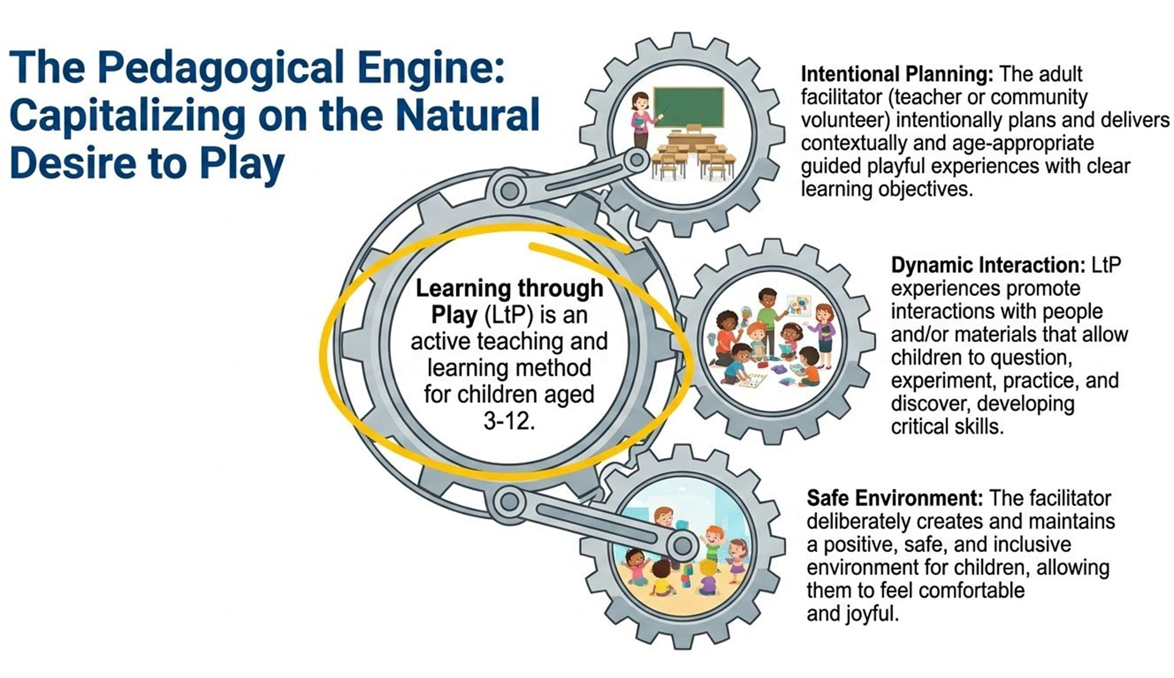
Learning through Play (LtP) Key Features
.
LtP  flagship program for PIE, implemented in
refugees,
`IDPs,
host communities
unstable environment

Slide 8
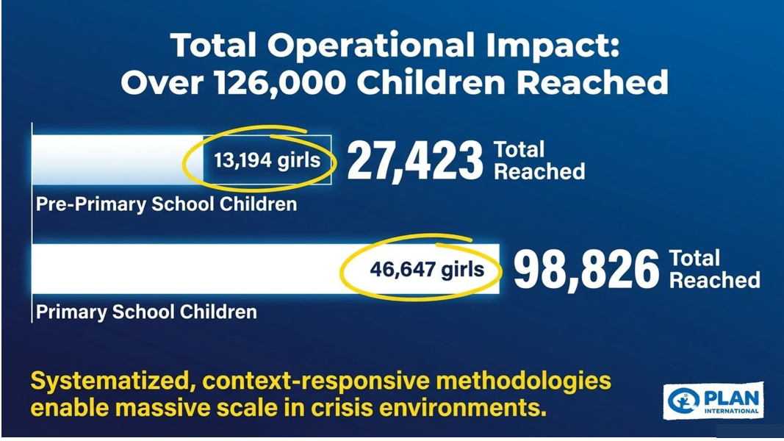

LtP

Slide 9
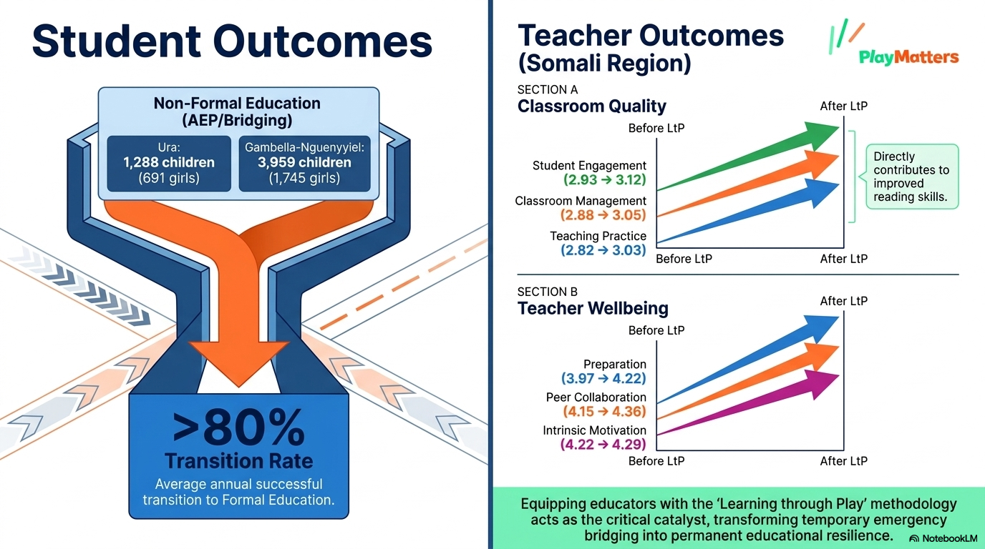
Field Level Evidences
Transition (BG, Ura)
Teachers Classroom Practice
Accelerated Education Program
Directly contributes to improved reading & numeracy skills
Equipping educators with the LtP methodology acts as the critical catalyst in transforming teachers classroom practices and student learning outcome

Slide 10


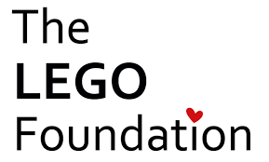



Thank you our donors!!!

Slide 11
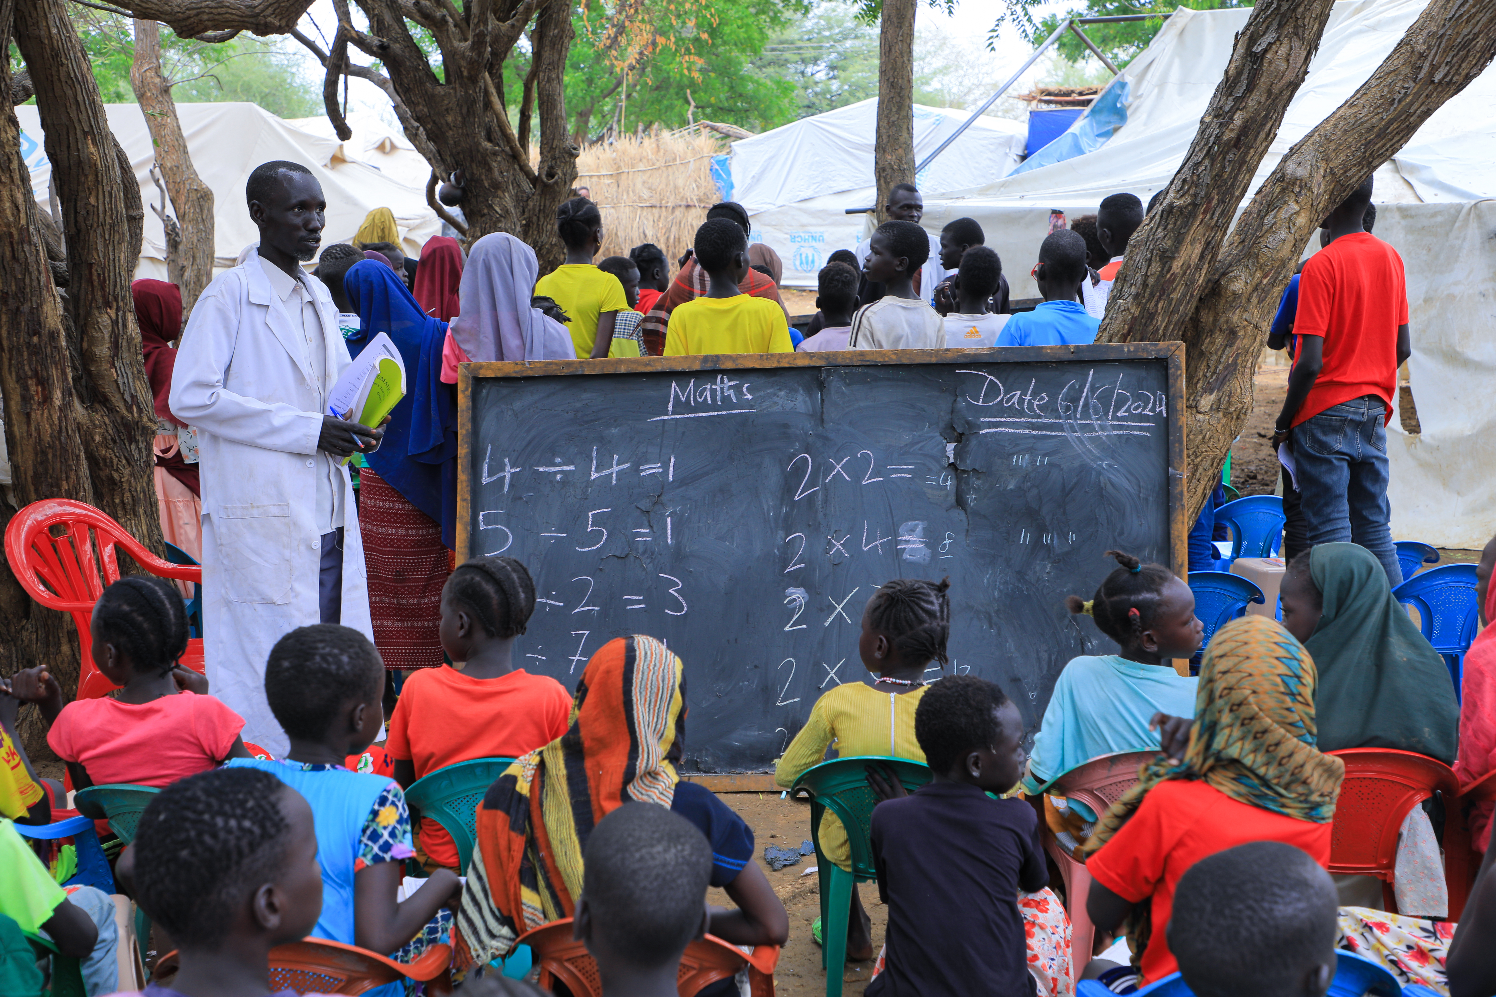
thank you!

