Slide 1
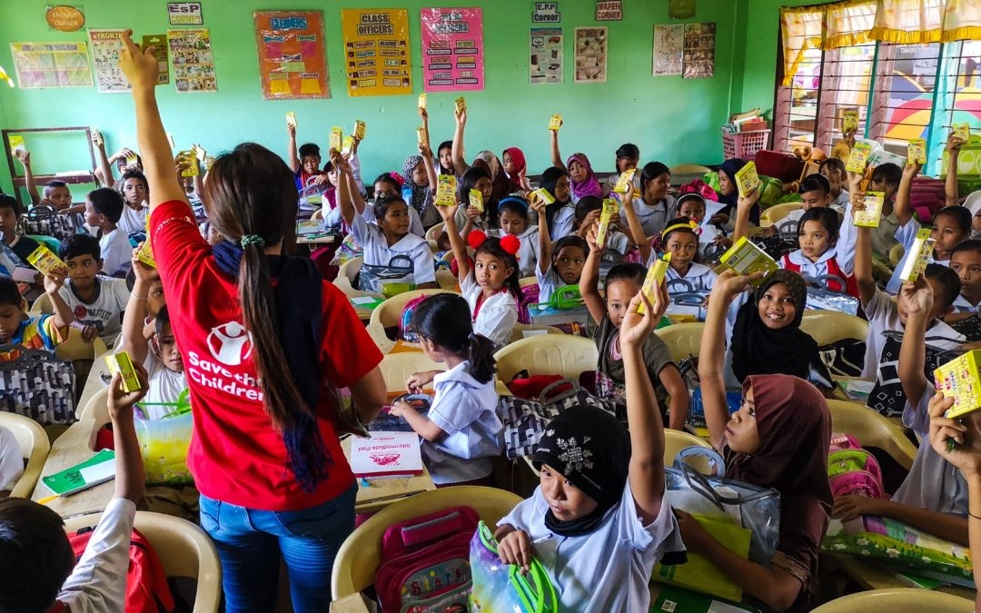
MHPSS in Education

Slide 2
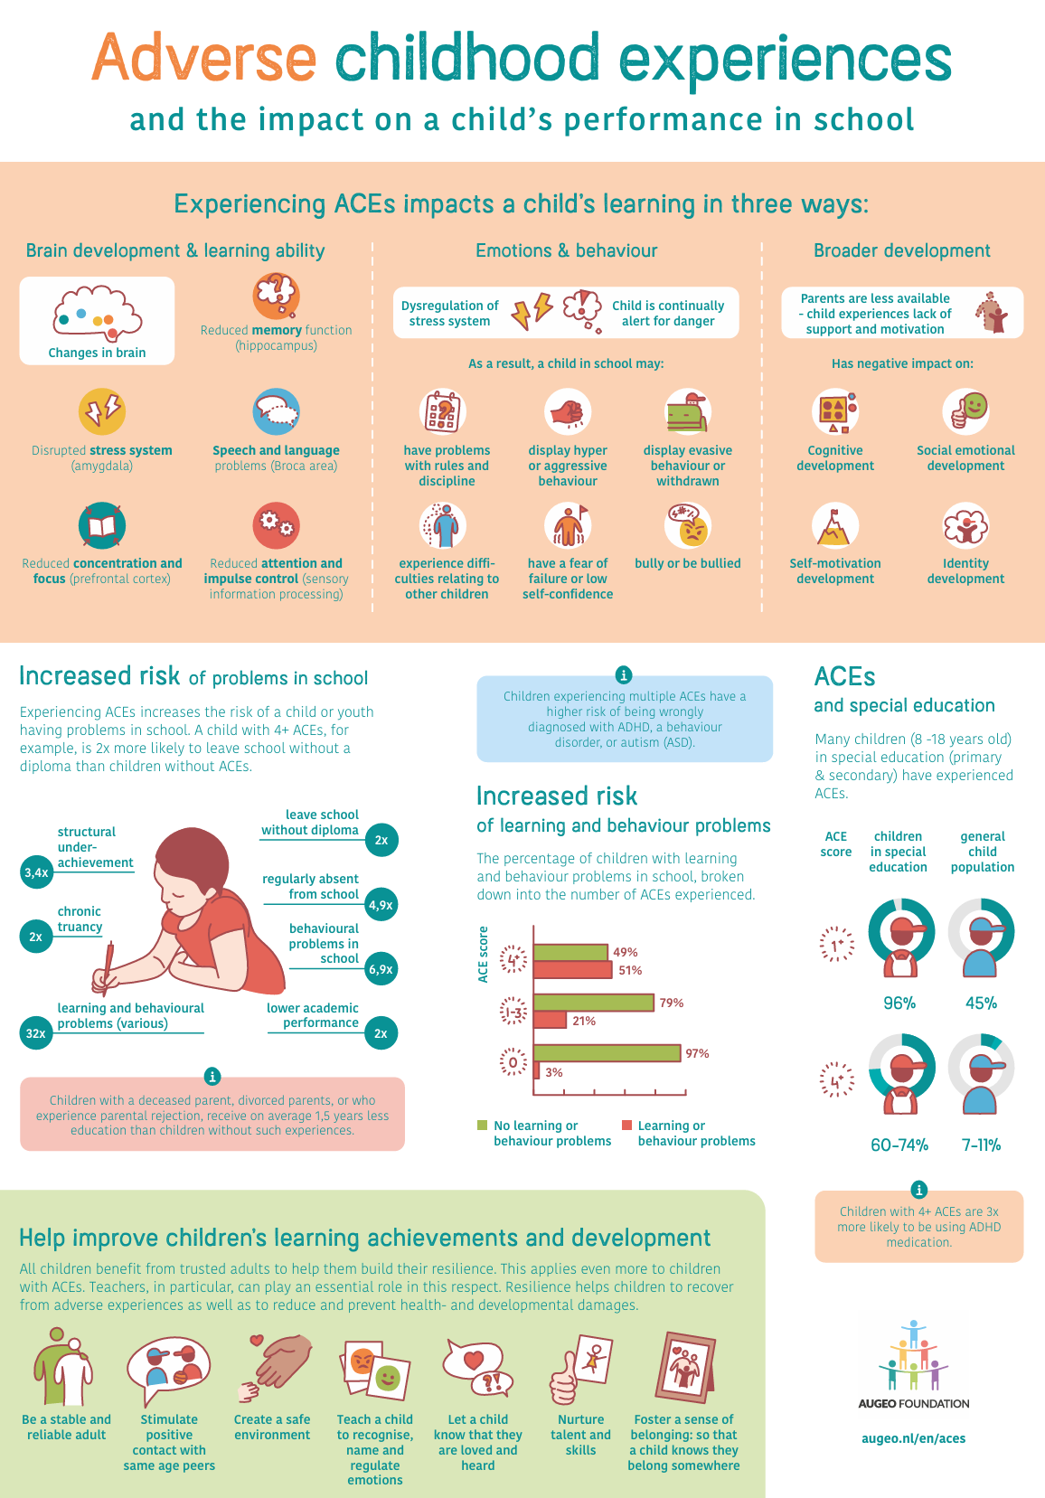

Slide 3
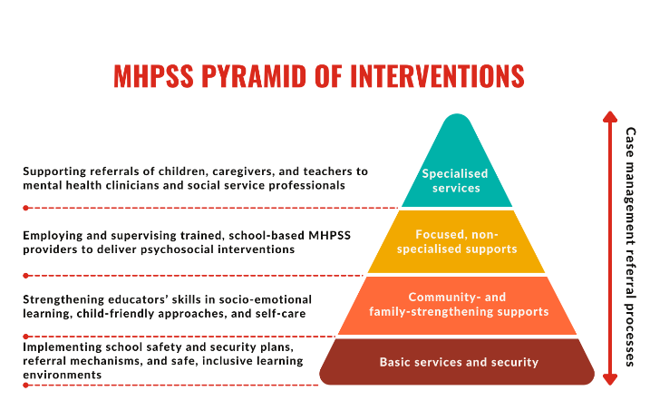
Notes:
This is what the different activities in the MHPSS pyramid of interventions can look like in education
MHPSS and Education
Attendance at school with quality teaching and a safe environment is a key factor in contributing to the well wellbeing of children and adolescents. The structure, routine and stimulating environment of school can play a major role to help children to return to normalcy and strengthen coping mechanisms.
MHPSS interventions in school or non-formal education settings should be done in conjunction with play and recreation activities, or schools should be considered as a possible structure in which to establish a CFS or recreation programme.
Specific considerations for school-based interventions include:
Teachers should be trained in MHPSS approaches and psychosocially supportive teaching methods, including topics and approaches mentioned in the section on play and recreational activities.
Teachers should be trained on PFA.
Teachers should be encouraged to engage in regular self self-care and stress reduction activities, especially following a crisis or emergency.
Activities should initially involve all children so as to reduce stigma. If further support is needed, ensure the child accesses extra support in a way that does not identify them as being “weak” or as someone who is not coping.
When identifying children who may need specialised support, ensure that the family is involved.
Ensure the school is linked with referral mechanisms, including access to child protection services, MHPSS activities including play and recreation activities, life skills, early childhood support and specialised mental health support.
Consider integrating psychosocial activities in mainstream classroom activities throughout the school day to aid concentration, relaxation and team building.
A healthy quality learning environment for boys and girls that prevents violence, bullying or isolation is key to supporting children’s development and wellbeing.
Even if MHPSS activities are not taking place in schools, it is very important to link with the education sector in order to encourage school attendance, and also to identify school going children who may need further support
For more on this, refer to Appendix 1 on the step-by-step approach to programming in play and recreational activities - many of the issues will be the same as for implementing school based activities.
MHPSS and Early Childhood Care and Development (ECCD)
When working with children, for example in a play and recreational activities programme, it is important to include strategies to work with babies and preschool children. Young children can also be included in group activities with older children, but specific early childhood activities should be included in interventions. Parents and caregivers should be included in ECCD activities both so they can support their children and access support they may need themselves.
With very young or distressed children, for example, consider the following types of play based activities:
Manipulation of clay or similar material.
Rattles and shaking toys for babies, clapping/ copying games, singing.
Creative activities such as painting, printing etc.
Running, hiding, movement games.
Sand and water play.
Remember:
It is important to use non-verbal activities with young children as well as activities to stimulate language development
Ensure that specific times are dedicated to interventions for this age group, as many young children will attend activities designed for older children that may not be suitable

Slide 4
Social and Emotional Learning
Objectives/Outcomes
Understand and manage emotions
Cope with stress
Feel and show empathy to others
Establish and maintain positive relationships
Make responsible decisions
Set and achieve positive goals
Notes:
SEL
Social and emotional skills go by many names: life skills, soft skills, 21st century skills, non-cognitive skills, transferable skills. Each term uses a slightly different theoretical framework driven by the needs of a specific field. However, all these terms refer to social and emotional competencies that develop in a child and adolescent’s life.
In education, we use SEL to refer to the process through which children can develop social and emotional wellbeing in the context of a positive, supportive and inclusive environment.
Through strengthening protective factors, SEL programming can help children not only deal with the adverse effects of negative life events but also increase their concentration, improve behavioral conduct and contribute to more positive attitudes towards learning. Therefore it is critical to integrate SEL into learning, whether that be a formal or non-formal learning environment.
In emergency contexts, there is overlap between SEL and PSS, which is generally thought of as immediate and targeted attention to an individual’s social and emotional wellbeing, if the individual has experienced severe adversity or chronic trauma.
SEL is important to us because it means that children, whatever context they are in, are ready to learn and have the social emotional knowledge, attitudes and skills necessary to both reach their potential and adapt to any changes in their contexts

Slide 5

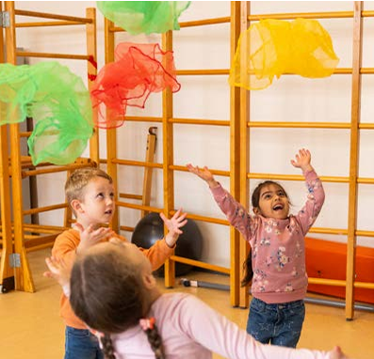
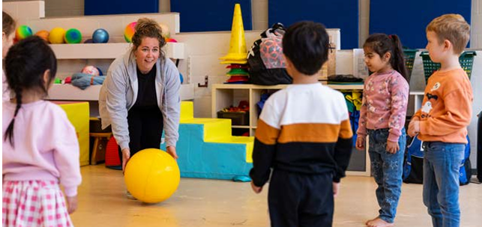

Slide 6

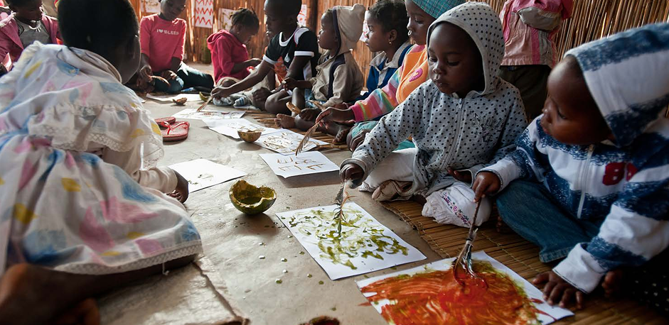

Slide 7
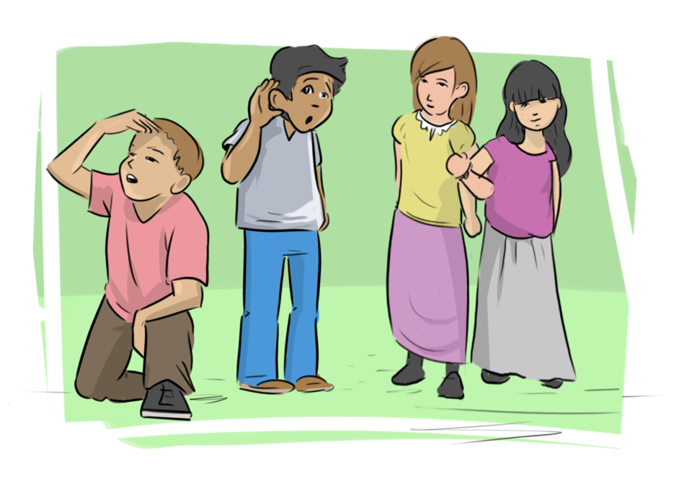
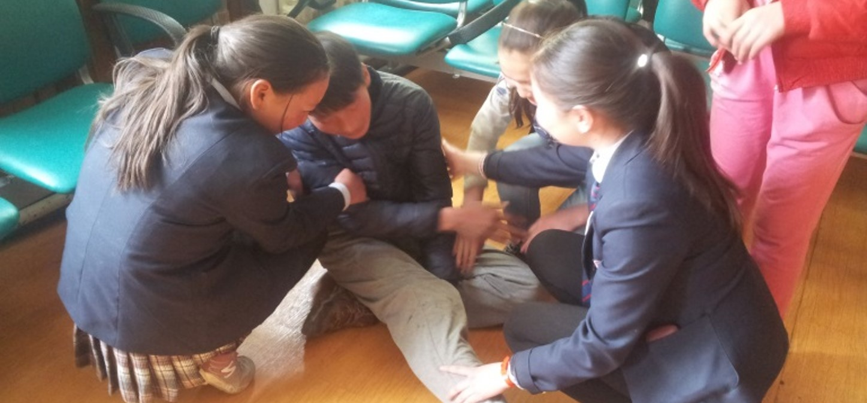




“I Support My Friends”
Peer-to-Peer Psychological First Aid (PFA)

