Slide 1



School Based Mental Health and Psychosocial Support
Patricia Landínez González
28 May 2026

Slide 2
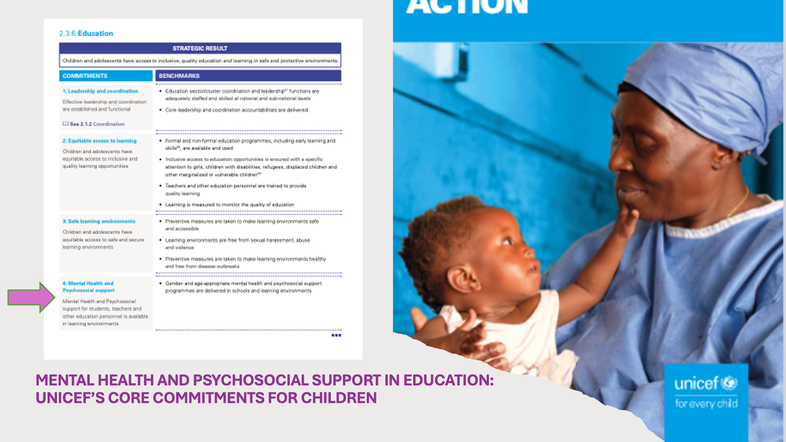

Slide 3
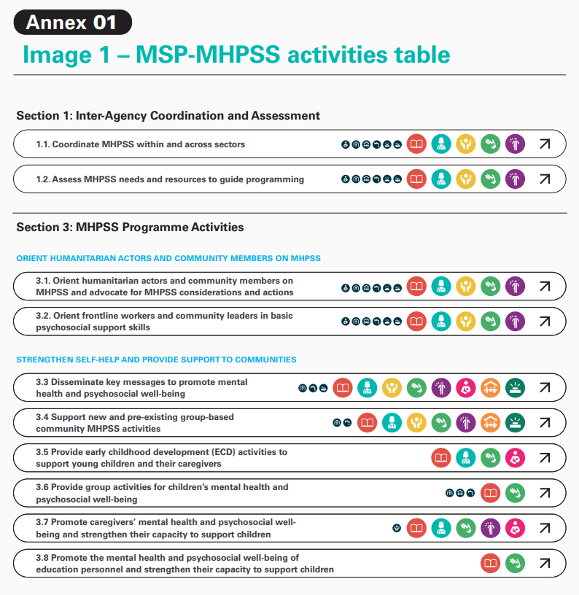

What is the MHPSS Minimum Service Package?
Set of high priority MHPSS activities
Intersectoral – shared understanding, common language
Based on:
  Existing guidelines
  Best available evidence
  Consultation & expert consensus
Designed to facilitate a faster, more effective, better coordinated response
Notes:
22 activities that are considered to be of the highest priority in meeting MHPSS needs in an emergency
when an emergency happens, we don’t need to start from scratch. We already have quite a lot of knowledge and evidence from emergencies around the world to help us in prioritising what to do.
Intersectoral: key strength - a lot of diverse actors came together to provide input on the MSP, it had multiple different donors, and the involvement of many sectors – meaning it incorporates activities that are typically delivered by health actors, social welfare/protection actors, education actors and others
Designed to be helpful to coordinators, programme planners, donors, technical advisors and any other organization or individual implementing MHPSS activities with diverse backgrounds, qualifications and levels of experience.

Slide 4
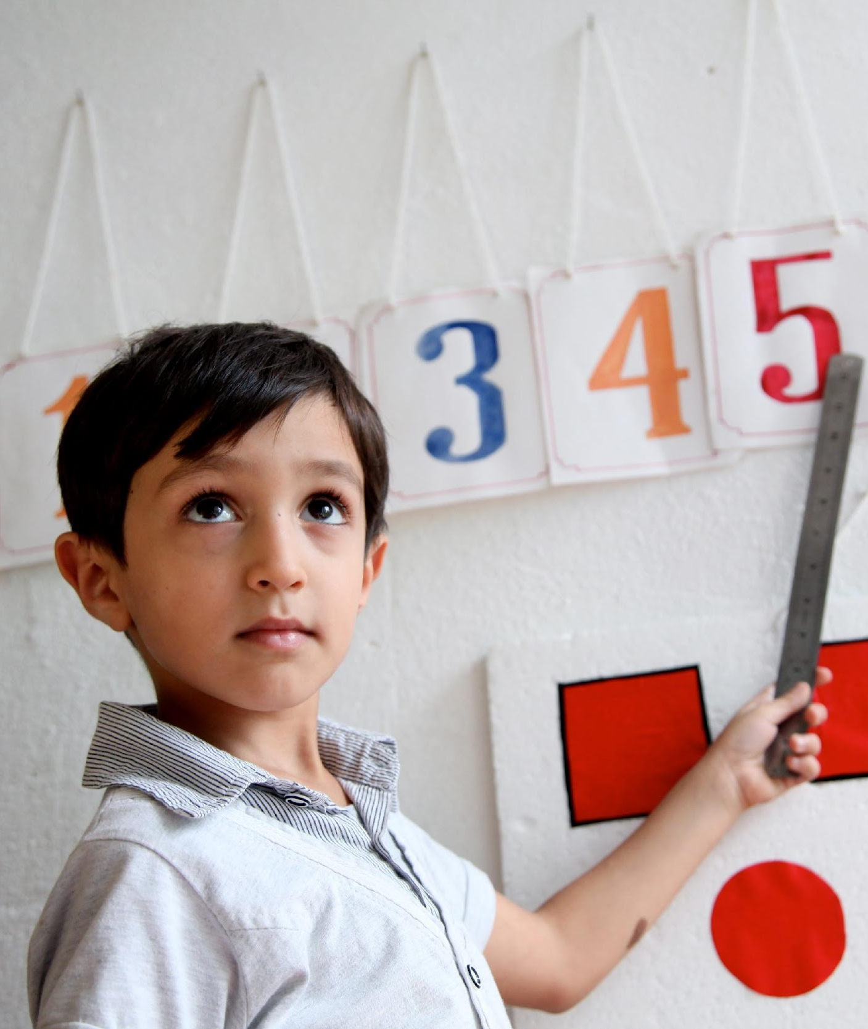
MHPSS activities for the education sector
Assessments
  Including the MHPSS needs of children, caregivers and education personnel in education needs assessment.
Coordination
  Working closely with actors in health, child protection, ECD, GBV, and other work areas to define roles and responsibilities, avoid duplication
ECE
  Integrating activities to support the MHPSW of children and their caregivers in Early Childhood Education programming
MHPSS services
  Delivering individual or group mental health and psychosocial support activities in schools and learning environments
Inclusive
  Guaranteeing that education activities are accessible and meet the needs of people with mental health conditions.
Workforce
  Equipping frontline education staff with knowledge and skills to promote and safeguard learners’ mental health and wellbeing
Community messaging
  Disseminating key MHPSS messages across schools and learning environments
Referral
  Establishing clear referral pathways and SOPs
Teacher´s wellbeing
  Promoting teacher wellbeing

Slide 5
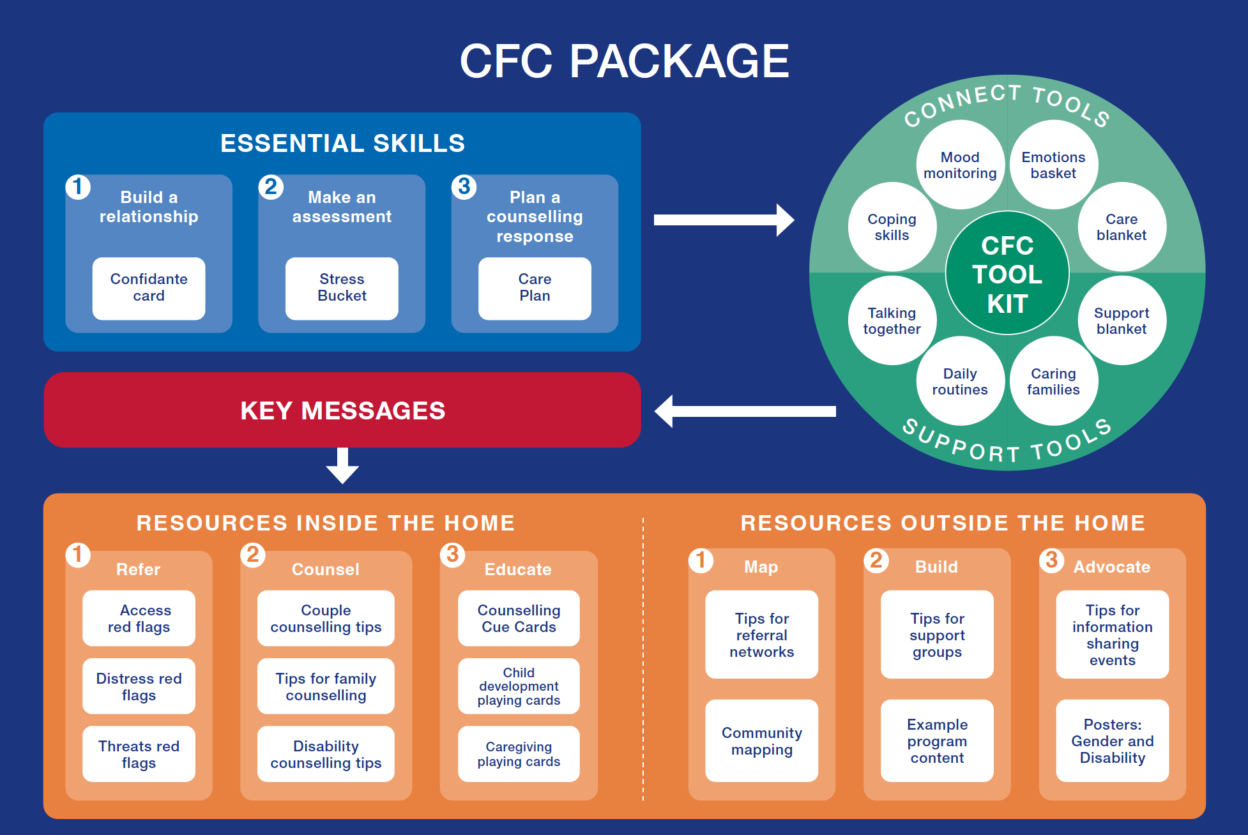
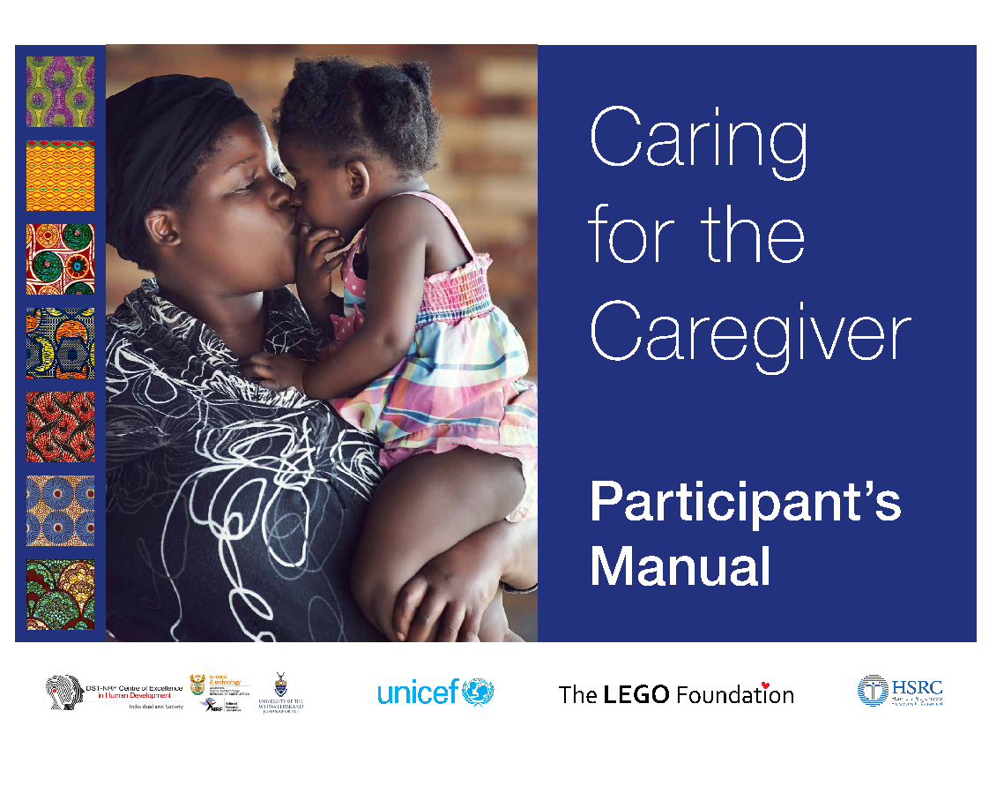
ECE

Slide 6
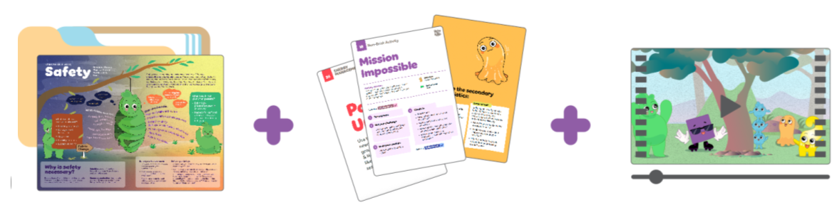
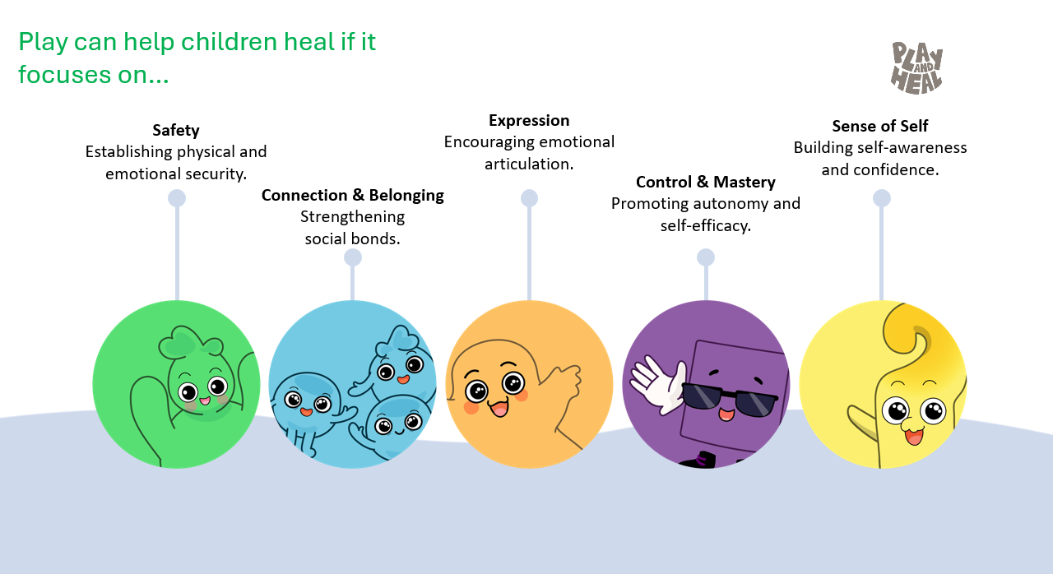
MHPSS interventions
PLAY & HEAL​
  Target group: Children and adolescents aged 6 to 12 years old
  Objective: To support children’s mental health and psychosocial wellbeing through play-based experiences that promote emotional recovery through play.
  Format: A flexible play-based MHPSS toolkit including activity cards, infographics, videos, and a range of facilitator support tools. The toolkit is designed for use with or without training, depending access in emergency settings.
  Implementation status: Field Testing – final ready Q3 2026
  Implementation contexts: Lebanon, State of Palestine, Syria, Turkiye.
  Play & Heal is an accessible, scalable, and trauma-informed play-based MHPSS approach for children in emergency and protracted crisis settings. It supports facilitators in creating safe, engaging, and responsive play experiences that help children recover from stress and adversity. The approach is grounded in five core characteristics of healing play: Safety, Connection & Belonging, Expression, Control & Mastery, and Sense of Self. These characteristics are embedded across all activities and facilitator practices, guiding how play is facilitated to support children’s emotional recovery during and after an emergency.

Slide 7

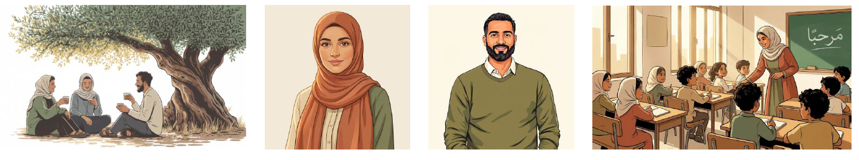
Workforce
HOSN EL HAL
Target group: Teachers working in emergency and high-stress settings.
  Objective: To support teachers’ mental health and wellbeing during and after crises
  Format: Short, easy-to-use multimedia resources (videos, infographics, key messages, audio, and PDFs). Best used when integrated into teacher training or coaching or peer support activities.
  Implementation status: In progress, to be finalized and disseminated ahead of the next academic year (by July 2026).
  Implementation contexts: During and post emergency settings. Initial piloting will be done in collaboration with UNRWA across Lebanon, Syria, Jordan, and Palestine.
  Languages: English, Arabic
Hosn el Hal, an Arabic term meaning “wellness,” is designed for high-stress, low-resource environments. It provides practical and accessible multi-media tools to prompt support in helping teachers cope with daily stressors. Assets cover five key areas: psychoeducation on stress and distress, strengthening self-awareness, promoting realistic self-care practices, fostering peer support, and reconnecting with purpose and meaning in the teaching role.
The assets do not come with a specific implementation plan. Distribution and use should be guided by UNICEF and partners in country.

Slide 8
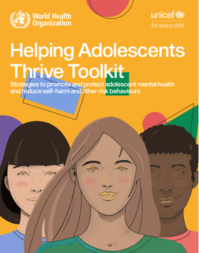
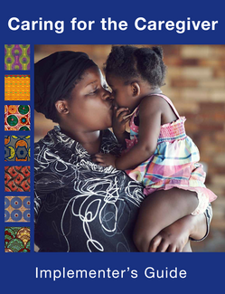

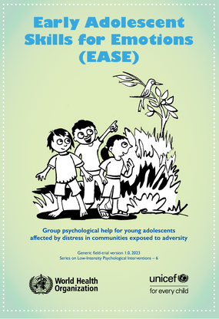

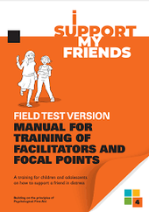
MHPSS TOOLS, RESOURCES, AND PLATFORMS IN SUPPORT OF UNICEF’S MHPSS LIFE COURSE APPROACH
UNICEF’S SUITE OF MHPSS INTERVENTIONS
Art-based Interventions
(Children and adolescents 5-12 years)
TeamUP
(Children and adolescents 6-18 years)
UNCIEF's Global Guidance, Tools & Resources
  UNICEF Multisectoral Operational Framework
  Research framework
  Minimum Services Package (MSP)
  EQUIP Platform
Digital MHPSS Promotion & Prevention Platforms
  Learning Passport
  Pode Falar
  MHPSS Chatbot Uganda
  HERE4You
  TeleMHealth
  Tili
  CollectiveMinds
  USupport
  UReport
  On My Mind/Out Minds Matter
Play and Heal
(Children and adolescents 6-12 years)
0-5 YEARS
6-10 YEARS
11-15 YEARS
16-19 YEARS
Caring for Caregivers
(<5 years)
I Support My Friends
(Children and adolescents aged 9-17 years)
Building Lifelong Opportunities for Mental Health (BLOOM)
(Children aged 5-10 years)
Early Adolescent Skills for Emotions (EASE)
(Adolescents aged 10-14 years)
Helping Adolescents Thrive (HAT)
(Adolescents 10-19 years)
Pode Falar
(Adolescents and youth 13-24 years)
CollectiveMINDS
(Adolescents and youth 13-24 years)

Slide 9

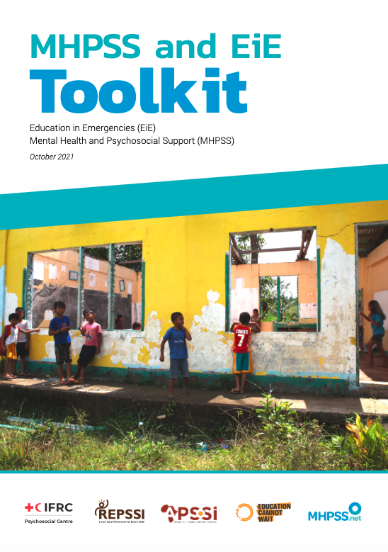
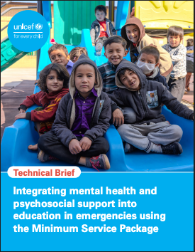
KEY RESOURCES
MHPSS Minimum Service Package
MHPSS in EiE Brief
MHPSS & EIE Toolkit
An overview of MHPSS activities and interventions that can be implemented in EiE context
Compilation of resources for MHPSS in EIE contexts
Single and easy-to-use intersectoral package.
Notes:
There are many resources available. In the following two slides, you will find some key selected resources. More can be found in the INNE and MHPSS.net Hubs.
UNICEF's Core Commitments for Children includes an Education MHPSS commitment (4) with the benchmark "gender- and age-appropriate mental health and psychosocial support programmes are delivered in schools and learning environments".
MHPSS and Education in Emergencies (EiE) ToolKit (2021) is an excellent compilation of available resources to support MHPSS in EIE programming. It's available in several languages.
Mental Health and Psychosocial Support Minimum Service Package (MHPSS MSP) (IASC, 2022) is a resource for humanitarian actors to plan, support, coordinate, implement and evaluate MHPSS activities within and across sectors.

Slide 10

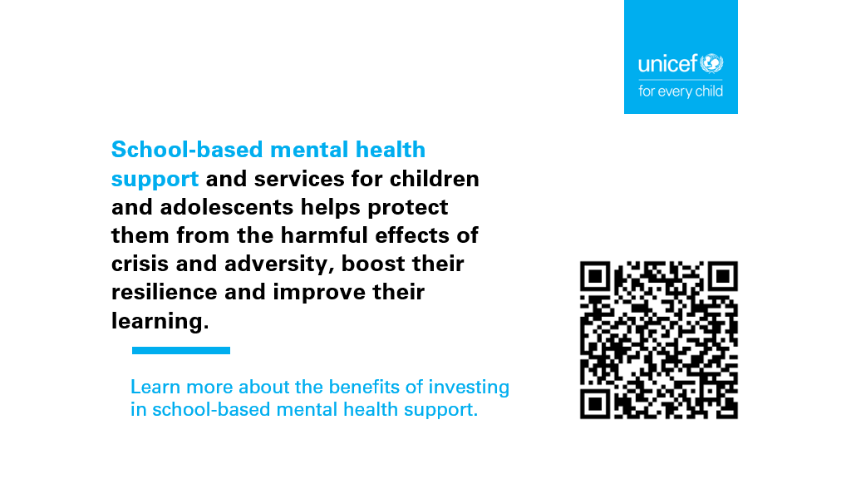
© UNICEF/UN0747703/Naftalin

