Slide 1

EDUCATION restoring HOPE for children in Gaza

Slide 2
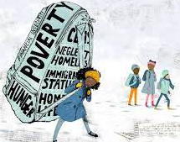
SITUATION – National Current Context in Gaza Strip
778 schools (97%)
>747 teachers killed
> 19,000 schools children killed
School buildings in Gaza strip sustained damaged/destroyed
338,617 Children receiving FE & NFE (face-to-face)
700,000 children
>624 temporary learning centers, including 20 school buildings, 35 community-led initiatives, and small centers implemented through Four partners
298,000 students attending online
School children in the strip have lost the school year since October 07 2023.
Negative Coping
Leading to Child Labor and Child Marriage. Also to teacher Absenteeism
Notes:
Fragmented Education System
DZ: estimated by DoE that 200,000 children under SDF
Confirm with Rasha whether .5 million are included in the 2 million.
Unofficial: >90% of the schools in non-GoS controlled schools not accredited by MoE

Slide 3
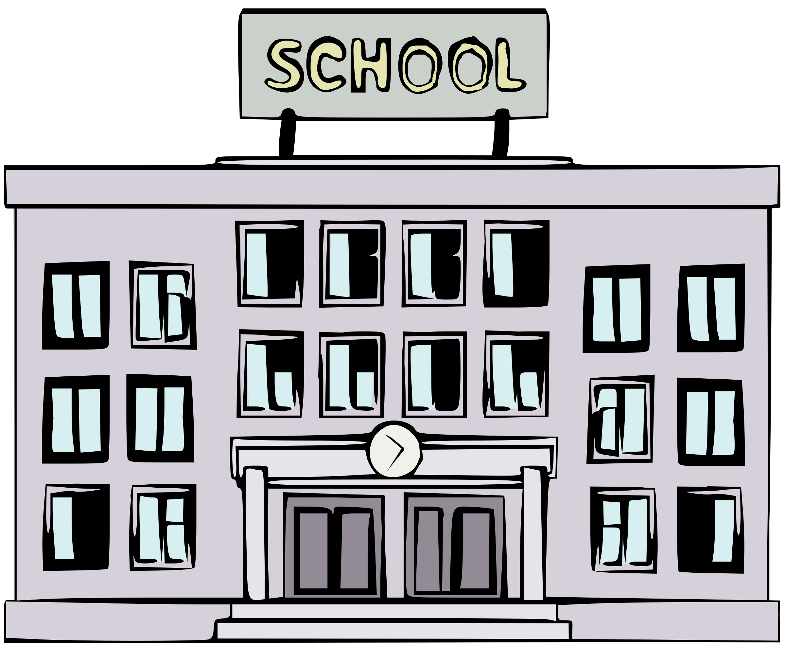
NEUTRALITY OF EDUCATION
Protection of LCs
Attack against schools under Res. 1612 MRM, reported to the SG
I’m not a target -> -> ->

Slide 4
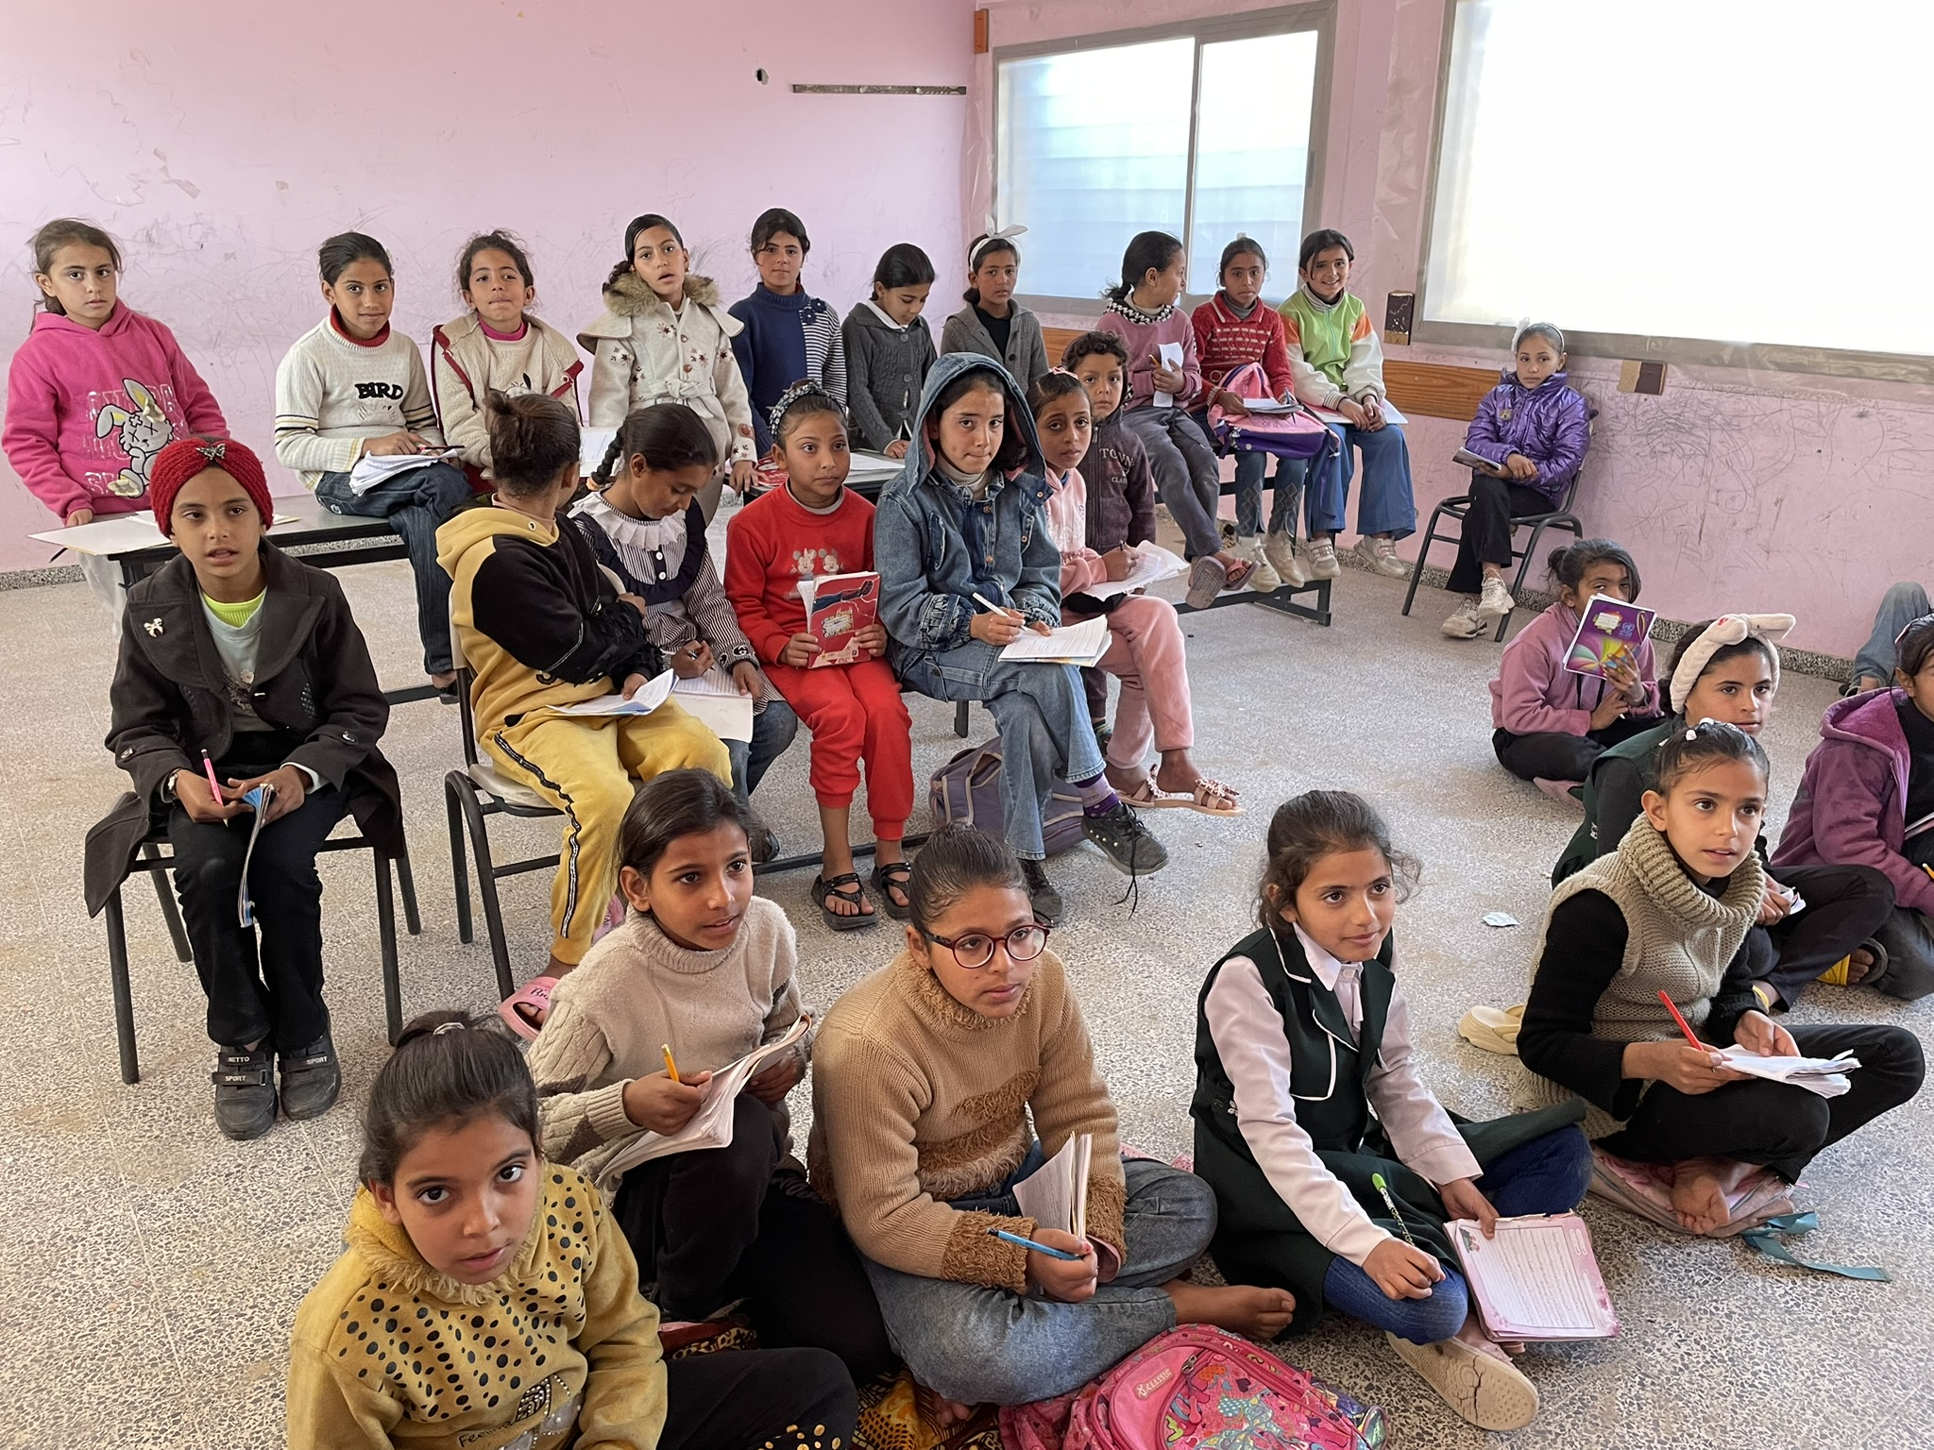
Main challenges (emergency response) Gaza
Challenging operating environment and limited humanitarian zone.
Limited space, supplies and useable school buildings impact significantly on scale up and recovery.
Learning centres have access to water and HEB/school feeding. All children have been subjected to trauma.
Challenges in procurement and importing; commercial goods when entering are significantly taxed, lack of approvals, loss of stock in warehouses, hardly any educational supplies available. Moving the winterization agenda quickly.
Restriction of movement and lack of fuel, and old and damaged trucks - for supply distribution, missions and field monitoring.
Different approaches to the educational response across the Gaza Strip.

Slide 5
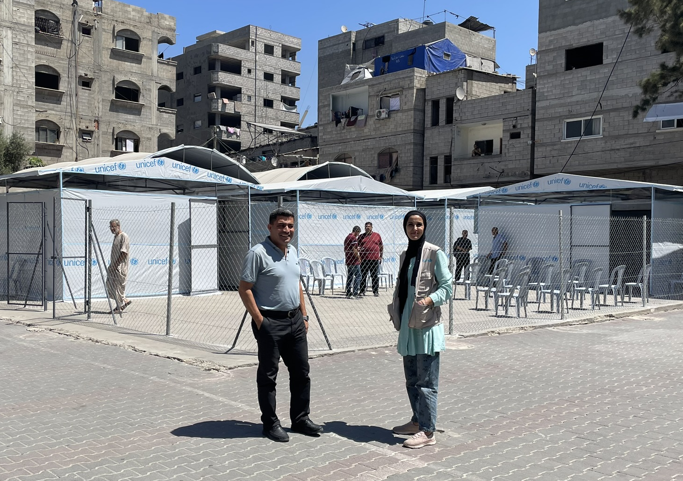
EDUCATION: Priority Setting in Gaza
Infrastructure
•Priority 1: Provide 700,000 children from grades KG2 to G12 with a space and learning equipment in rehabilitated classrooms, semi-permanent structures (HPT) with secure well protected environment and WASH facilities.
•Priority 2: Enhance the quality of learning through targeted programming, professional development and data management systems to ensure increased learning outcomes. Provide leadership for the education system through technical support and managing a harmonized approach.
•Priority 3: The provision of holistic services. including the provision of water and school feeding, well being gender responsive and trauma informed activities, disability screening to respond to additional needs creating a model of learning based on equity, inclusivity and protection.

Slide 6
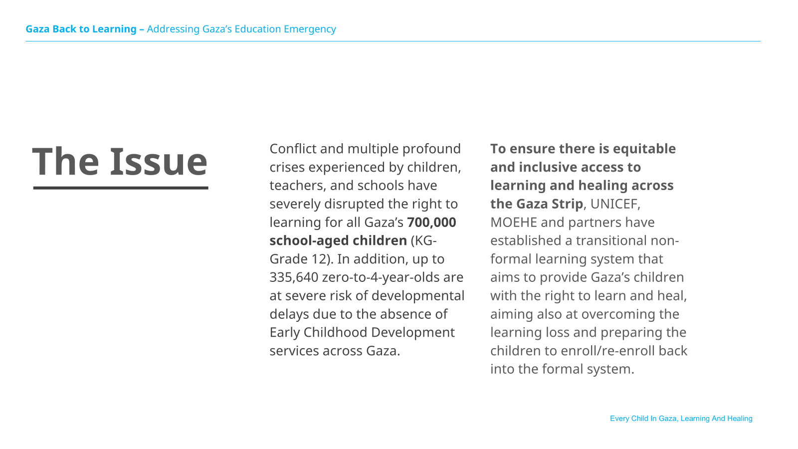

Slide 7
Gaza Back to Learning – Addressing Gaza’s Education Emergency
The solution: A principled approach to quality and inclusive learning and healing for every child in Gaza.
Every Child In Gaza, Learning And Healing

Slide 8
Gaza Back to Learning – Addressing Gaza’s Education Emergency
The solution: A principled approach to quality and inclusive learning and healing for every child in Gaza.
1. Right to quality and inclusive Education
Every child in Gaza has a right to quality and inclusive learning and services that support healing after profound traumas
5 Interlinked
High-Level Back to Learning & Healing in Gaza Principles
2. Whole of system view
A ‘whole of system’ view where there is equity in access and
multi-sectoral interventions to improve learning and
healing outcomes, irrespective of delivery channel
3. Shared responsibility and
accountability
Partners work together around a single plan and results
framework, leveraging unique value add
4. Financial management and
due diligence
Resilient and effective financial management and due diligence
in a complex operating context
5. Feedback cycle
Reliable feedback cycle on educational and multi-sectoral interventions, progress on learning and healing outcomes
Every Child In Gaza, Learning And Healing

Slide 9
Gaza Back to Learning – Addressing Gaza’s Education Emergency
3 interlinked strategies to expand access to learning and healing for every child in Gaza.
Strategy 1: Expanding access to reach every child with quality and inclusive in-person learning
Rotation/shift system to maximize the number of children getting access
Expand capacity in existing centres by preparing and utilizing additional spaces
Light touch/minor rehabilitation of damaged schools/classrooms
Establishing new multi-sectoral Learning Centres in underserved areas, including rubble and unexploded ordinance (UXO) removal
Integrating NGO/community-led Temporary Learning Spaces into a harmonized networked system.
Matching children and the volunteer education workforce to multi-sectoral Learning Centres/Temporary Learning Spaces. In addition, deploying a voluntary workforce for each multi-sectoral LC/TLS and providing them with the capacity building they need to benefit children and young people who are experiencing multiple crises and trauma.
Strategy 2: Providing quality and inclusive interventions in multi-sectoral Learning Centres/Temporary Learning Spaces, which improve learning and healing outcomes
Basic furniture including chairs, desks, blackboards, and teaching and learning supplies in every Learning Centre/Temporary Learning Space
Teaching and Learning Interventions, including through a non-formal Accelerated Learning Programme (ALP) which is competency-based and based on international standards (4 core subjects + SEL)
Inclusion and well-being to support learning and healing, including through Mental Health and Psychosocial Support (MHPSS), disability support, health screening, nutrition, recreation/creative art activities. Referrall to specialized services including UASC.
Strategy 3: Governance and accountability to ensure transparency and value for money
An e-services system (HR and Learning Management Information System) to support voluntary workforce management, payments, financial reporting, capacity building, printing and distribution of learning material, and to manage student data, referrals to specialized services on MHPSS and health, and track learning progress.
Multi-sectoral Learning Centre Governing Body and Child Council for transparency and accountability to what children and parents are demanding
Every Child In Gaza, Learning And Healing

Slide 10
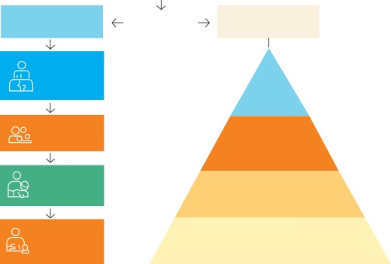
Gaza Back to Learning – Addressing Gaza’s Education Emergency
Deep dive: Mental Health and Psychosocial Support
At the centre of our multi-sectoral approach is a laser focus on Mental Health and Psychosocial Support to address trauma and support children’s learning.
School-based
MHPSS
Referral pathways
Family centers
community services
Teacher capacity building & self-care packages
Level 4
Sepcialized services
Clinical psychologists
Group-based
activities
Level 3
Focused non-specilled seed
Group counselling
Individual supportive sessions
People in distress
Teachers identifying children in distresss
Level 2
Community & family support
Psychosocial activities
Parent and caregiver engagement
Group Counseling or supportive
sessions
Level 1
Basic services & security
Safe and structured learning environments
Protective routines
Every Child In Gaza, Learning And Healing

Slide 11



Gaza Back to Learning – Addressing Gaza’s Education Emergency
Partners are already reaching more than 399,514 children with vital in-person (face-to-face) learning and healing services (57% of all school-aged children)
260,000 children are enrolled and attending MoEHE-UNICEF Learning Centres – 172- across the Gaza Strip (new LCs ready to be opened in Gaza City) through face-to-face modality
Embedded MHPSS/SEL in Temporary Learning Space to support children’s emotional regulation, safety, and readiness to learn (50,000 are receiving structured L3 MHPSS and expected 20% to go for specialized service)
Basic back to learning supplies are ordered (25,500 SIC, 4,000 ECD kits)
Monthly incentives
154,514 children attending partner and community-based Temporary Learning Spaces
Cluster with partners is finalizing the damage assessment of PA schools to identify immediate light-touch/minor rehabilitation priorities
Plans to train teachers and facilitators to identify distress early and refer children requiring specialized support.
Every Child In Gaza, Learning And Healing

Slide 12
Gaza Back to Learning – Addressing Gaza’s Education Emergency
We estimate that the per-child cost for providing and sustaining access to Learning Centres/Temporary Learning Centres for 1 year is approximately US$281.07
(indicative and subject to change)*
US$281.07
The basic estimated unit cost per child is inclusive of capital expenditures (CapEx) and operating expenditures (OpEx) for one full year of provision:
US$61.68
CapEx
US$35.73
Temporary infrastructure for Learning Centres/TLS, including high-performance tents
US$18.05
Furniture, e.g., chairs, desks, blackboards, lockable cupboard
US$7.89
Basic learning centre ICT equipment and WASH facilities
US$219.39
OpEx
US$109.83
Learning and multi-sectoral services, including Back to Learning stationary, workforce training, inclusion of children with disabilities, MHPSS, PSEA content, health screening, recreation/creative arts
US$107.14
Learning Centres/TLS workforce, including Principals, Teachers, Special Education Needs, Counsellors, Facilitators, Guards, Cleaners, Health and Safety Officers
US$1.50
Independent Third-Party Monitoring (TPM) with a focus on financial due diligence, neutrality and humanitarian principles
US$0.30
Monitoring by MoEHE
US$0.63
Learning Centre Governance body and Child Council, as well as basic costs for e-services HR and Learning Management System
* UNICEF calculations and indicative estimates. Estimates are not comparable to costs related to formal education provision by MoEHE and/or UNRWA. Note: UNRWA costs are apprx. US$700 per child (formal education).
Every Child In Gaza, Learning And Healing

Slide 13

Gaza Back to Learning – Addressing Gaza’s Education Emergency
Advocacy
Three key themes will provide the basis of advocacy
Advocacy will specifically aim to deliver the following objectives:
To complement operational strategies, a combination of advocacy, media campaigning, civil society networks, and international engagement will be conducted to create the will, understanding, and incentives to get all Gaza’s children into school, learning, and healing.
The right to education: Every child in Gaza has a right to learn and heal. The advocacy campaign will shine a spotlight on the 700,000 children who are denied this right, focusing minds on what needs to be done to get them into in-person learning and healing.
Teachers who Teach: Teachers in Gaza want to teach. However, teachers have also suffered loss and trauma due to the conflict. Morale of the profession is low. The campaign will help raise the profile of teachers as a cornerstone of Gaza’s education recovery and seek to improve teachers’ morale and self-care knowledge.
New Directions/Innovation: The State of Palestine has some of the most committed educationalists who innovate every day to deliver the right to quality and inclusive education. The campaign will help elevate creative strategies and approaches from the State of Palestine which can be diffused in Gaza and beyond.
Political leaders support universal access to learning and healing services
Teachers are supported and motivated to teach, including focusing on their mental health and wellbeing.
Children, parents, communities and civil society demand access to quality and inclusive education
Every Child In Gaza, Learning And Healing

Slide 14
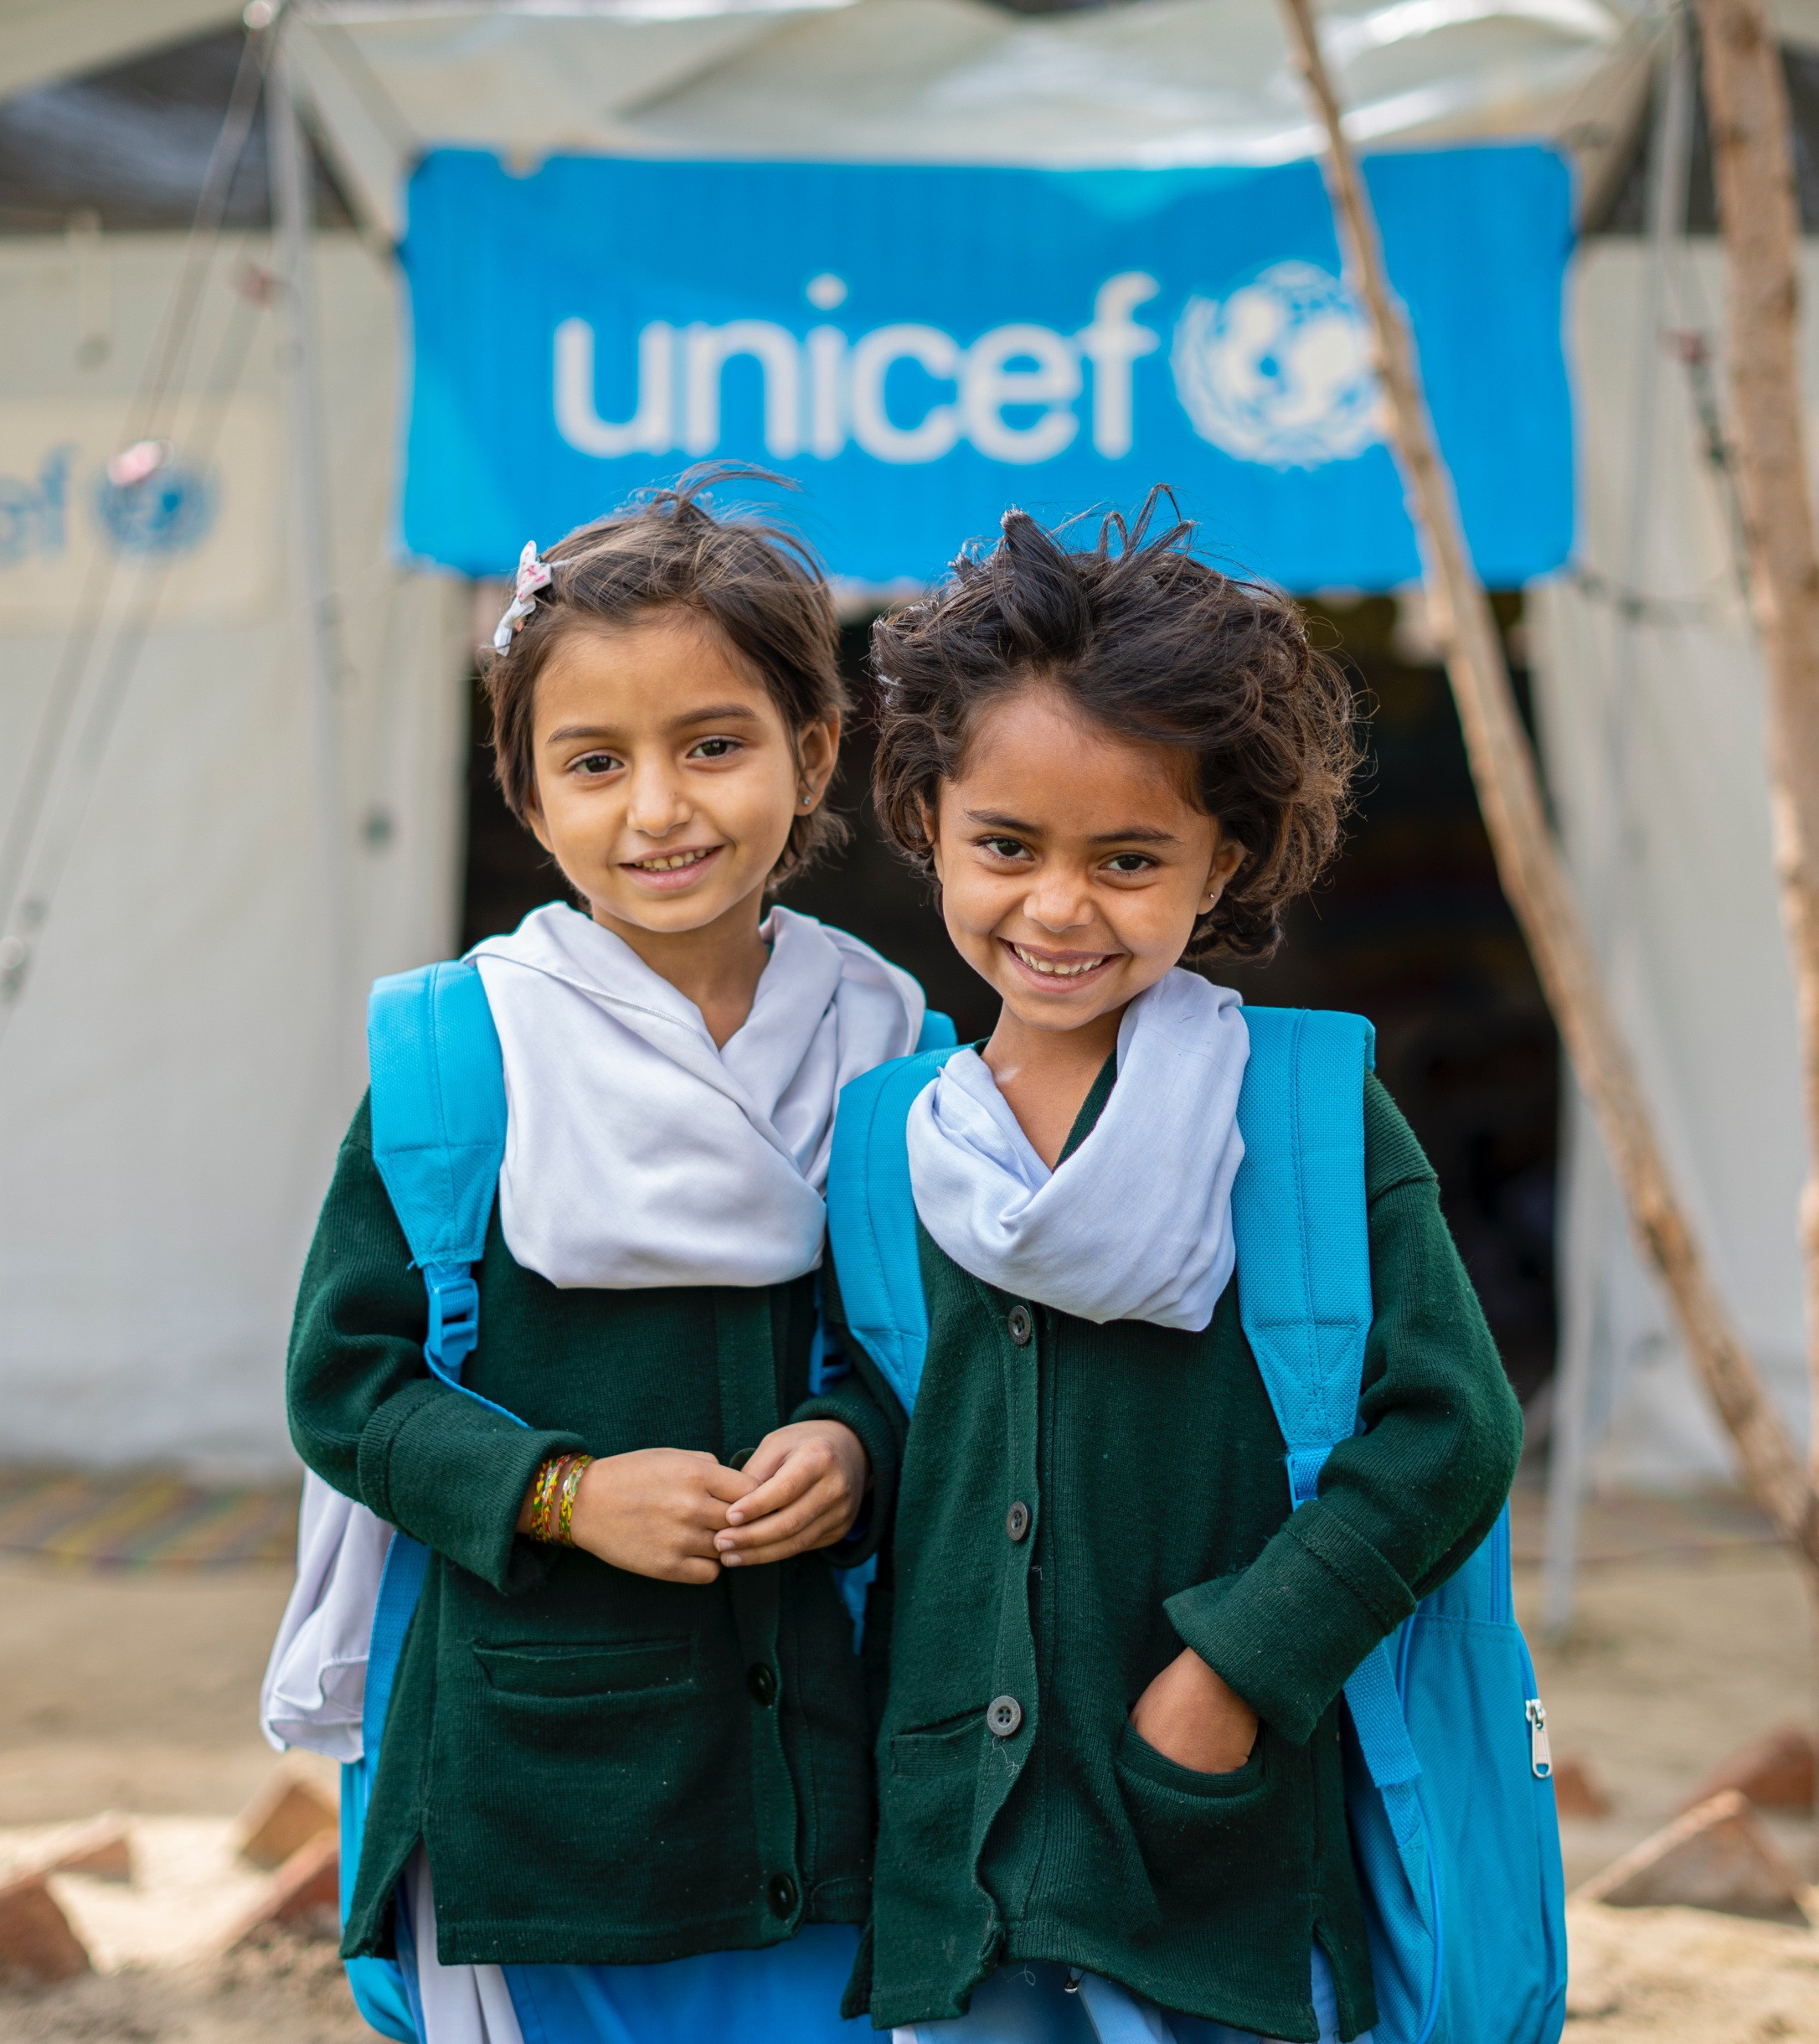
Gaza Back to Learning – Addressing Gaza’s Education Emergency
3 Urgent Results
1
Number of Learning Centres/Temporary Learning Spaces: increase the number of Learning Centres/Temporary Learning Spaces across all parts of the Gaza Strip. -> rubber removal.
Number of children: increase the number of children accessing Learning Centres/Temporary Learning Spaces and receiving a full package of learning and healing services, relevant to children’s learning levels, age, grade and unique needs.
Attendance: Ensure regular attendance of children and teachers to maximize impacts on learning and mental health outcomes and wider benefits of in-person learning to address multiple overlapping traumas.
2
3
Every Child In Gaza, Learning And Healing

Slide 15
KEY ASKS
Urgent need for essential teaching and learning materials to continue entering Gaza – especially high durability school tents for temporary learning spaces (top priority). Education supplies/materials were stuck at the border in Egypt since 2 years. They have resumed slowly entering end of January 2026 (not regular entering)
Urgent actions needed to remove rubble from destroyed buildings to free spaces for Temporary Learning Spaces (TLS). Urgent coordination and action needed to protect current TLS spaces.
Need for multi-year unearmarked grants to ensure the transition from emergency/short term to medium/long-term response, including reconstruction.

