Slide 1
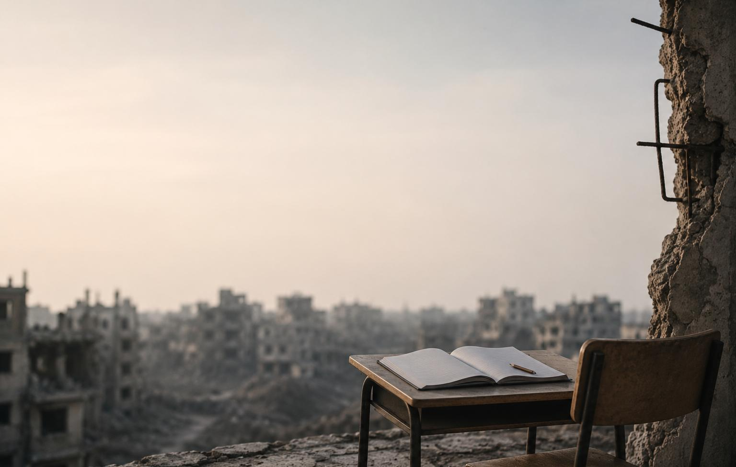

Education under Conflict
With a Focus on PWDS in Palestine
21/05/2026
PRESENTED BY:
Community Based Rehabilitation Program- Bethlehem Arab Society for Rehabilitation

Slide 2


Table of Contents
1
2
3
PWDs Reality in Palestine
Education in Palestine
Education and PWDs
4
5
6
BASR’s Education Unit
Effects of ongoing war
Strategies and Approaches
7
Lessons Learned

Slide 3

Context of Disability in Palestine
  For decades, Palestinians have been exposed to protracted humanitarian challenges due to political instability, economic crisis, and restricted access to essential services.
  Since October 2023, the situation has deteriorated with increased Israeli military actions, casualties, settler violence, displacement, demolitions, and movement restrictions.
  These developments have severely impacted vulnerable groups, particularly persons with disabilities (PWDs).
3

Slide 4

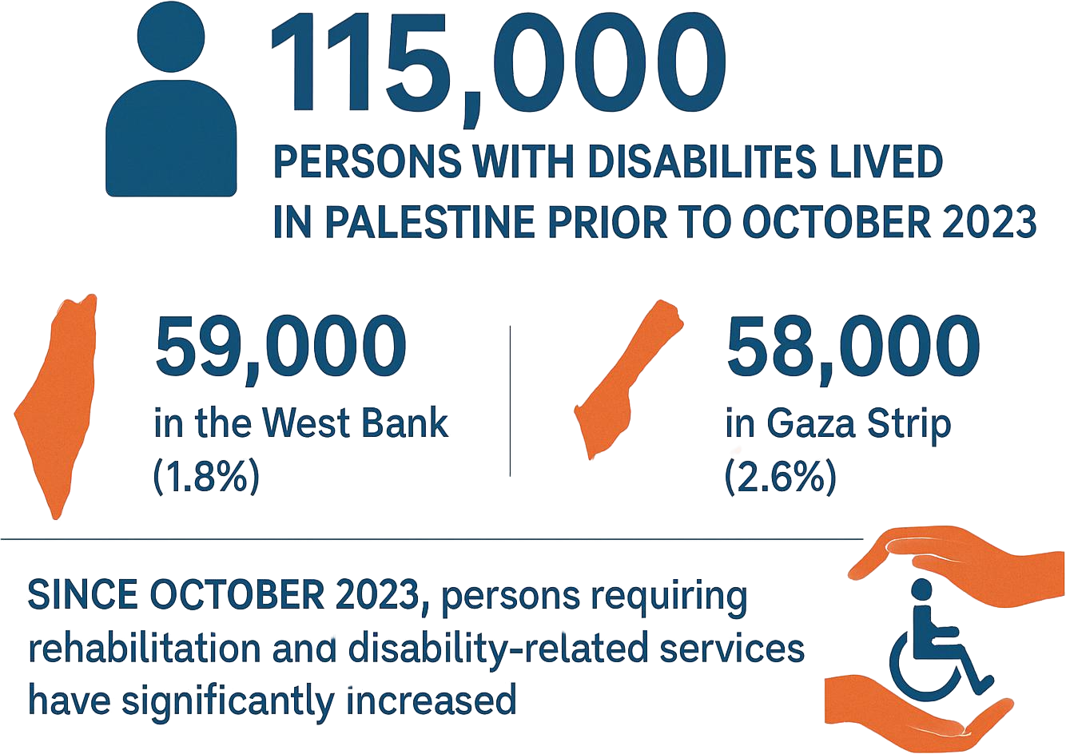
(PCBS, 2023)
*Updated figures are still under assessment.

Slide 5
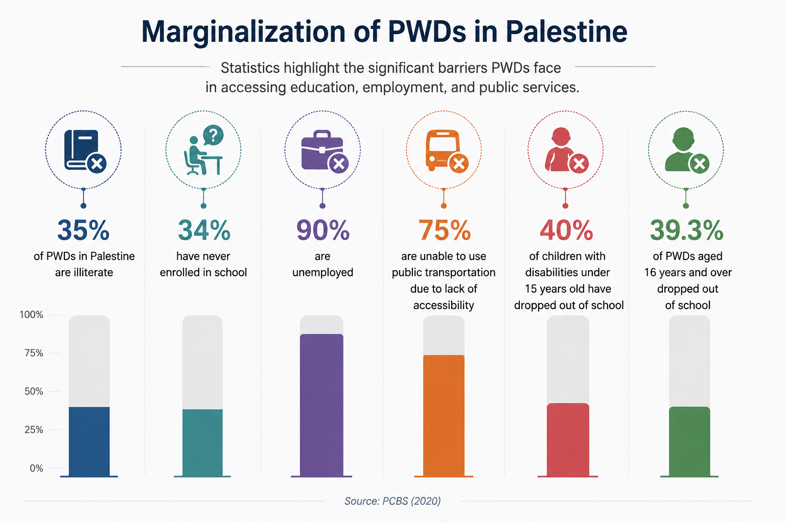

Slide 6
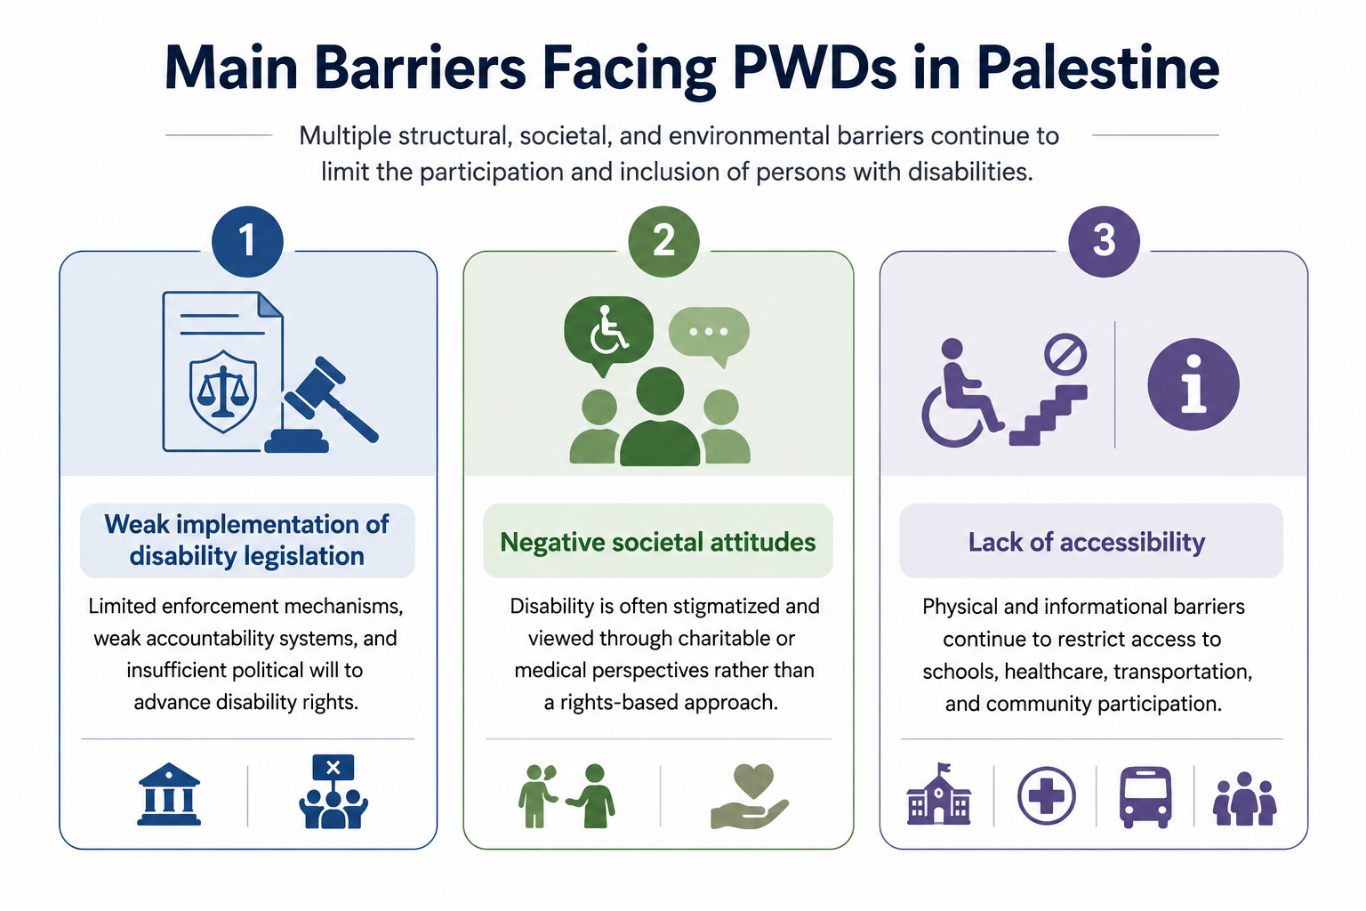

Slide 7
Education Reality in Palestine: Learning Under Protracted Conflict
  The education system in the Occupied Palestinian Territory is in a severe crisis. Both Gaza and the West Bank, including East Jerusalem, are facing significant challenges that endanger the future of thousands of children.
  Ongoing war, movement restrictions, displacement, and systemic violence have greatly hindered children’s access to education, depriving many children of the vital support and structure that schools offer (Education Cluster and UNICEF, 2025).

Slide 8
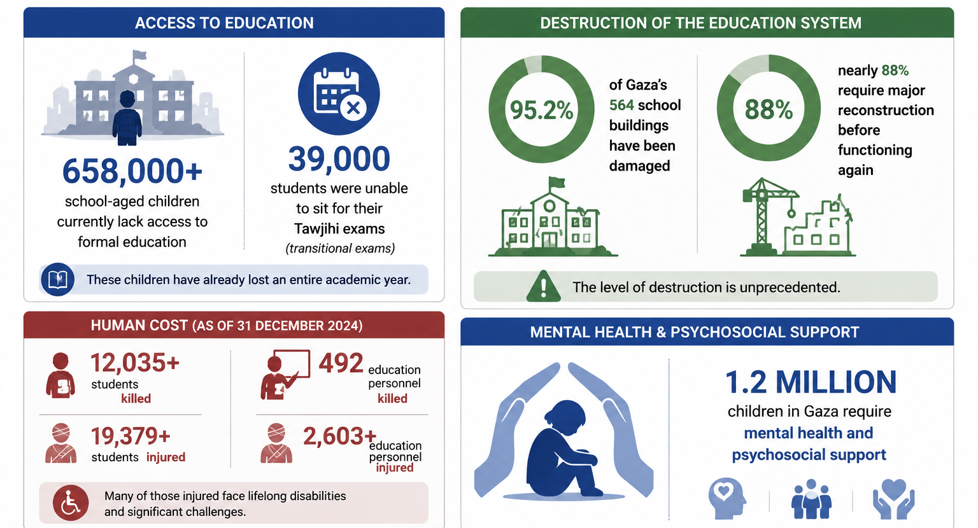
The Devastating Impact on Education in Gaza
Source: Education Cluster and UNICEF (2025) Education Overview 2024: The State of Education in Gaza and the West Bank

Slide 9
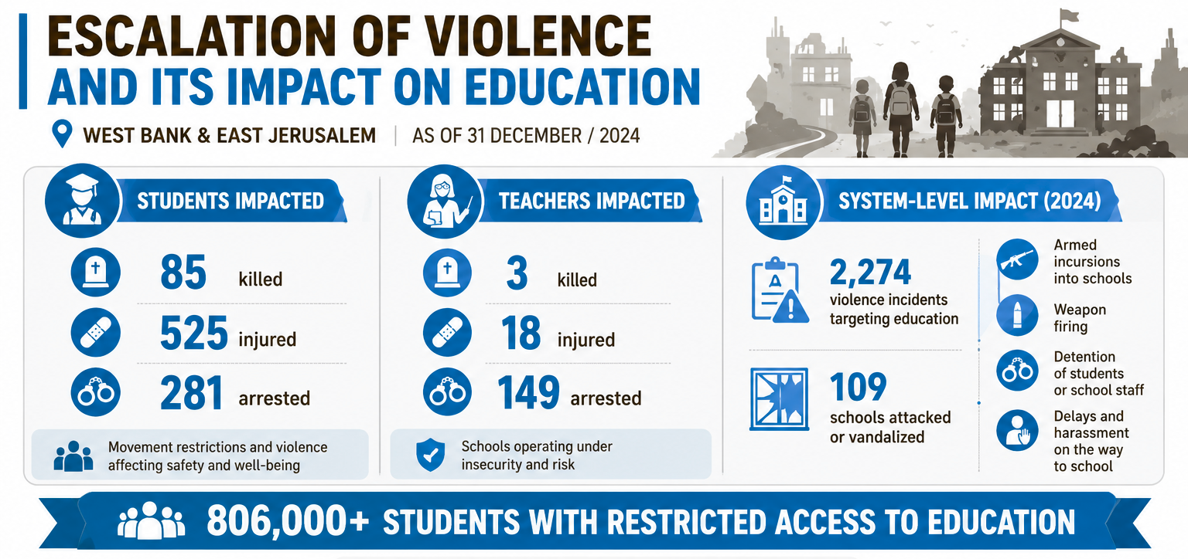

Slide 10
  Since October 2023, the West Bank has experienced escalating violence, military operations, and severe movement restrictions, significantly disrupting access to education.
  Students and school staff face increasing protection risks, including settler attacks, harassment at checkpoints, delays and detentions, and weapon-related incidents near schools.
  Violations against education have intensified, including school demolitions and repeated disruptions to the learning process.
  These conditions continue to undermine safe, consistent access to education across many areas of the West Bank, including East Jerusalem.

Slide 11
PWDs Education in Palestine
Persons with disabilities (PWDs) in Palestine face significant educational barriers due to political instability, stigma, inaccessible learning environments, and limited inclusive education services.
Despite the Ministry of Education’s Inclusive Education Policy, most schools remain physically inaccessible and lack assistive devices, inclusive learning materials, and adequately trained staff.
In addition, children with intellectual disabilities, including autism, continue to face severe exclusion from mainstream education settings, contributing to interrupted learning and long-term educational marginalization. As a result, most children with disabilities experience low educational attainment and limited access to future opportunities.

Slide 12
MAIN OBSTACLES AFFECTING ACCESS TO EDUCATION UNDER OCCUPATION IN PALESTINE
Restrictions on Freedom Movement
Destruction of Schools and Educational Institutions
Increased Economic burden
Displacment
Killings of students and academics

Slide 13
Cases on the impact of conflict on access to education in the different geographical areas of Palestine
Due to the Israeli authorities continuous denial of Palestinian geographic continuity and imposed isolation.
Masafer Yatta
Jenin Refugee Camp
Gaza Strip

Slide 14
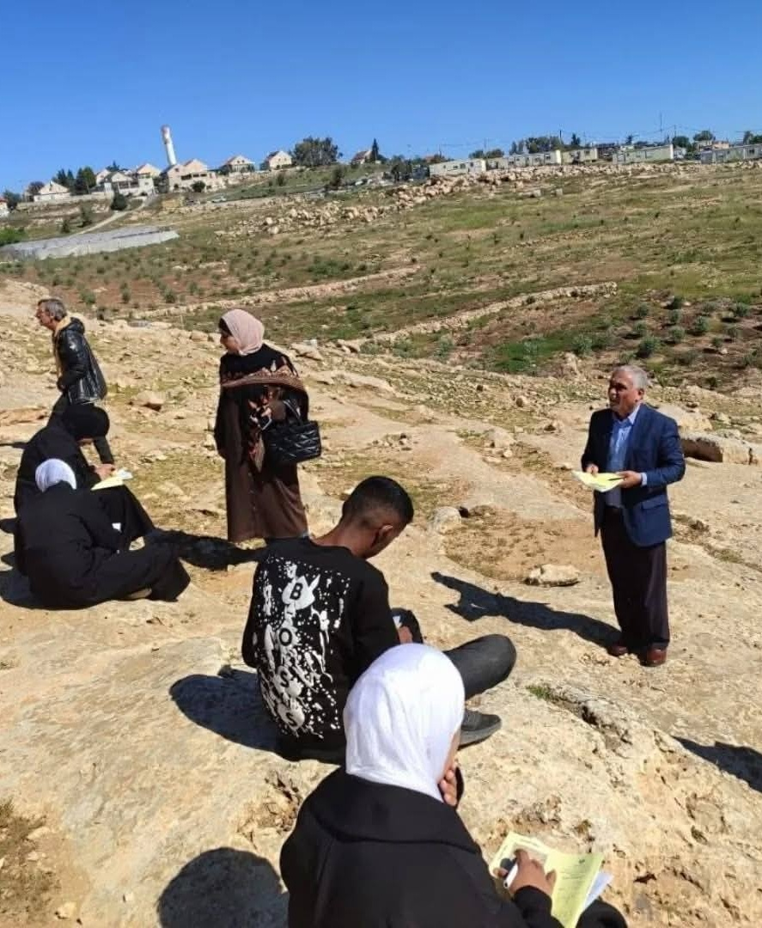
MASAFER YATTA
  Movement Restrictions: Located in area C of the West Bank, daily checkpoints, blockades, and restrictions have creeped into the lives of students and faculty. These restrictions are exacerbated for cwds and pwds considering they have to travel furhter distances to reach their schools for the lack of inclusive educational institutions in the area
  Demolitions: Structures spanning 18 communities are at risk of demolition including schools, leaving students and teachers stranded on days of demolition. Thus, less money is put into making the places accessible since it would still be under threat of displacment even after being rebuilt.
Tawjehi students from Umm Al khair take their exams in the hills after the Israeli army and settlers prevented them from reaching their school.(2026)

Slide 15
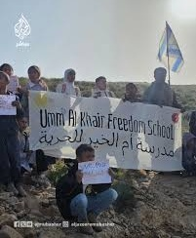
MASAFER YATTA
  Settler Violence: Rising settler violence and coercive measures have forced the internal displacement of several communities in Masafer Yatta, entirely disrupting formal education pathways for vulnerable children including cwds. Thus, while all children try to escape and steer away from settlers, cwds might find heightened difficulties doing so because of weak hearing, eyesight, or mobility difficulties.
ٍفعdents from Umm Al khair school protest the closure of the road leading up to their school .(2026)

Slide 16
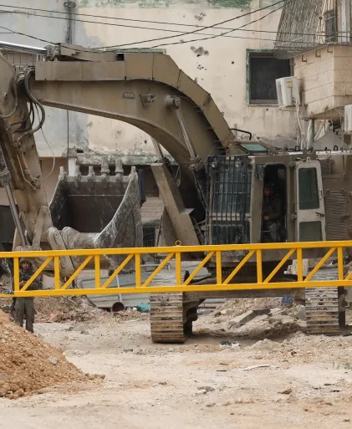
JENIN CAMP
  Displacement and Restrictions of Movement: The people of Jenin refugee camp are currently not allowed to go back to their homes under Israeli military pretenses leaving them unable to reach their schools or homes.
  Increasing economic burden: Due to the displacment and property damage families from Jenin camp are unable to send their kids to schools in the areas they are displaced to, because shelter and survival is more essential in terms of spending.
Israeli military closing all roads leading to Jenin Refugee Camp (2025).

Slide 17
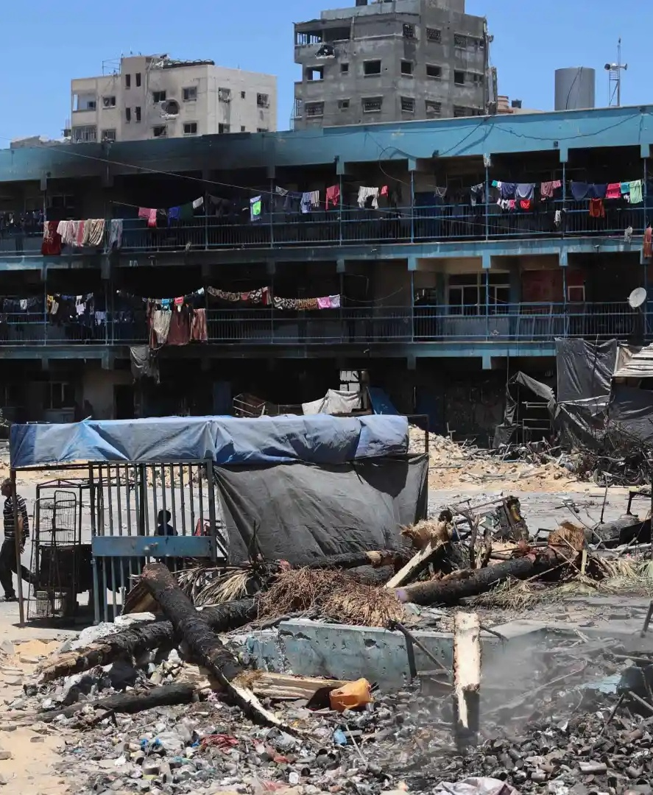
GAZA
  Collapse of all formal education systems: Following the genocide and severe devastation in the strip, students in Gaza no longer have any school to go to, and in the cases where the school survived it is most probably is being used as a shelter for the displaced families.
  Killing and Intentional targeting: Students, teachers, and academics in Gaza have been targeted by either killing or imprisonment.
UNRWA school in Jabalia (2024)

Slide 18
MITIGATION STRATEGIES IN PALESTINE.
Online Learning
Enhancing Accessibility
Through environmental accommodations and structural adaptations, financial aid, mobile clinics and localized services.
Increased dependency on home assignments and online learning.
Education Initiatives
Infrastructure & Rebuilding
This include initiatives pertaining to emergency and non-formal learning, as well as higher education and mentorship.
Evaluation & Future Scaling: Assessing impact and planning for sustained growth and evolution.

Slide 19
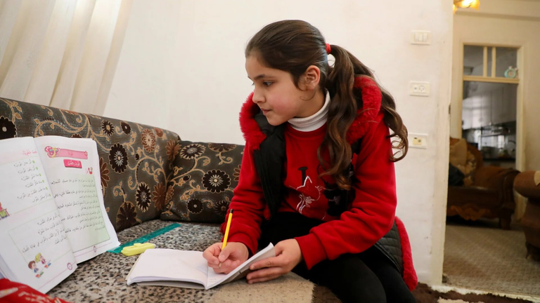
Online Learning
Online learning is seen as an “affordable” tool to keep students and teachers “safe”while keeping the educational process on the roll amidst war.
POSITIVE
NEGATIVE
1- Crowded Households keeps students from concentrating on their lessons
2- Technology needed is not available to everyone (poor families, IDP centers, etc)
3- It is expensive considering the major economic crisis
1- No crossing checkpoints or being held at gates.
2- No transportation fees
3- Not being targeted by nearby settlers on their way to school

Slide 20
Online Learning
  Providing families with assistive technologies such as tablets and smart phones with accessibility features, included accessible forms of the Palestinian school curriculum
  Training families of children with disabilities on the use of assistive technology and the available accessibility features for educational purposes
  Conduct home visits by CBR workers and follow up on the online learning process and how it can be improved or enhanced

Slide 21
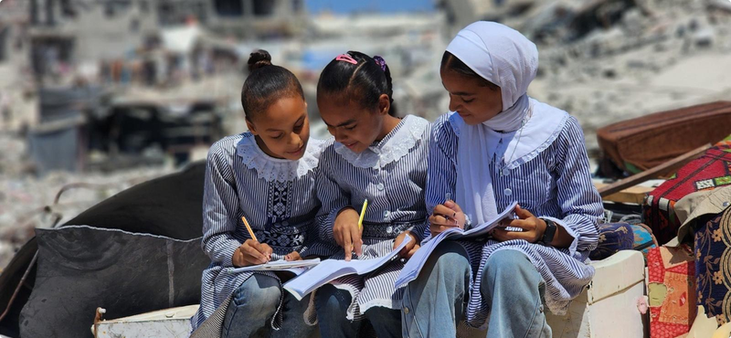
Enhancing Accessibility
  Partnership with the Ministry of Education MoE: The CBR has strengthened coordination with the MoE through Memorandums of Understanding (MoUs) to support inclusive education and improve access for children with disabilities.
  Early Detection and Referral Mechanism: The CBR Conducts early childhood disability screening and referrals to ensure timely educational and rehabilitation support.
  School Accessibility Adaptations: The CBR has Implemented environmental accommodations and adapted school infrastructure, educational tools, and learning materials to improve accessibility and inclusion for children with disabilities.

Slide 22
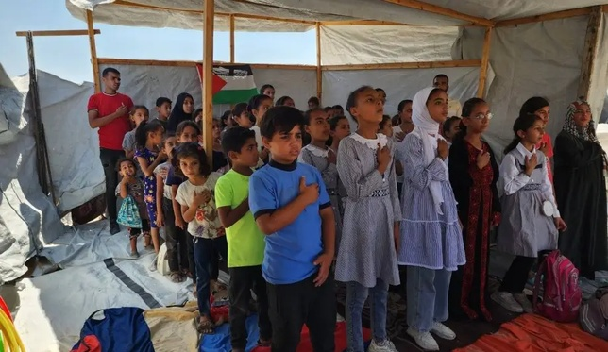
Educational Initiatives
during Emergencies
  Due to increased displacement rates in Palestine and disruptions caused by the Israeli Occupation, many children are unable to attend schools regularly and access formal education.
  In response, BASR’s CBR Program implemented alternative and non-formal educational initiatives to support continuity of learning in marginalized and displaced communities the West Bank. These initiatives combined educational and recreational activities with Mental Health and Psychosocial Support (MHPSS) services to support children’s wellbeing and resilience. Activities were implemented in vulnerable communities, including Al-Karmel and Al-Ramadin, targeting children affected by displacement and restricted access to education.

Slide 23
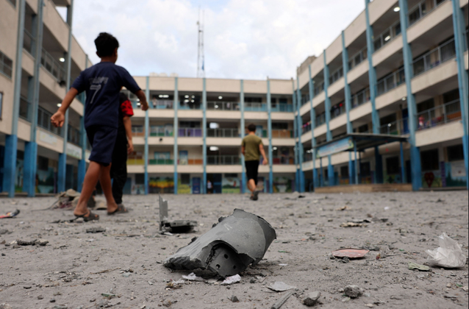
Infrastructure &
Rebuilding
  Supporting the rebuilding of destroyed schools and educational infrastructure, to ensure the restoration of safe and accessible educational environment
  Advocating for the protection of children’s right to education, through raising local and international awareness on the devastating impact of conflict, attacks on educational infrastructure, displacement, and movement restrictions on children’s access to safe, inclusive, and continuous learning opportunities

Slide 24
Lessons Learned:
The importance of decentralization and localized services
Strengthening alternative and non-formal learning approaches.
Build capcity for local communities and education actors.
Promoting inclusive and accessible education at all times.
Viewing crises as opportunities for transformation.

