Slide 1
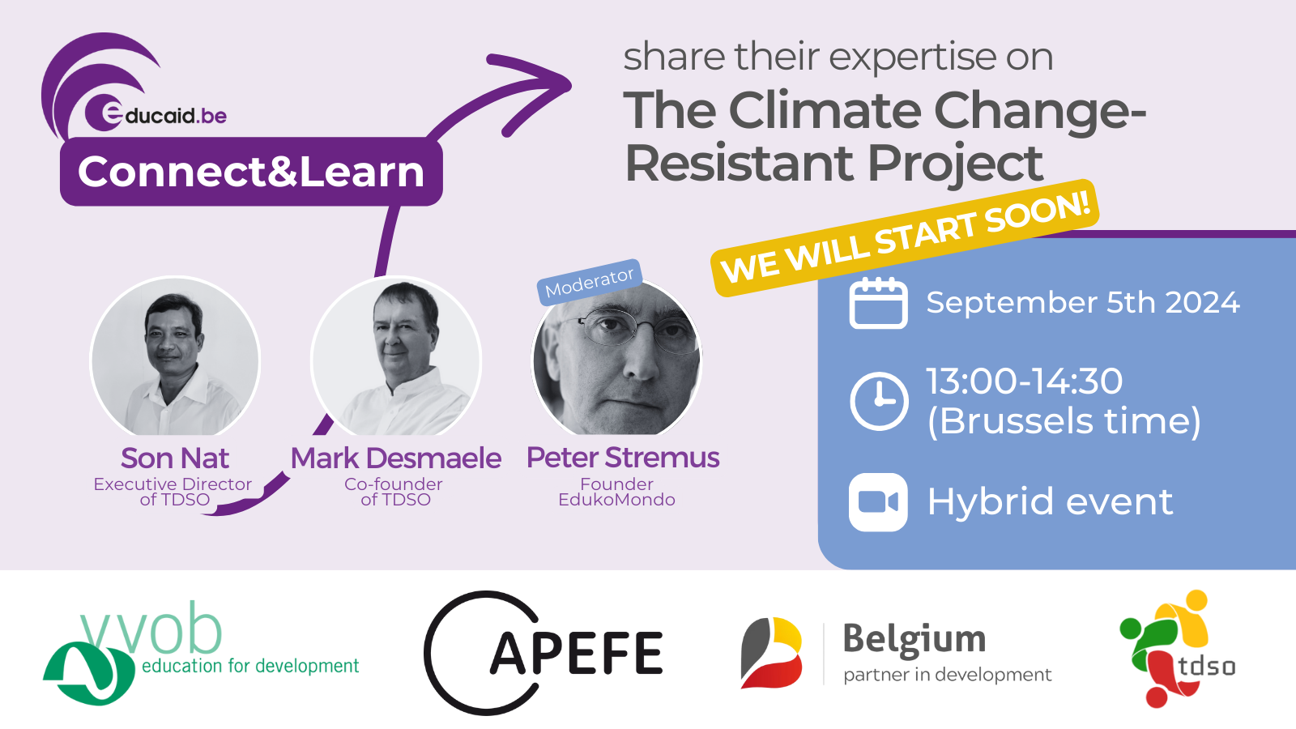

Slide 2


Greenspots
Climate Change Resistant Schools
September 2024

Slide 3
Agenda 1/2
Introduction
  Welcome and introduction of the presenters
  TDSO, a short presentation
Greenspots, Climate Change Resistant Schools in Cambodia
  Climate Change Resistant School infrastructure
  Delivery of climate change related STEM content (Teacher Training)
  Community involvement

Slide 4
Agenda 2/2
Project Model
  ‘Adoption’ of a school by a partner organisation (NGO, charity, European School, …) - Fundraising
  Delivery of STEM content and teacher training
  Role of local partner – Role of NEP in Cambodia
Who can partner, what can be the role of the participants in this meeting?
  Search for potential partners
  Curriculum development
  Replication in other countries-regions under same ‘Greenspots.org’ flag

Slide 5
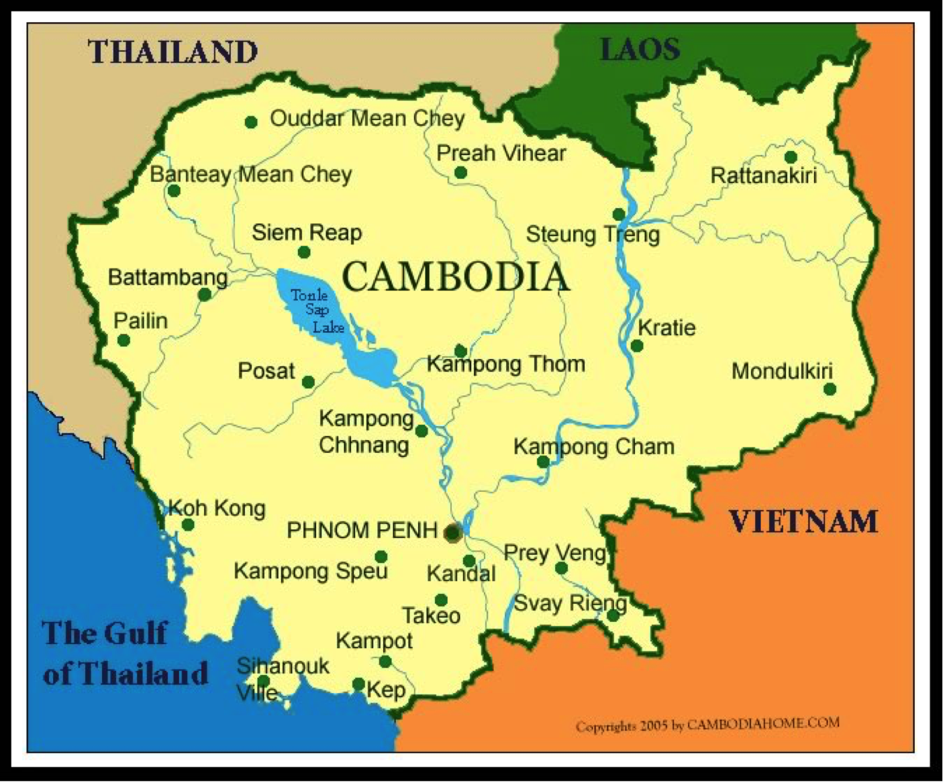
Siem Reap- Cambodia – some unpleasant figures
+95% of children enrol in primary school
167.736 in primary school
34.438 in secondary school
Less than 5% in higher education
= 60 % drop-out
Source: The World Bank – Numbers for Siem Reap Province, 1 million inhabitants

Slide 6
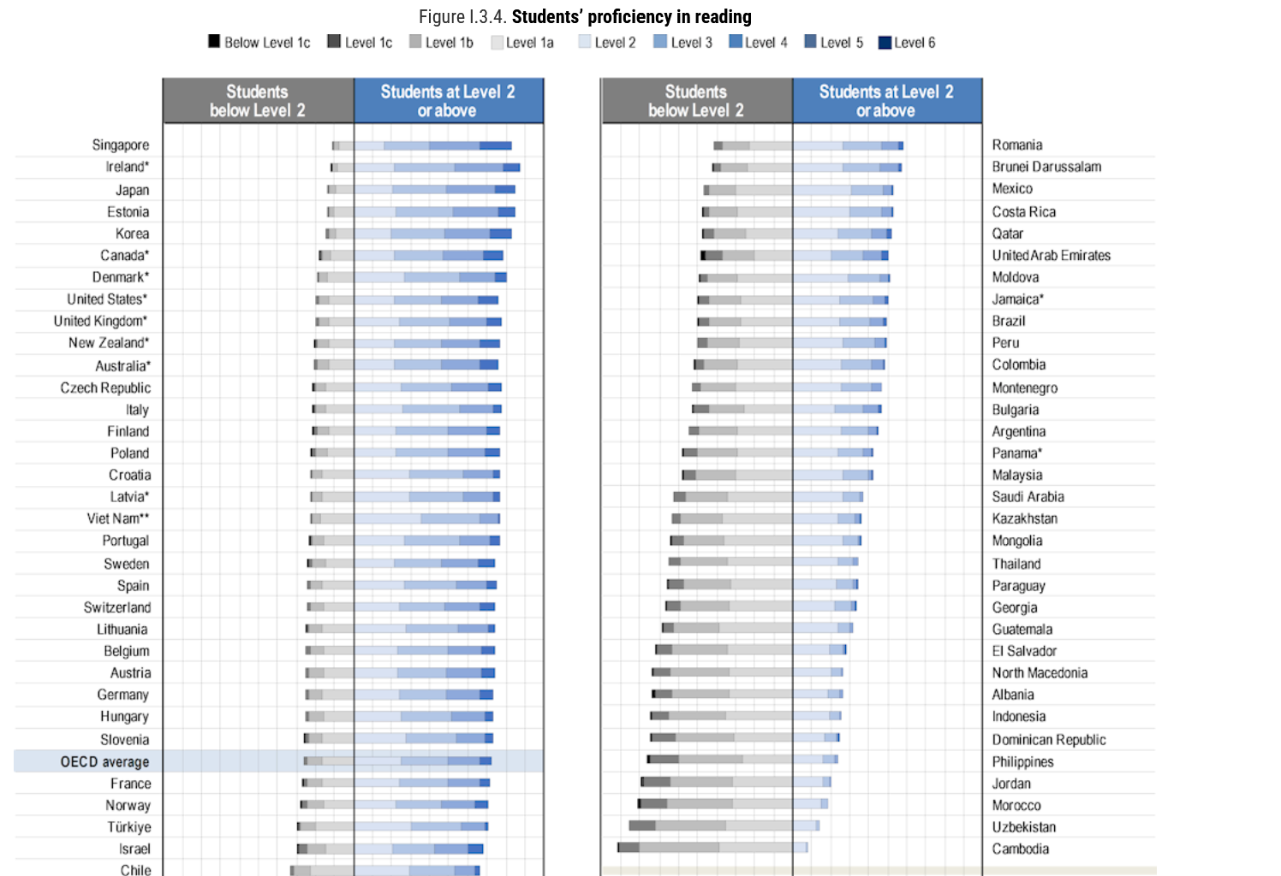
PISA tests, Results for Cambodia
Lowest of all in reading
Second lowest in maths & science

Slide 7
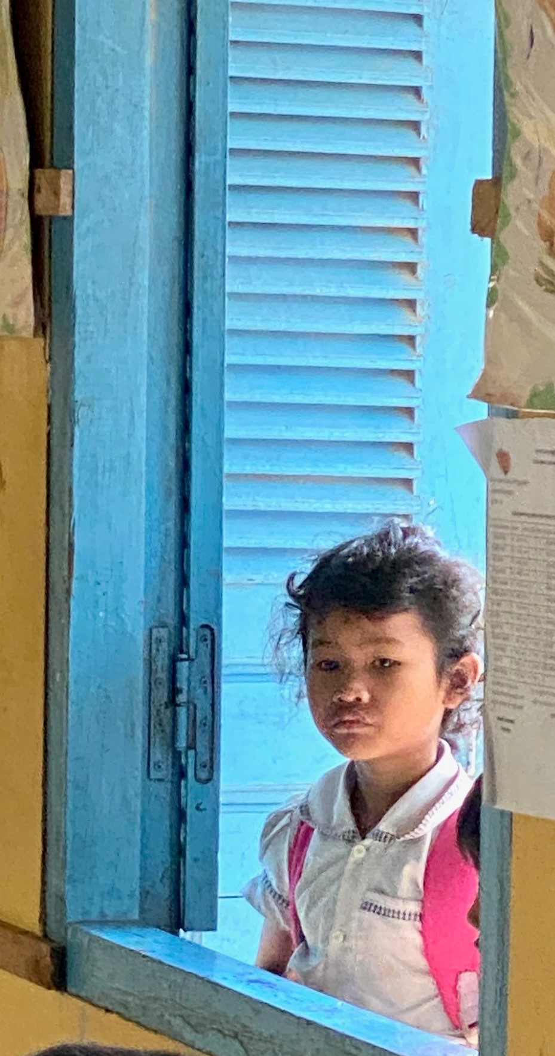
The hard truth
The reason for high drop-out rates and low results is
the lack of quality teaching in public schools
Insufficient number of trained teachers
Old-fashioned teaching techniques
Part-time primary school (morning or afternoon)
Poor quality of infrastructure (classrooms, sanitary, cooling, drinking water, etc.)
Low kindergarten attendance
Large classes
Lack of school materials (books, computers, ...)
Other factors include the indirect cost of attending school, the distance from home to school, low motivation and the need for helping hands in farming and housework.

Slide 8
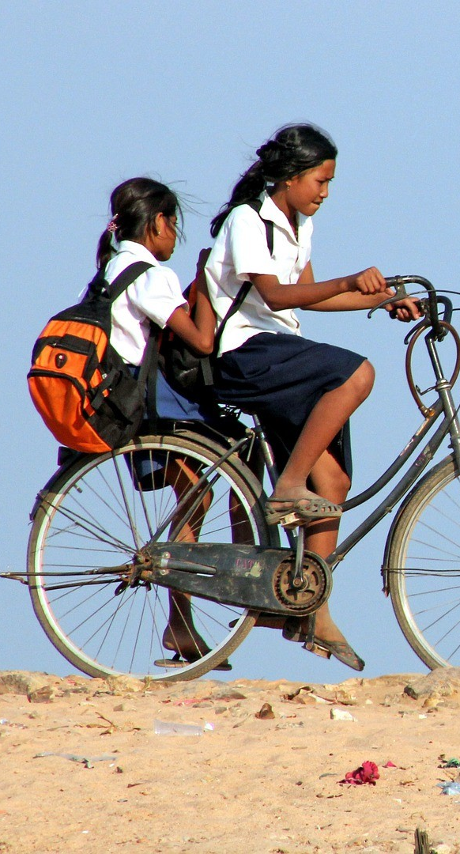
Regardless of sex, gender, disability, socio-economic status, race, religion, ancestry, …
Every Child has the Right to a Trained Teacher ©

Slide 9

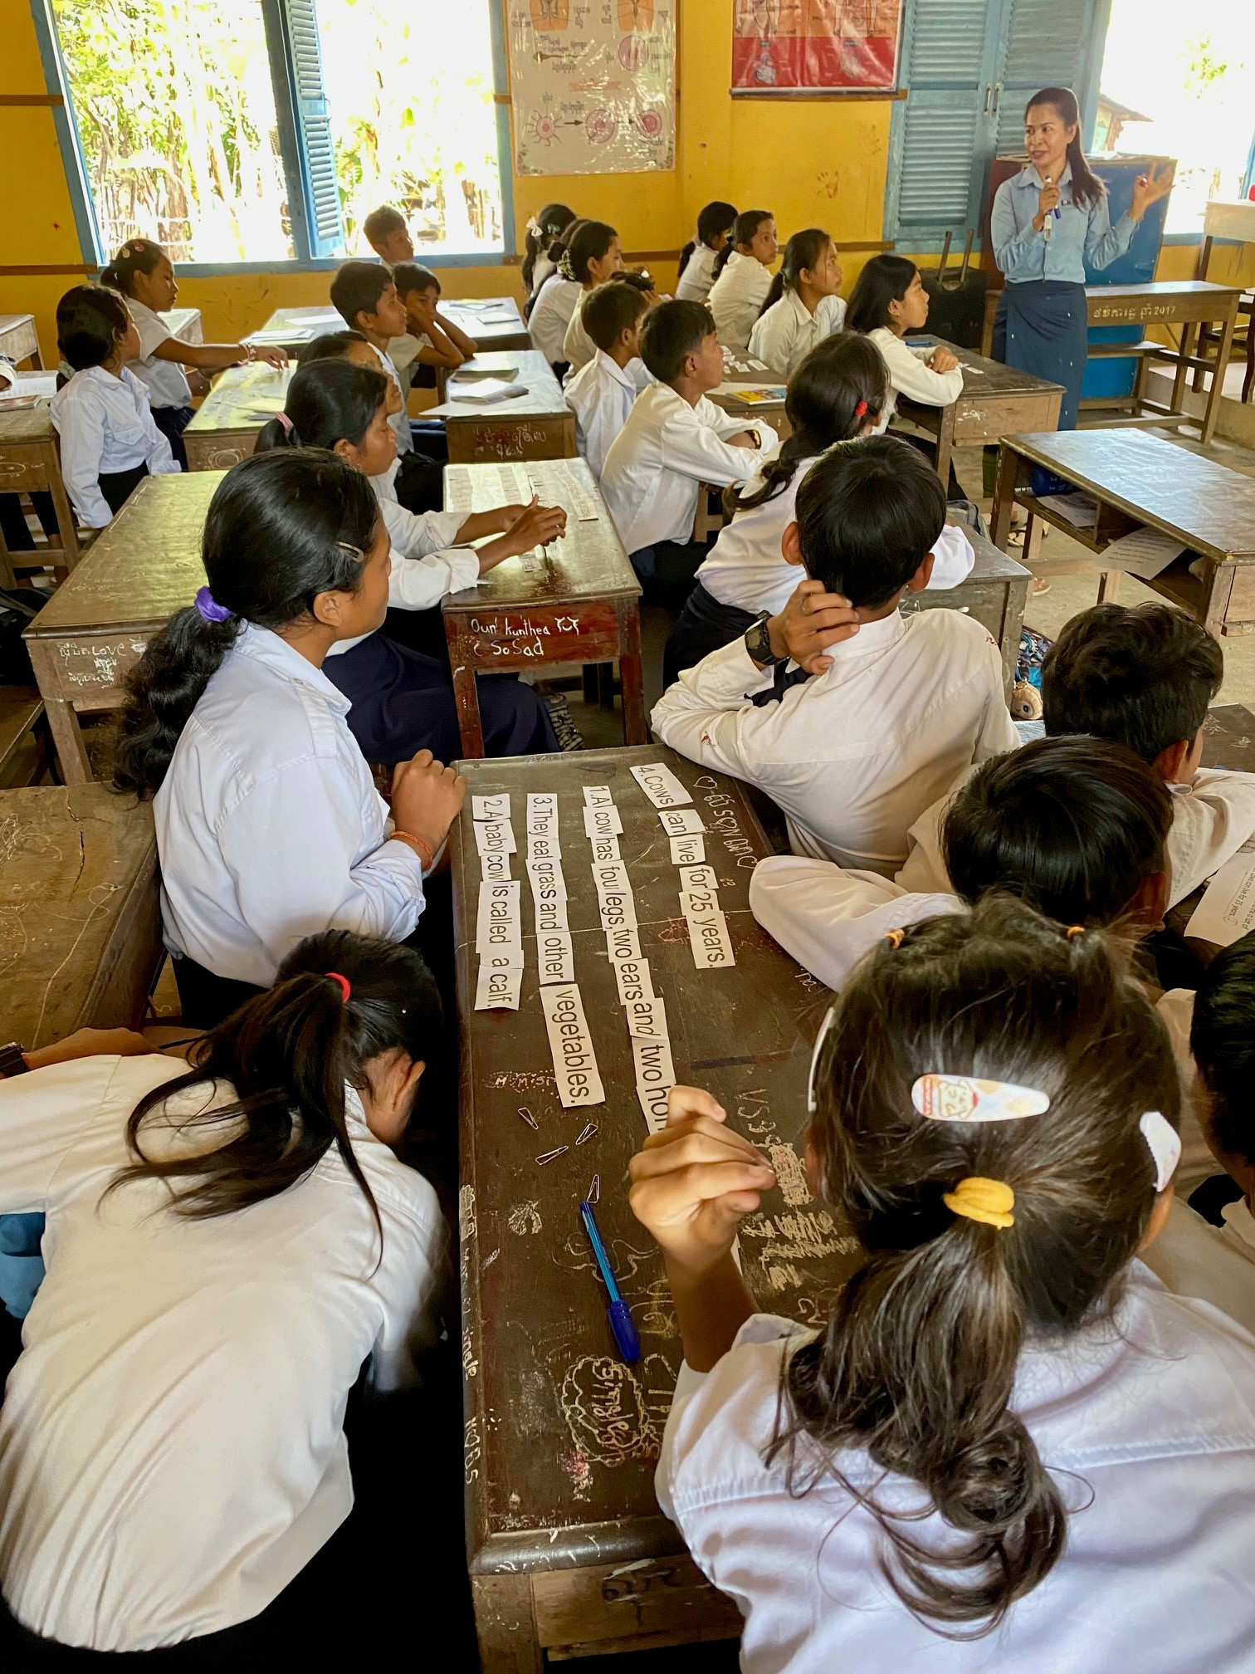
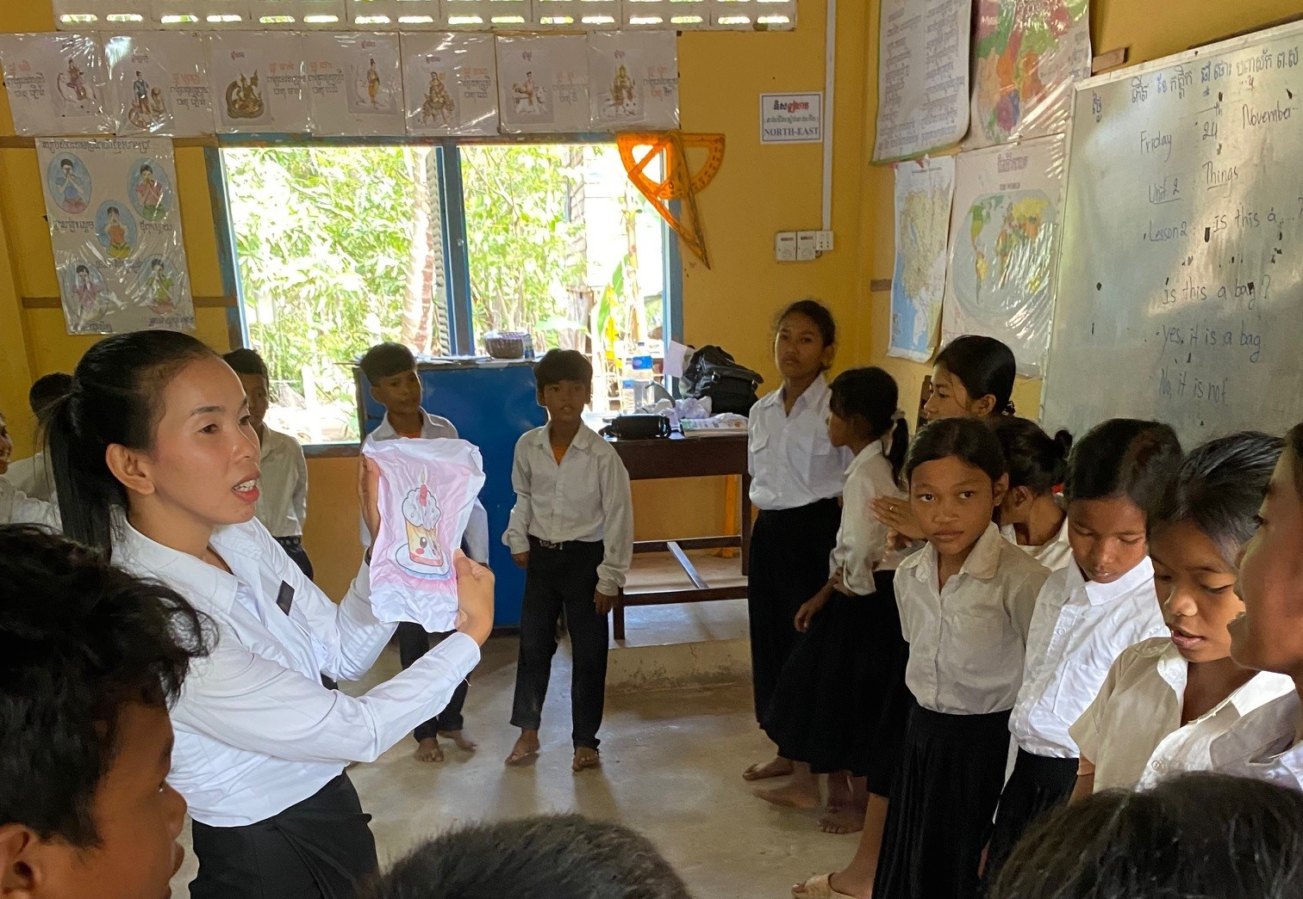
Vision
Bilingual Education (Khmer and English) is the key to economic, social, and cultural emancipation.
Well trained Teachers
are the true pillars of educational progress and the catalysts for positive societal transformation.

Slide 10
Basic Training for teachers in
Continuous Professional Development (CPD)
Content
Public Primary Schools
Advanced
Training Programs
Teacher Training
Methodology
Public Secondary Schools
Workshops, seminars, conferences, meetups, ….
Informal Schools
Educational Leadership
Culture
Teacher Training Colleges
English for Teachers
IT for Teachers
Coaching and Mentoring
Edubox
Practice School

Slide 11
Greenspots.org
Goals
1. Enhance school infrastructure: implement climate-resilient school infrastructure to ensure a safe and comfortable learning environment.
2. Promote STEM and CLIL education: equip teachers with the necessary knowledge and skills to educate students about climate change, its challenges, and potential solutions while improving English language proficiency.
3. Engage parents and community: raise awareness and involve parents and the broader community in supporting climate-resilient schools.

Slide 12
Greenspots.org
Deliverables
1. Infrastructure improvements: installation of cooling devices, reinforced roofs, shaded areas with trees, rainwater evacuation systems, and provision of clean drinking water.
2. Teacher Training Programs: comprehensive STEM education, climate change workshops, and CLIL methodology training for teachers.
3. Community Engagement Initiatives: programmes and events aimed at increasing community awareness and participation in climate-resilient practices.

Slide 13
Project Model
‘Adoption’ of a school by a partner organisation (NGO, charity, European School, …) – Fundraising
Delivery of STEM content and teacher training
Role of local partner – Role of NEP in Cambodia

Slide 14
Who can partner, what can be the role of the participants in this meeting?
Search for potential partners
Curriculum development
Replication in other countries-regions under same ‘Greenspots.org’ flag

Slide 15
Proud to be a Climate Change Resistant School!
Partner of the Greenspots.org network

