Slide 1



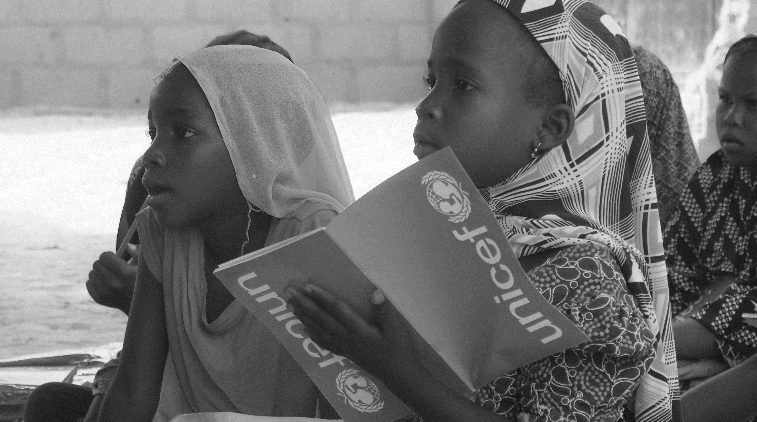
Adaptation of TaRL to
BLENDED Learning in Northeast Nigeria

Slide 2
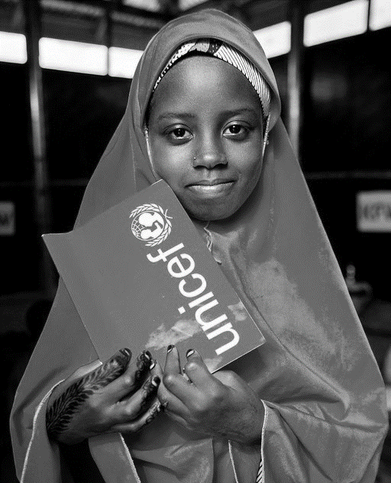
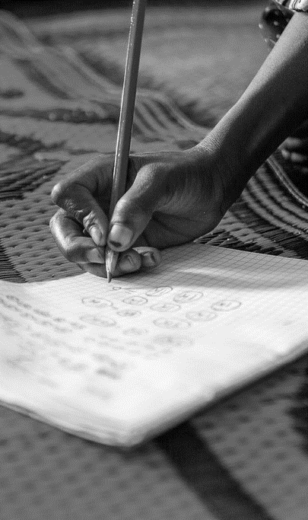
EDUCATION IN NIGERIA
Across Nigeria, half of grade three learners cannot read a word or do simple operations with two-digit numbers. (NEDS, 2016)
.
Large regional and gender divide in primary learning outcomes (North-South; boys and girls)
Primary school enrolment increased by over 5 million in the last five years.
Girls’ participation in primary education substantially increased - GPI from 0.89 to 0.94 in five years.
Pre-school
Education
Enrolment & Participation
Out-of-School
Children
Quality of Learning

Slide 3
WHY FOCUS ON NORTHEAST
Niger
Chad
Sokoto
Burkina Faso
Kebbi
Katsina
Jigawa
Yobe
27.6% of children are literate in the Northeast (26.8% girls) compared to 73.3% (74.7% girls) in the Southwest.
28.6% of children are numerate in the Northeast (27.9% girls) compared to 82.8% (83.5% girls) in the Southwest.
Zamfara
Kano
27.6%
Literate children in the Northeast
28.6%
Numerate children in the Northeast
Borno
Kaduna
Nigeria
Bauchi
Gombe
Benin
Niger
Kwara
Plateau
Adamawa
Federal Capital
Territory
Ghana
Togo
Nasarawa
Oyo
73.3%
Literate children in the Southwest
82.8%
Numerate children in the Southwest
Taraba
Osun
Ekiti
Kogi
Benue
Ogun
Ondo
Lagos
Edo
Enugu
Anambra
Ebonyi
Cameroon
Abia
Cross
River
Delta
Imo
Central African
Republic
Rivers
Akwa
Ibom
Bayelsa
Equatorial Guinea

Slide 4


IMPACT ON LEARNING
The learning loss further exacerbated the learning crises of an already weak education system in terms of foundational skills.
Where a total of:
Schools closure for 7 months in 2020 left over 80 million children, youth and adult learners with limited opportunities for learning.
4.2 million in the Northeast with 400,00 most vulnerable from Internally Displaced Person (IDP) children
The learning lost further added to the loss caused by the crisis.
1,200
Primary/Junior Secondary Schools destroyed
645
Teachers killed during the insurgency
Crisis
COVID-19
>24
Months of Education lost in Borno State.
824
schools still remains closed

Slide 5

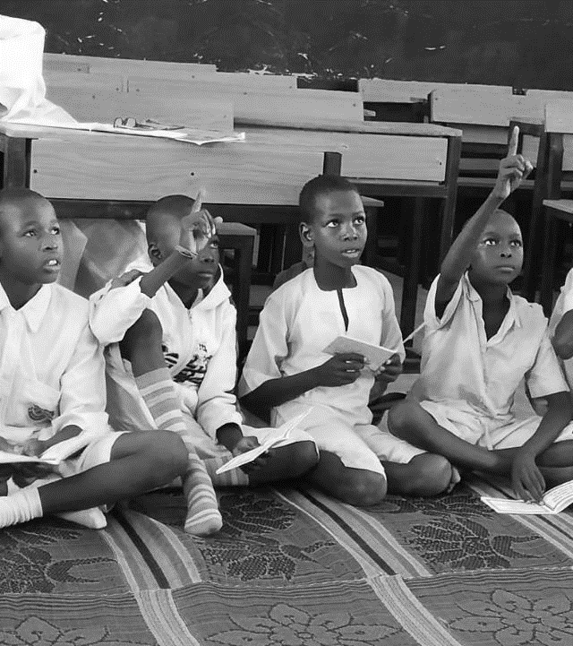




IMPACT OF TARL SCALE-UP
TaRL was successfully piloted in Northeast Nigeria since 2018 with amazing results.
Different donors expressed interest in building on the results achieved and contributing to UNICEF’s work in tackling Nigeria’s deep-rooted learning crisis – so that “Every Child Learns”
School closure due to Covid-19 in March 2020 disrupted ongoing Master Trainers (MTs) training for the Scale-up in Borno, Adamawa and Yobe (BAY) states.
Scale-up Plan
October 2019 -
August 2024
900 estimated
number of schools
370,000 estimated
number of learners
9,500 estimated
number of teachers

Slide 6

INNOVATIVE SOLUTION – AN URGENT NEED!
We can’t afford to wait any longer – we must act now to at least maintain the gains made
Adapt the TaRL intervention to be able to respond to the current situation - the COVID crises situation without dropping the basics of Teaching at the Right Level (TaRL): assessment, grouping and implementation.
Embarked on consultations but realized that it has not been practice before; we had to learn how to go about it together!

Slide 7
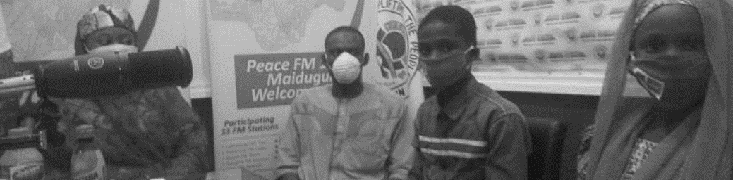
TARL - BLENDED LEARNING APPROACH
Teaching at the Right Level (TaRL) is an evidence-backed educational approach that helps children develop basic reading and mathematics skills, opening doors to a brighter future.
Leverage from the existing radio learning in Borno State. Since no precedence - no need to risk it all but to try a pilot.
Three primary schools with TaRL experience were selected for the pilot: 2 public and 1 IQE.
A four week’s pilot with 10 hours of learning set aside from the ongoing radio learning.

Slide 8
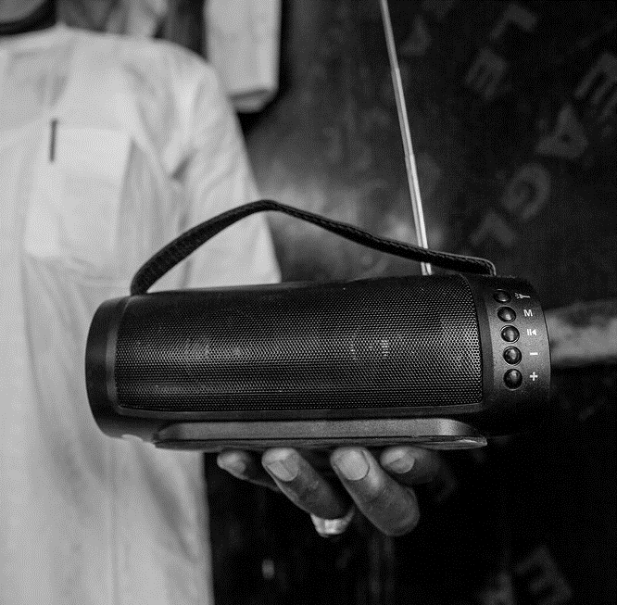
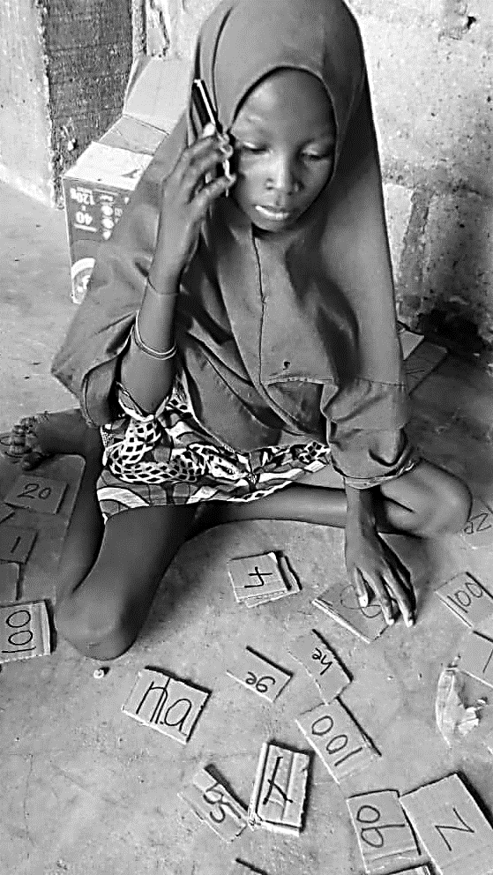
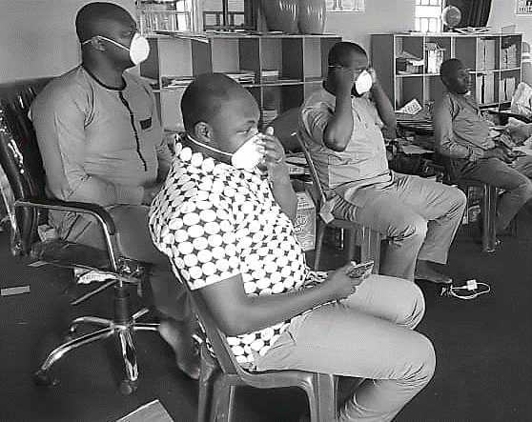
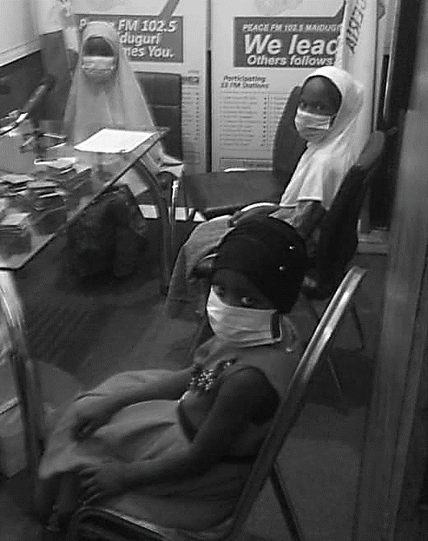
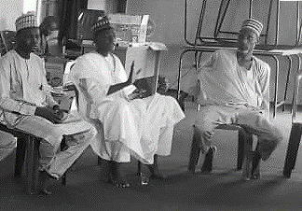
TARL - BLENDED LEARNING APPROACH
Orientation of State Universal Basic Education Boards (SUBEBs), Ministry of Religious Affairs (MORA), Master trainers & School Based Management Committees (SBMCs)
GOAL: Introduce remote learning approach, their roles and responsibilities to it. It lasted for only 2 hours
TaRL Programme Teams

Slide 9
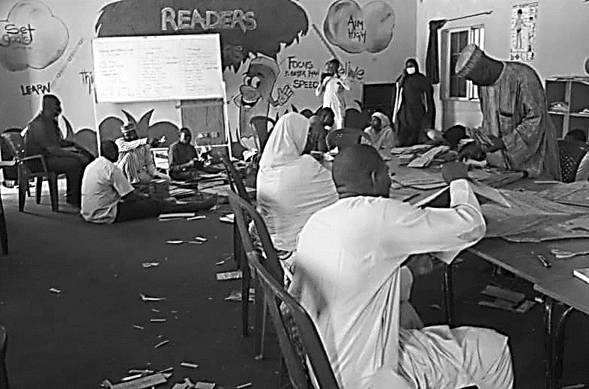
TARL - BLENDED LEARNING APPROACH
Material development packaging and distribution lasted for 11 days. Low cost as no budget for the pilot.
GOAL: Ensure materials are in the hands of every learner.
Master Trainers (MTs), Mentors, School-Based Management Committees (SBMCs) and partners representatives developed TaRL Learning Materials (TLMs). Each pack contained:
Pen
Notebooks
Flash cards
worksheets and
Assessment sheets

Slide 10
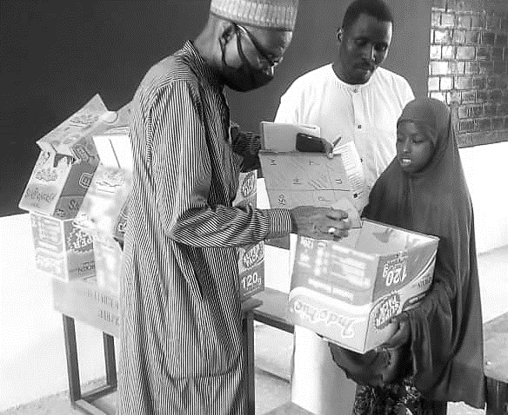
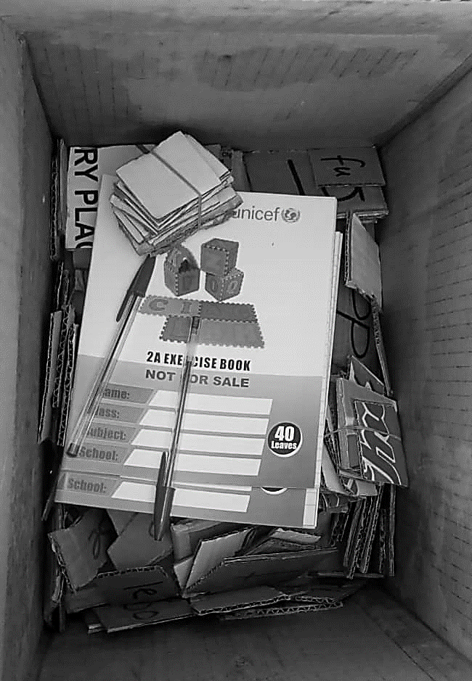
TARL - BELENDED LEARNING APPROACH
Material Distribution by SBMCs
A parcel with worksheets & assessment sheets to a learner.

Slide 11
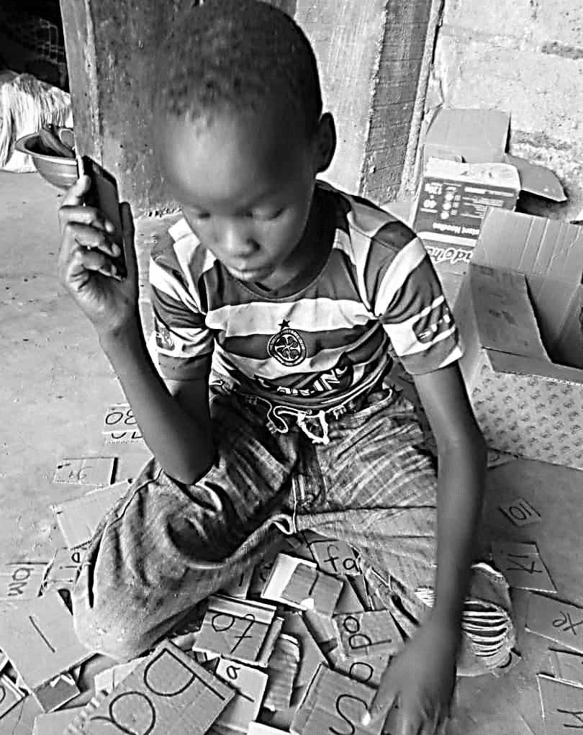
TARL - BELNDED LEARNING APPROACH
Remote Assessment
Assessment is the backbone of the TaRL approach. It is purely assessment for learning:
Use a quick non-threatening ONE-ON-ONE ASSESSMENT of every child to determine the current reading and math levels of children.
Once the instructor has heard every child read or try to read, she/he is aware of who is stumbling at which stage and why.

Slide 12
TARL REMOTE LEARNING – BASELINE & ENDLINE RESULTS
Baseline Assessment Results
Key Figures
There results below show that the greatest needs of the learners are in literacy and operations for numeracy
71% of the assessed learners are non-readers, they cannot sound letters of the alphabet, 25% are those whose highest level of competency was at word reading and only 4% at paragraph and story fluency in reading.
327
Key Figures
3 schools
(2 Formal & 1 IQE)
in 2 LGEAs
1 Government
Teachers
(P4 - P6)
Baseline Assessment Results
Literacy
Beginner Level: Little or no knowledge of Alphabet
Word & Para Level: Little knowledge in words & fluency
Story Level: Little knowledge in Comprehension
Numeracy
1-digit level
2-digit level
3-digit level

Slide 13
TARL REMOTE LEARNING – BASELINE & ENDLINE RESULTS

Slide 14
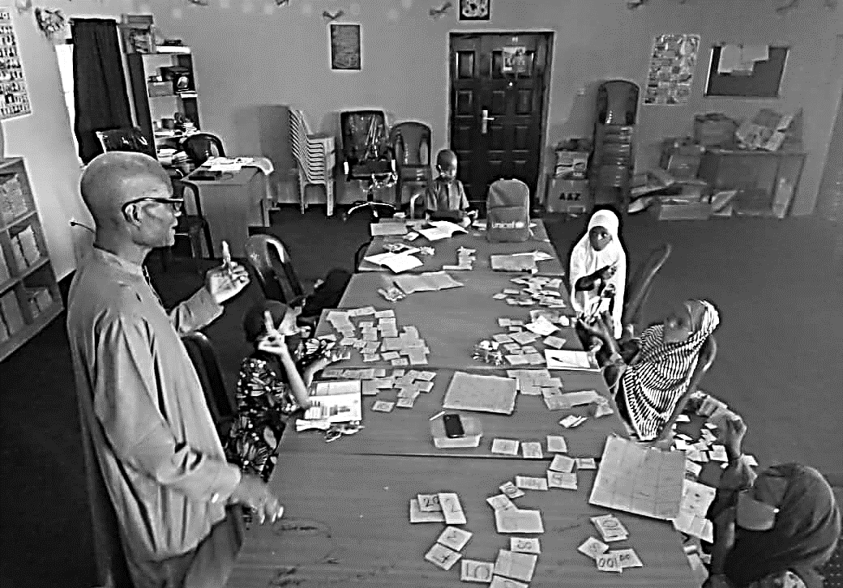
TARL - BLENDED LEARNING APPROACH
Methodology
Activities are engaging, fun, and creative focusing on building strong foundational skills- ability to read, write, express and do basic math.
Child-Centered, Multifaceted, Lively and Relatable.

Slide 15
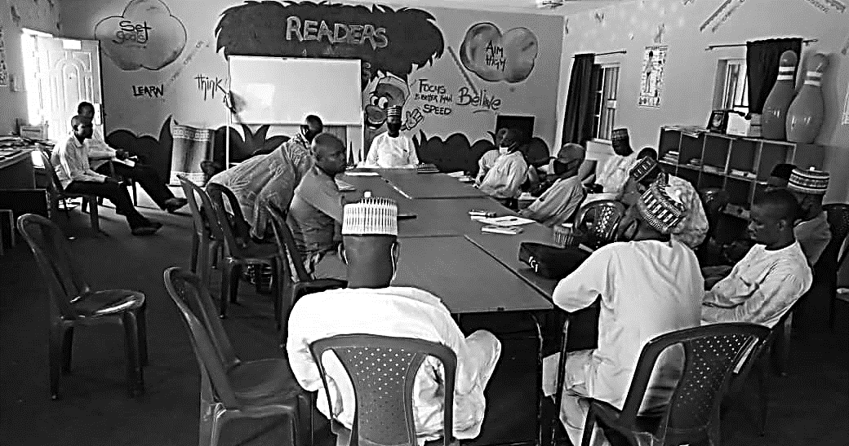
TARL –BLENDED LEARNING APPROACH
Monitoring Measures
To check if the plan is going on as planned: Data quality checks, evaluation questions and voice recordings on publicity and data collection were the monitoring devices used by the consortium during this period.
Review meetings for feedback.

Slide 16




CHALLENGES AND LESSON LEARNED SO FAR…
It was effective in reestablishing a sense of normalcy for children beyond education outcomes: Life saving interventions: Psychosocial Support (PSS), COVID -19 sensitization etc.
It mitigated learning lost and provided alternative modality and various mixes of no ,low and high-tech solutions.
It proved very effective in ensuring that children remain engaged to learning and motivated to return to school after the lockdown. Over 90 % return of learners to TaRL classes after lockdown was recorded
Effectiveness of Remote Learning : Difficult to target specific level. Possibility of assistance by caregivers.
Equity issues: not all learners have access to cell phones or radios. Hence reading hubs for a group of 10-15 learners to use a cell phone/radio
Education not seen as life saving interventions during pandemics/emergencies: Fear of accelerated transmission
CHALLENGES
LESSON LEARNED

Slide 17
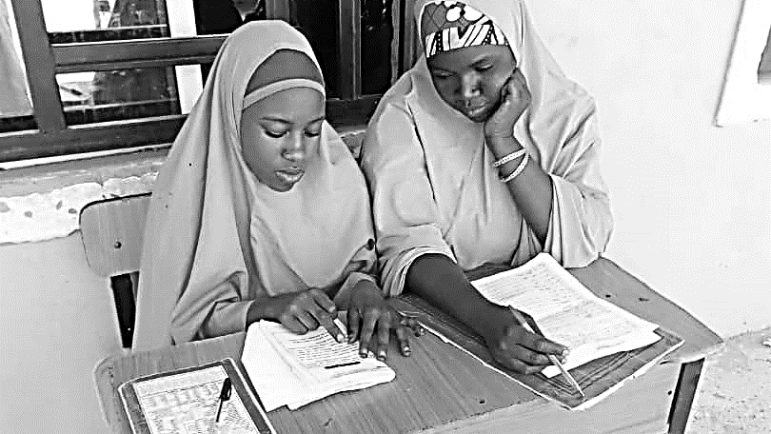
NEXT STEPS
Enhance the remote learning system to serve as a platform for other key services including health, nutrition, child protection, and water and sanitation for children.
To build on the innovative solutions generated by the response to school closures to make education systems more resilient.
Reinforcing focus on equity and inclusion in remote learning innovations.

Slide 18
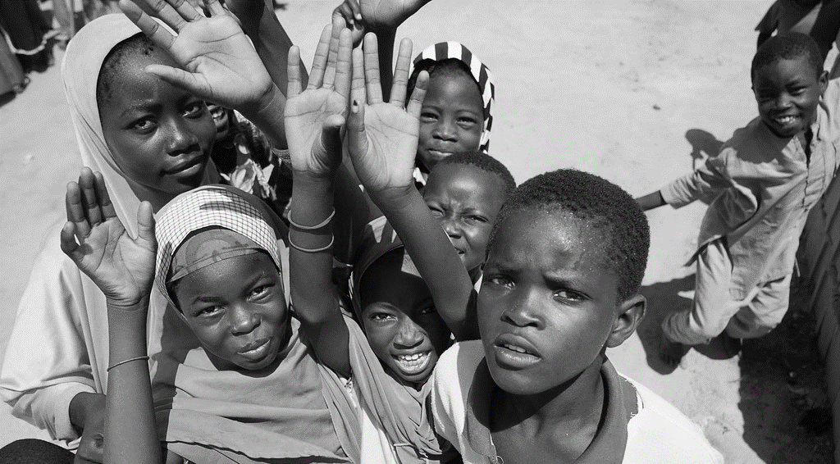
THANK YOU FOR LISTENING

