Slide 1
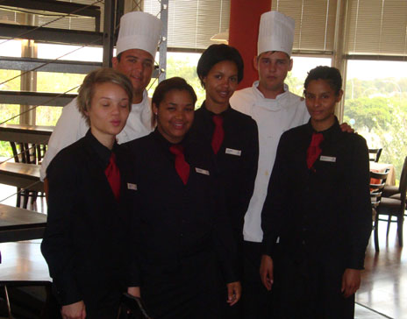
Vocational Education and Training for Development
Simon McGrath

Slide 2
What are the Issues?
We are seeing a major shift back to an interest in VET-for-development but there is a risk that past critiques are not being addressed
Current VET-for-development policies and practices are weakly informed by understandings of the complex relationships between learning, working and living
VET-for-development is locked into an outdated model of development, and we need to build a new account
Challenge of linking VET to “Beyond 2015” agenda

Slide 3
The Return of VET-for-Development
UNESCO World Report, Skills GMR and Third International Congress
UNESCO Strategy, Inter-Agency Group, G20 and OECD work; sharp ODA rise; rise of new donors
Regional initiatives (e.g., SADC Strategy; next week’s Asia meeting)
Still largely couched in a youth unemployment “time bomb” rhetoric – cf. NCCK Report 45 years ago; Victoria Falls conference 20 years ago – new notion of NEETs
An avoidance of past critiques of public VET

Slide 4
The Complex Modes and Sites of Learning for Work and Lives
VET does not simply take place in public vocational schools and colleges for young people
It takes place in private providers and in complex public-private partnerships
It is found in “academic” schooling and in HE
It occurs in public, private and informal enterprises; in community and domestic spaces; and through new technologies
It is formal, non-formal and informal
It is lifelong and lifewide

Slide 5
The VET-for-Development Orthodoxy
Economic development is the ultimate goal of society
Skills lead to employability, which leads to jobs
Training leads to productivity, which leads to economic growth

Slide 6
Rethinking VET-for-Development
Development theory has moved on from this position
It is seen as environmentally unsustainable
Rise of broader developmental accounts. For instance:
Human Rights
Capabilities
Integrated Human Development (McGrath 2012)

Slide 7
A Human Rights Perspective
Tomasevski’s 4 As:
availability of provision at the systemic level;
access in practice;
acceptability in terms of quality, process and content; and
adaptability to the needs of individuals and groups. (Tomasevski 2001)
All can be applied to VET
Possibilities of a vision of VET for all based on a realisation of the multiple forms of vocational learning that individuals do and could access AND on a rights-based commitment to acceptability and adaptability

Slide 8
A Capabilities Perspective
Well-being and flourishing are the goals of development
Informed by social justice
Aggregate goals determined by public debate
Powell (2012) on South African FET capabilities:
learners’ voices
capabilities to choose and to aspire
VET should be about supporting VET that people value for their lives and livelihoods

Slide 9
An Integrated Human Development Perspective
Centred in Catholic Social Teaching
Human dignity is the core value
Crucial importance of the dignity of labour – cf. ILO’s decent work
VET is about promoting humanness – learning to be and to become – cf. UNESCO’s lifelong learning
VET is about developing character and values, as well as about learning narrow work skills – cf. Kerschensteiner and Dewey

Slide 10
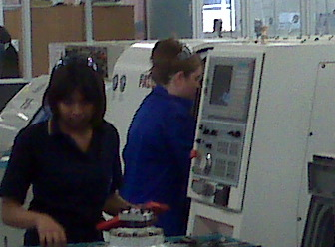
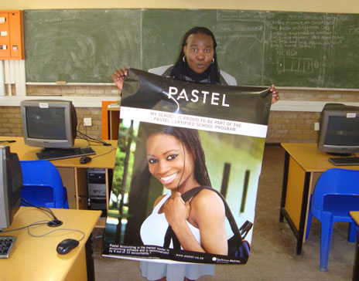
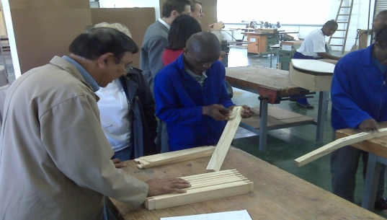
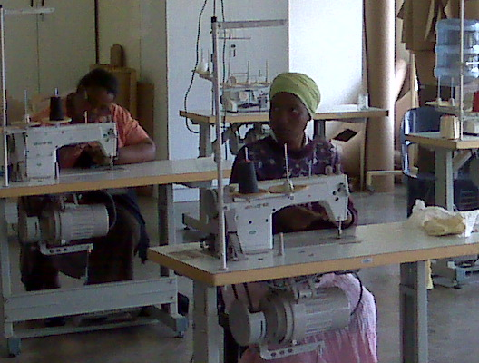
Conclusion
We need a new debate regarding the purposes, natures and possibilities of VET, which links to:
Emerging notions of development and ties into debates about global development policies “beyond 2015”;
A broad sense of the multiple sites and modes of learning and working;
A realisation that VET does not simply have economic purposes; and
A new commitment to listening to the voices of learners as key actors in the VET system.

